Slide 1
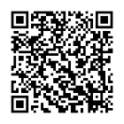
Autonomous Cyber-Physical Systems:
Course Introduction
Fall 2025: CS 513
Instructor: Jyo Deshmukh
Course website: https://shorturl.at/p1ErK
Course materials: https://shorturl.at/inv8N

Slide 2
What is a Cyber-Physical System?
Different ways to answer this question!
Wikipedia: A Cyber-Physical system (CPS) is a mechanism controlled or monitored by software algorithms.
NSF: engineered systems built from, and depending upon, the seamless integration of algorithms and physical components
From a historical perspective CPS combines elements of cybernetics, mechatronics, control theory, process science, embedded systems, distributed control, and more recently communication.
One common saying: CPS = Control + Computation + Communication

Slide 3
Our focus on CPS in this course
Control
Systems where the behavior of the physical components is strongly influenced by the software components
Systems where there the communication between the physical component and the software component may be direct or through a network
Systems in which the primary role played by software is control (in contrast to passive monitoring)
Communi-cation
Computation
CPS

Slide 4
One view of a CPS
Actuators
Physical component
Sensors
Environment/Plant
Communication Network
Controller
(Some embedded code)

Slide 5
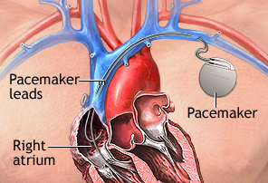
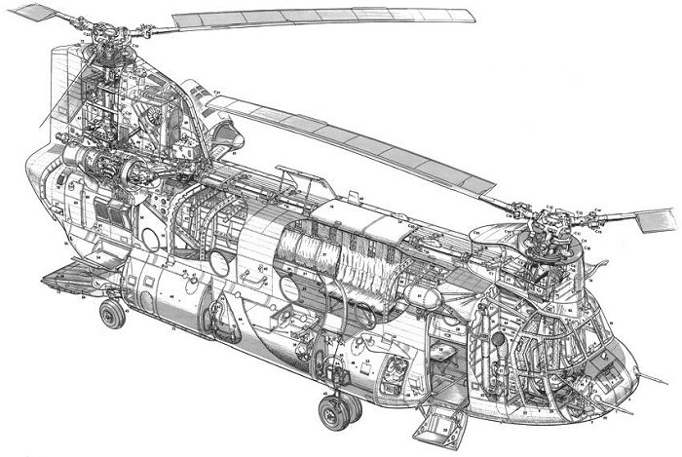
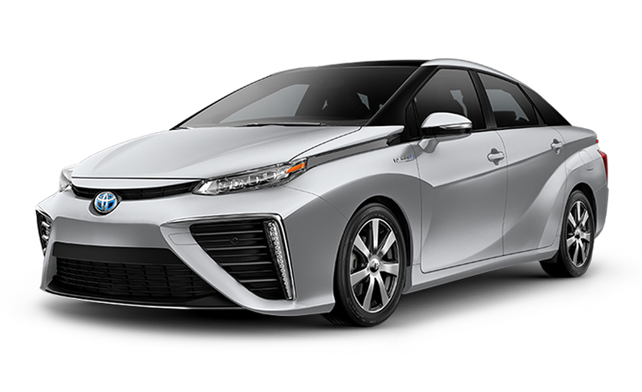
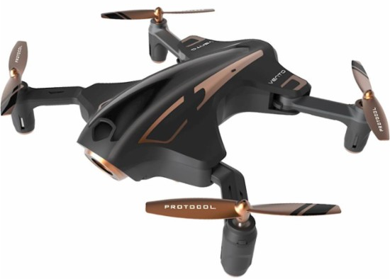
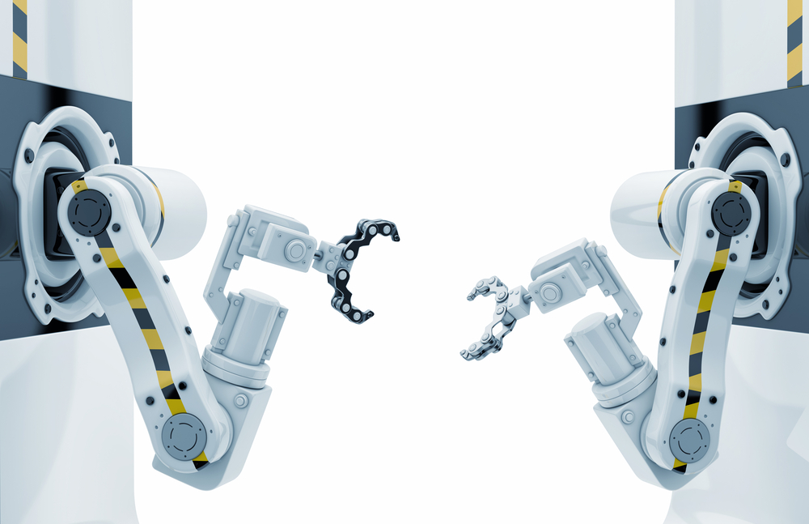
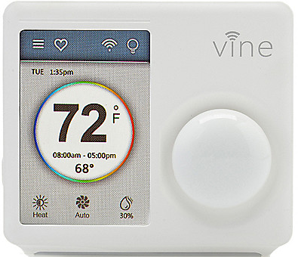
Examples
[All images from Google image search]

Slide 6
What’s an autonomous CPS?
Autonomous: without the need for human intervention or control
Autonomous CPS = CPS with no human operator!
Semi-autonomous: CPS with autonomy under specific conditions but requiring a human operator otherwise.
Today, several CPS examples are semi-autonomous, and getting to fully autonomous

Slide 7
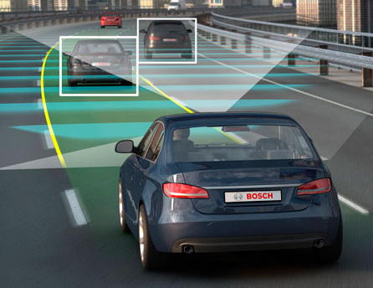
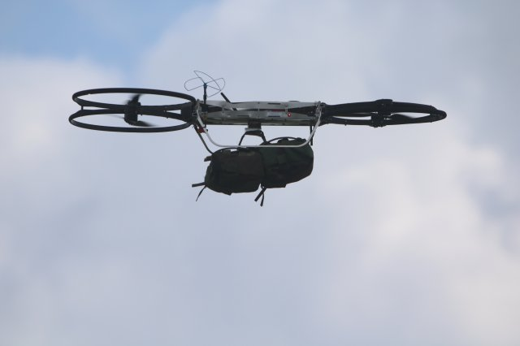
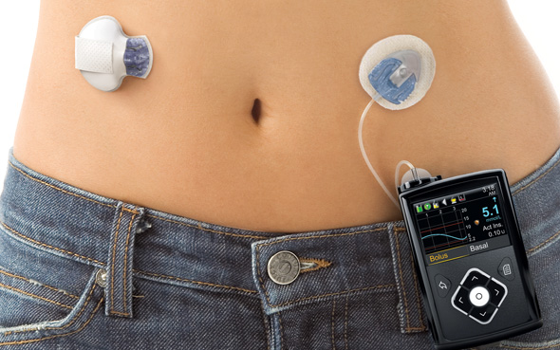
Autonomous/Semi-autonomous CPS
Image credit: Motor Authority
Image credit: army.mil
Image credit: Google images

Slide 8
Course Objectives
Gain basic familiarity with CPS topics
  Computational models
  Control algorithms
  Ingredients for autonomy
  Challenge Problems/Case studies
Model-Based Software Development Paradigm for CPS
  Developing models for physical components + software + communication
Software Engineering: Writing checkable requirements and tests
Software testing for CPS
Learn autonomous software stack through case studies in autonomy

Slide 9
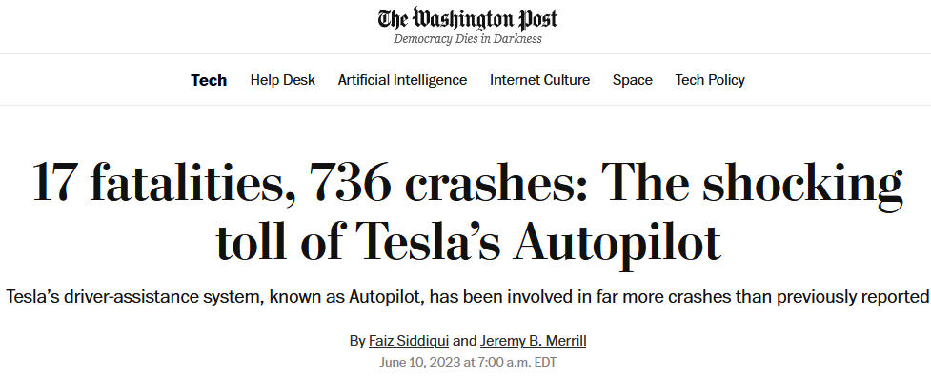
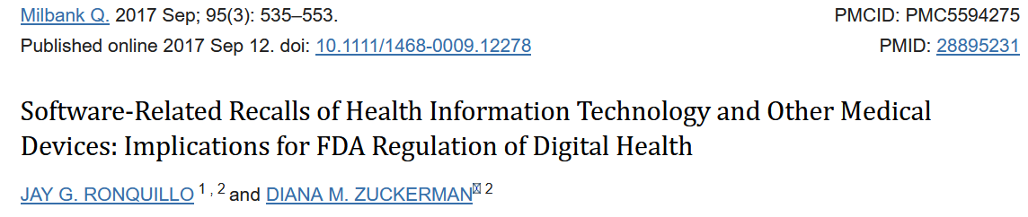
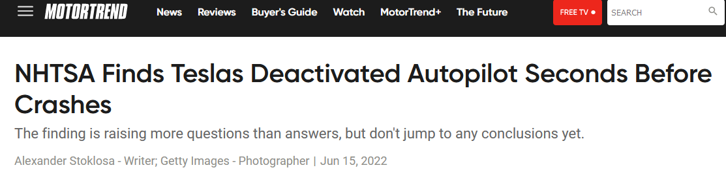
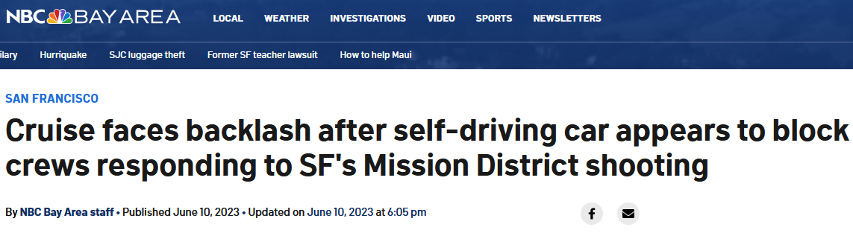
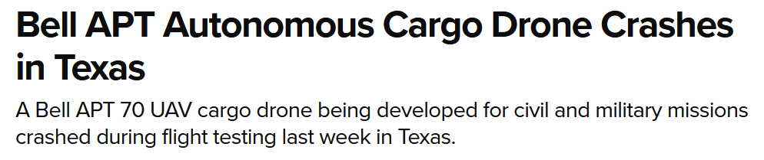
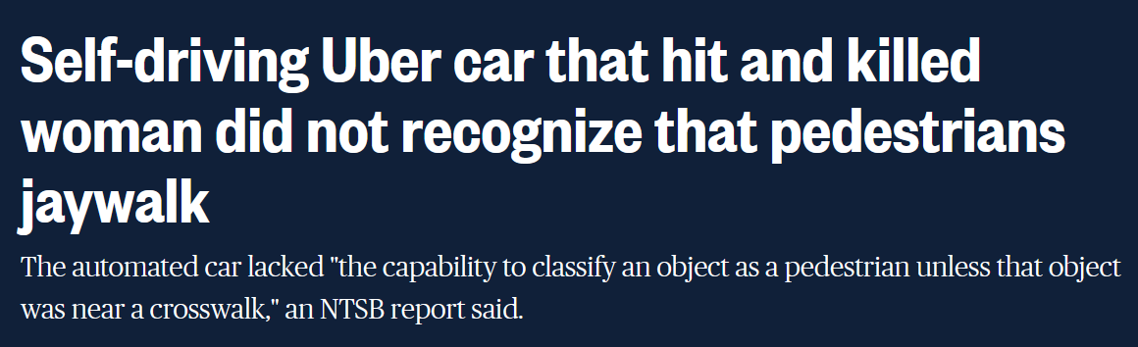
Key theme of the course: Safe Autonomy
ACPS are safety-critical, and/or mission-critical with huge implications on human health, well-being, economy, etc.

Slide 11
Course Overview
Part I: Models of Computation, Model-based Control Design
  Synchronous & Asynchronous Models, Timed Models, Dynamical System Models, Hybrid Models, Basics of Control
Part II: Safety: Specifications, Monitoring, Test Generation, Verification
  Temporal Logic, Test Generation, Falsification
Part III: Ingredients of Autonomy
  Basics of modern perception, planning, decision-making, reinforcement learning

Slide 12
How will we evaluate ourselves?
3 Written Homework Assignments
  Focus on theory
2 Mini-Projects
  Learn how to code the controller for a self-driving car subsystem
  Learn how to use a vision-based perception module as a sensor
Class Project

Slide 13
Class Project
Details at: https://shorturl.at/YY8j1
Purpose:
  Freedom to choose your own advanced application
  Write formal requirements
  Generate tests/proofs using verification/falsification/test generation
  Show the application of formal reasoning
Expected outcome:
  Model the environment/deployment scenario for an ACPS application
  Design the autonomous software stack for an ACPS
  Demonstrate that it works
  Show a test/verification/assurance strategy

Slide 14
Example Projects (do not have to pick any of these)
Design an eVTOL to follow a specific route plan (specified formally)
Vehicle model and controller to automatically change lanes
Explore multi-vehicle simulators for collaborative merging, autonomous intersection control
Traffic simulator for vehicle platooning
Create a model of the human heart and design a pacemaker
More ideas on the Project Resources page!

Slide 15
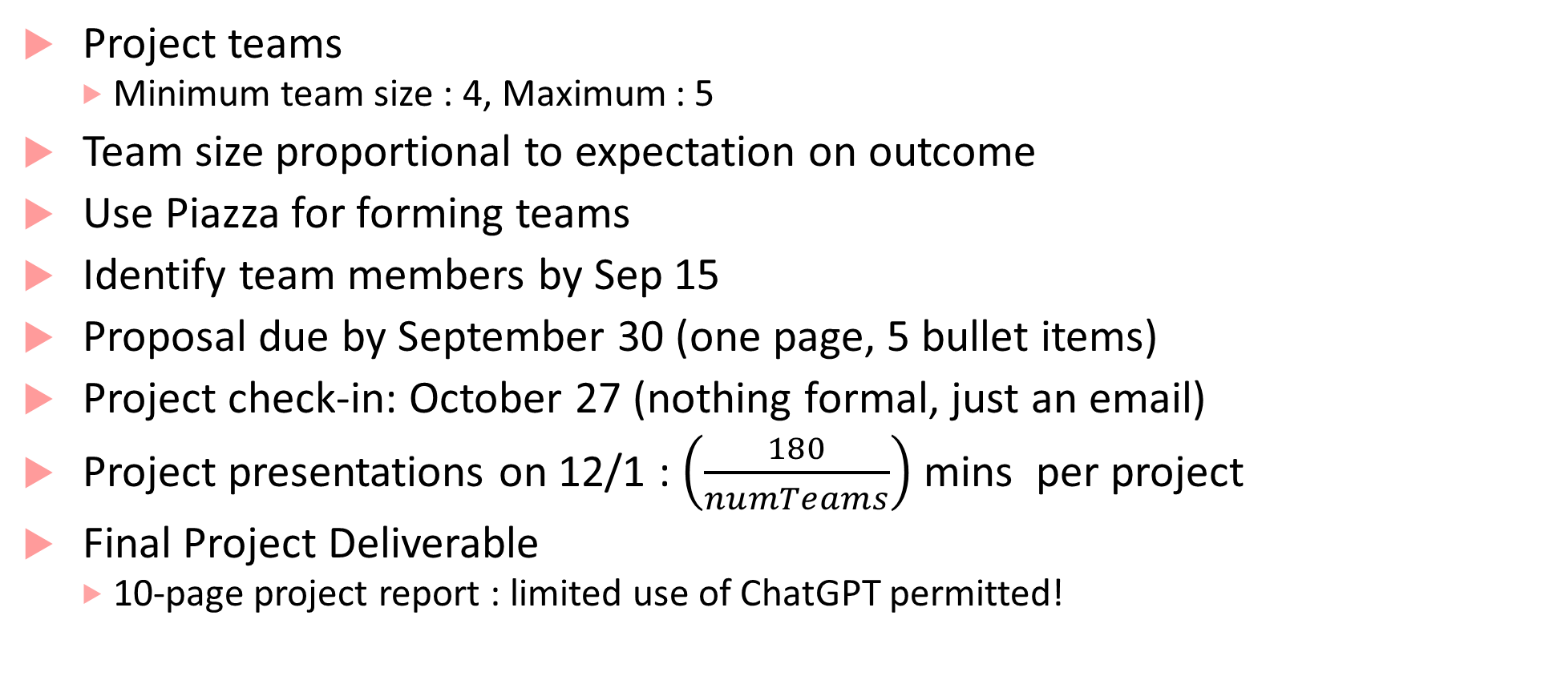
Project Timeline
Project teams
  Minimum team size : 4, Maximum : 5
Team size proportional to expectation on outcome
Use Piazza for forming teams
Identify team members by Sep 15
Proposal due by September 30 (one page, 5 bullet items)
Project check-in: October 27 (nothing formal, just an email)
Project presentations on 12/1 :$\left(\frac{180}{numTeams}\right)$mins per project
Final Project Deliverable
  10-page project report : limited use of ChatGPT permitted!

Slide 16
Grading and Evaluation Breakdown
Assignments: 40% (13+13+14)
Mini-Projects: 30% (15x2)
Project: 25%
  Proposal: ungraded
  Final Report: 10% (talk) , 15% (final report or demo)
Class participation: 5%
  Q&A, Project engagement, Office hours, …

Slide 17
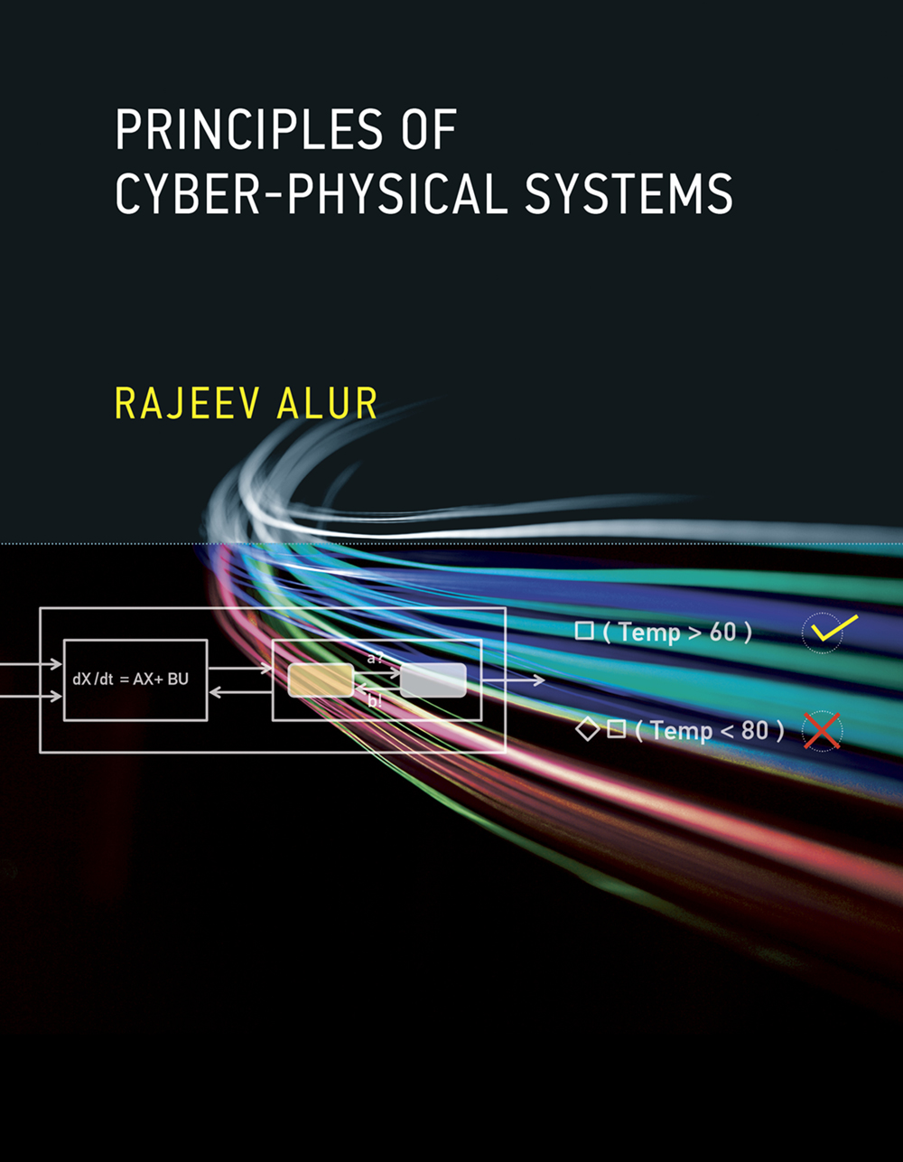
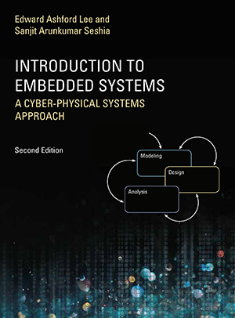
Textbooks: None. Supplementary reading:
Principles of Cyber-Physical Systems by Rajeev Alur
$56-63 on Amazon
Free e-book available on USC libraries
Introduction to Embedded Systems: A CPS approach
- Free at: https://ptolemy.berkeley.edu/books/leeseshia/

Slide 18
Office Hours, Class Timings
Class Timing: 2:00-5:20
First 5 mins: recap of last lecture + outline of this lecture + announcements
Last 20 mins: optional questions, discussions, etc.
Office Hours: Monday, 11:00am-12:00pm (or by appointment)
TAs: Sheryl Paul, Vidisha Kudalkar, Jeremy Morgan
  Office Hours: TBD

Slide 19
Logistics
Piazza:
This term we will be using Piazza for class discussion. The system is highly catered to getting you help fast and efficiently from classmates, the TAs, and myself. Rather than emailing questions to the teaching staff, post your questions on Piazza.
Find our class page at: https://piazza.com/usc/fall2025/cs513

Slide 20
Questions?

