Slide 1
Autonomous Cyber-Physical Systems:
Stability Analysis for Nonlinear Dynamical Systems
Hybrid Dynamical Systems
Fall 2024. CS 513.
Instructor: Jyo Deshmukh
Acknowledgment: Some of the material in these slides is based on the lecture slides for CIS 540: Principles of Embedded Computation taught by Rajeev Alur at the University of Pennsylvania. http://www.seas.upenn.edu/~cis540/
This lecture also uses some other sources, full bibliography is included at the end of the slides.

Slide 2
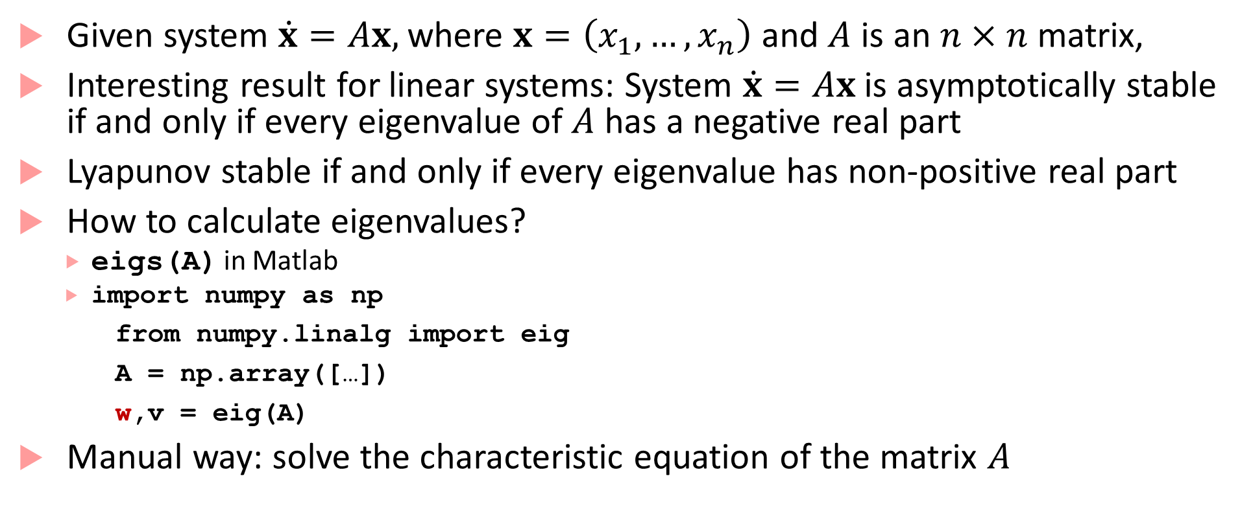
Stability Analysis for Linear Systems
Given system $\dot{x}=Ax,$where $x=\left(x_{1},…, x_{n}\right)$ and $A$ is an $n×n$matrix,
Interesting result for linear systems: System $\dot{x}=Ax$ is asymptotically stable if and only if every eigenvalue of $A$ has a negative real part
Lyapunov stable if and only if every eigenvalue has non-positive real part
How to calculate eigenvalues?
  eigs(A) in Matlab
  import numpy as np
from numpy.linalg import eig
A = np.array([…])
w,v = eig(A)
Manual way: solve the characteristic equation of the matrix $A$

Slide 3
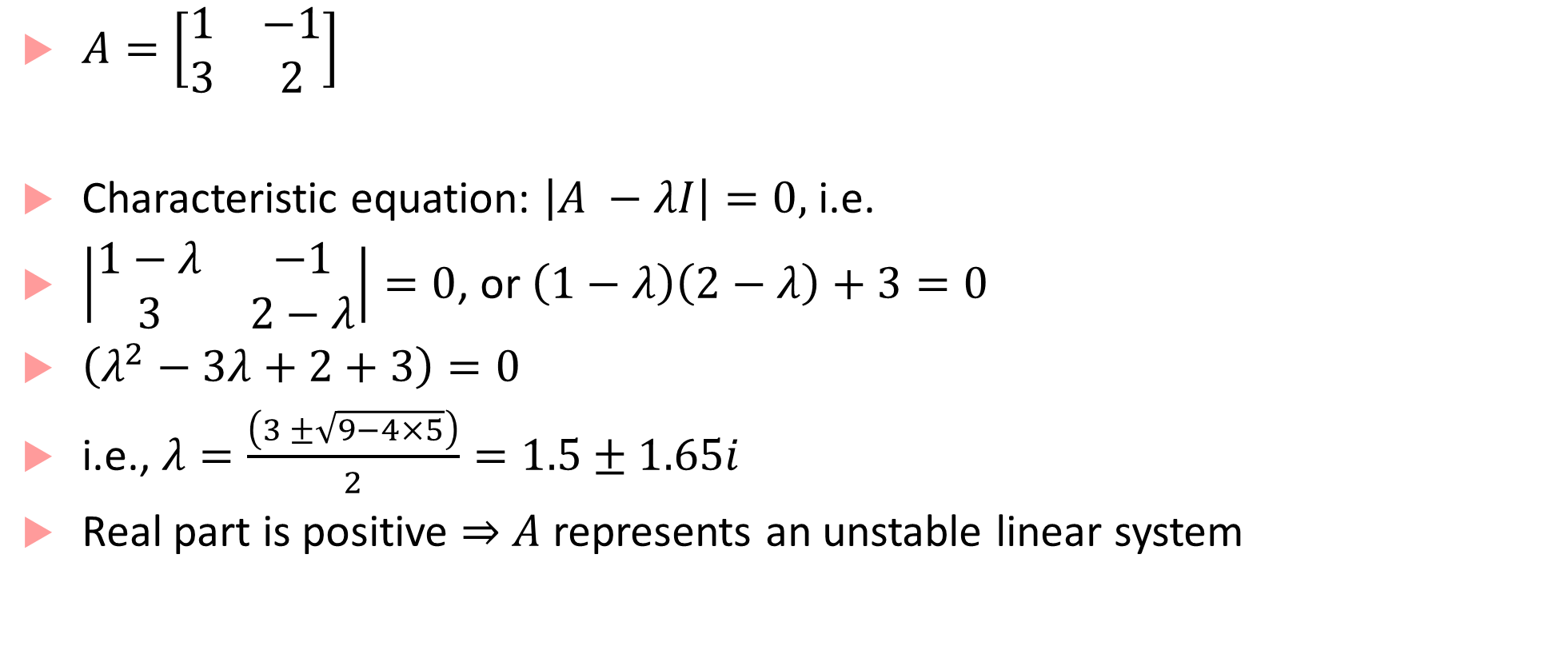
Stability analysis example for linear systems
$A=\left[\begin{matrix}1 & −1 \\ 3 & 2\end{matrix}\right]$
Characteristic equation: $\left|A −λI\right|=0,$ i.e.
$\left|\begin{matrix}1−λ & −1 \\ 3 & 2−λ\end{matrix}\right|=0$, or $\left(1−λ\right)\left(2−λ\right)+3=0$
$\left(λ^{2}−3λ+2+3\right)=0$
i.e., $λ=\frac{\left(3 ±\sqrt{9−4×5}\right)}{2}=1.5±1.65i$
Real part is positive $⇒$ $A$ represents an unstable linear system

Slide 4
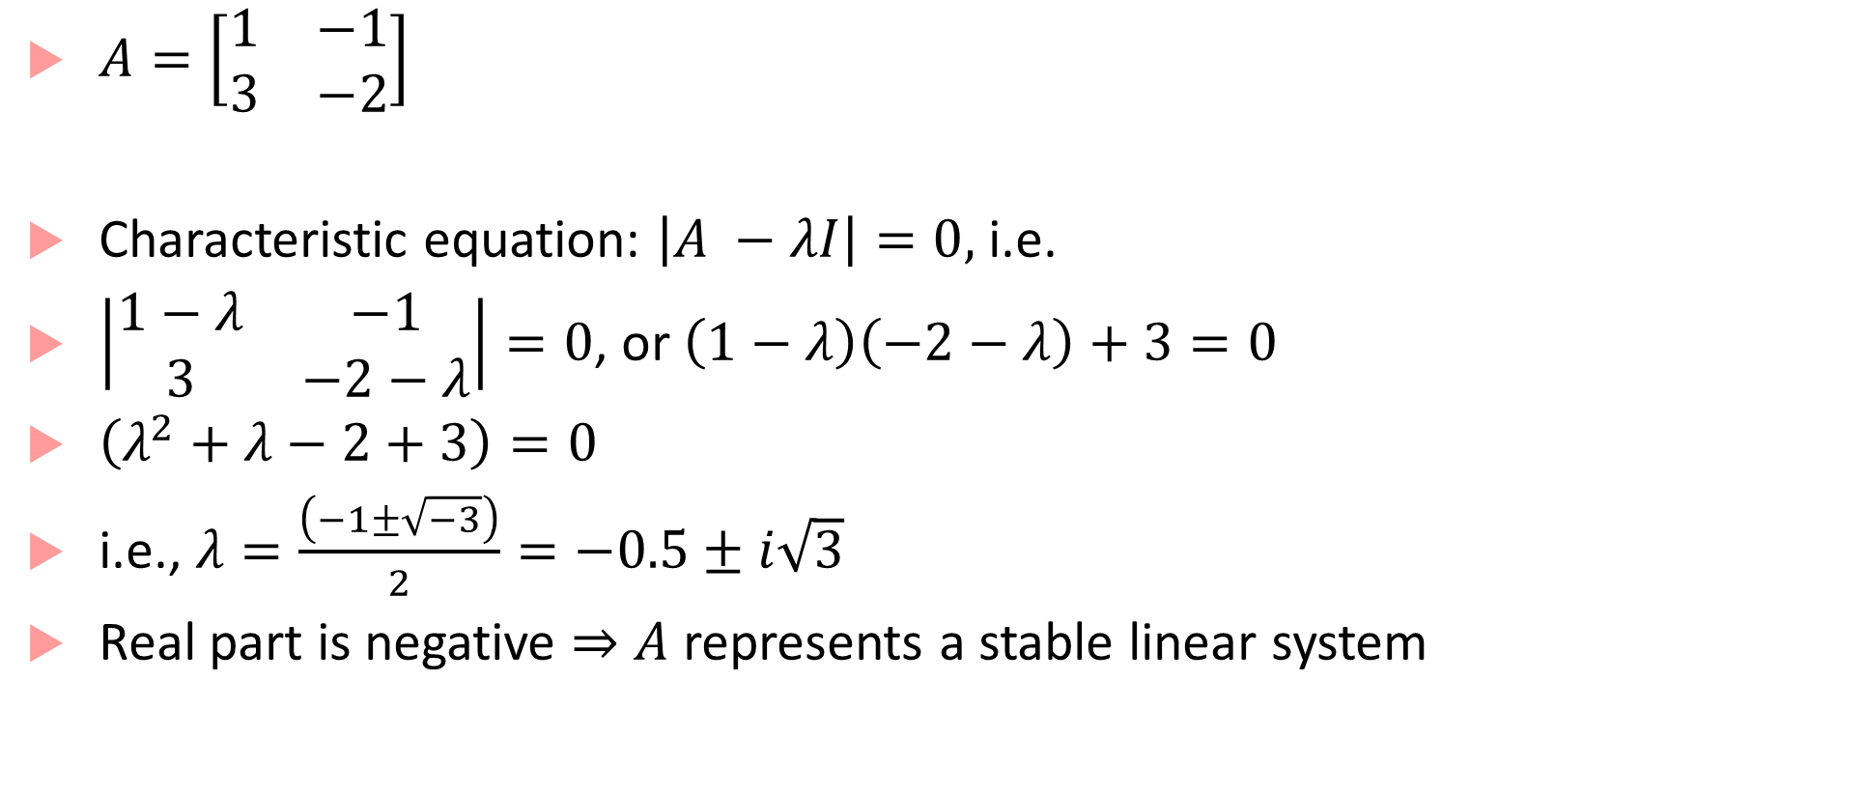
Stability analysis example for linear systems
$A=\left[\begin{matrix}1 & −1 \\ 3 & −2\end{matrix}\right]$
Characteristic equation: $\left|A −λI\right|=0,$ i.e.
$\left|\begin{matrix}1−λ & −1 \\ 3 & −2−λ\end{matrix}\right|=0$, or $\left(1−λ\right)\left(−2−λ\right)+3=0$
$\left(λ^{2}+λ−2+3\right)=0$
i.e., $λ=\frac{\left(−1±\sqrt{−3}\right)}{2}=−0.5±i\sqrt{3}$
Real part is negative $⇒$ $A$ represents a stable linear system

Slide 5


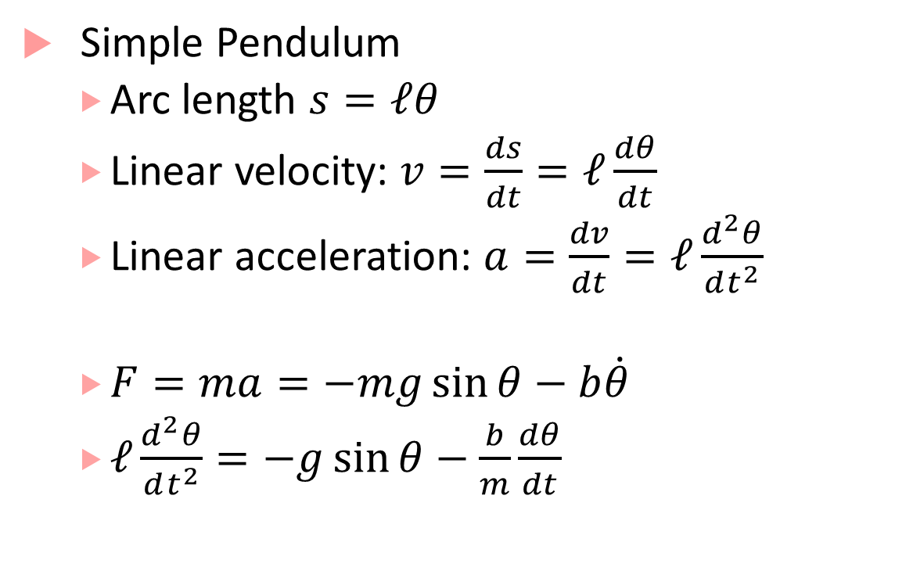



Nonlinear Dynamical System
Simple Pendulum
  Arc length $s=ℓθ$
  Linear velocity: $v=\frac{ds}{dt}=ℓ\frac{dθ}{dt}$
  Linear acceleration: $a=\frac{dv}{dt}=ℓ\frac{d^{2}θ}{dt^{2}}$
  $F=ma=−mg\sin{θ}−b\dot{θ}$
  $ℓ\frac{d^{2}θ}{dt^{2}}=−g\sin{θ}−\frac{b}{m}\frac{dθ}{dt}$
$$θ$$
$$ℓ$$
$$mg\sin{θ}$$
Friction
$$mg\cos{θ}$$
$$mg$$

Slide 6
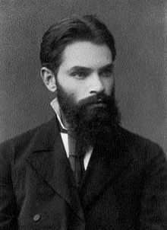
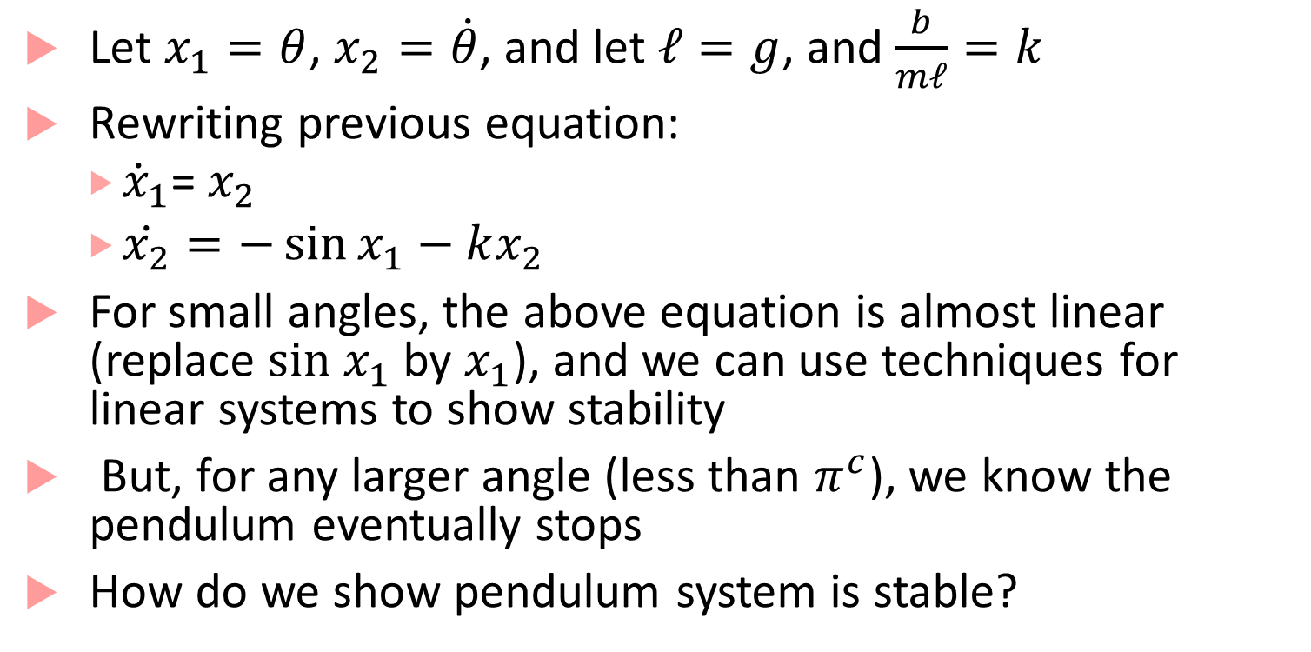
Simple Pendulum Dynamics
Aleksandr Lyapunov
Russian mathematician
Let $x_{1}=θ$, $x_{2}=\dot{θ}$, and let $ℓ=g$, and $\frac{b}{mℓ}=k$
Rewriting previous equation:
  ${\dot{x}}_{1}$= $x_{2}$
  $\dot{x_{2}}=−\sin{x_{1}}−kx_{2}$
For small angles, the above equation is almost linear (replace $sin x_{1}$ by $x_{1}$), and we can use techniques for linear systems to show stability
But, for any larger angle (less than $π^{c}$), we know the pendulum eventually stops
How do we show pendulum system is stable?
Use my method!!

Slide 7
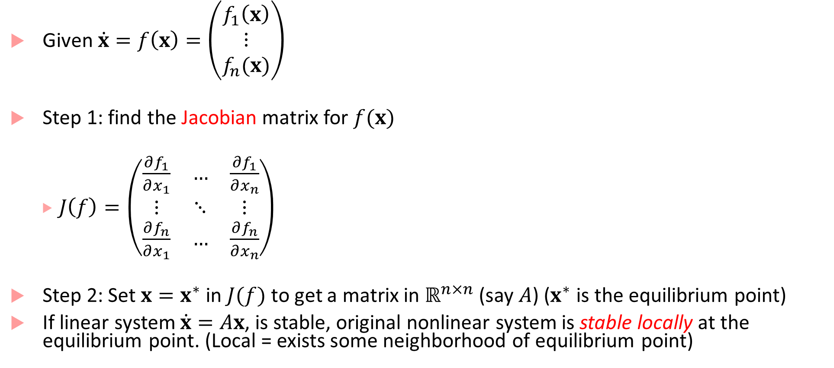
Lyapunov’s first method
Given $\dot{x}=f\left(x\right)=\left(\begin{matrix}f_{1}\left(x\right) \\ \begin{matrix}⋮ \\ f_{n}(x)\end{matrix}\end{matrix}\right)$
Step 1: find the Jacobian matrix for $f(x)$
  $J\left(f\right)=\left(\begin{matrix}\frac{∂f_{1}}{∂x_{1}} & … & \frac{∂f_{1}}{∂x_{n}} \\ ⋮ & ⋱ & ⋮ \\ \frac{∂f_{n}}{∂x_{1}} & … & \frac{∂f_{n}}{∂x_{n}}\end{matrix}\right)$
Step 2: Set $x=x^{∗}$ in $J(f)$ to get a matrix in $ℝ^{n×n}$ (say $A$) ($x^{∗}$ is the equilibrium point)
If linear system $\dot{x}=Ax$, is stable, original nonlinear system is stable locally at the equilibrium point. (Local = exists some neighborhood of equilibrium point)

Slide 8
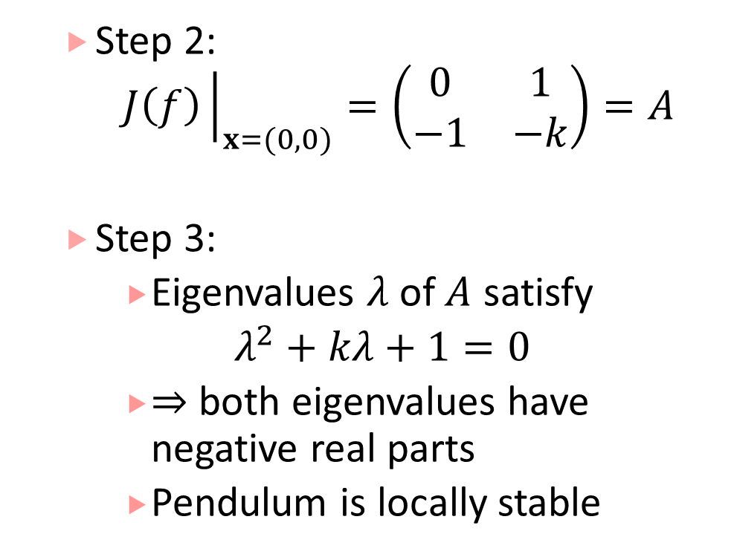
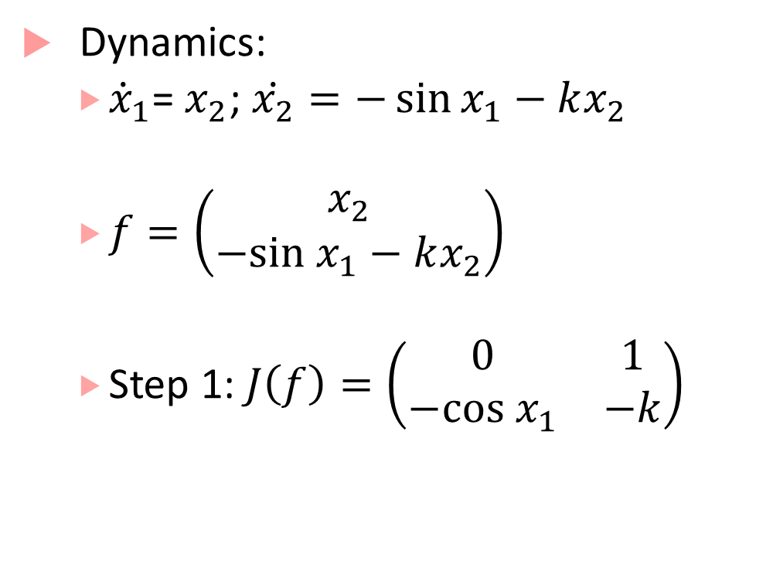
Lyapunov’s first method for pendulum
Dynamics:
  ${\dot{x}}_{1}$= $x_{2}$; $\dot{x_{2}}=−\sin{x_{1}}−kx_{2}$
  $f=\left(\begin{matrix}x_{2} \\ −sin x_{1}−kx_{2}\end{matrix}\right)$
  Step 1: $J\left(f\right)=\left(\begin{matrix}0 & 1 \\ −cos x_{1} & −k\end{matrix}\right)$
  Step 2:
    $$J\left(f\right){\left.​\right|}_{x=(0,0)}=\left(\begin{matrix}0 & 1 \\ −1 & −k\end{matrix}\right)=A$$
  Step 3:
    Eigenvalues $λ$of $A$ satisfy
    $λ^{2}+kλ+1=0$
    $⇒$ both eigenvalues have negative real parts
    Pendulum is locally stable

Slide 9
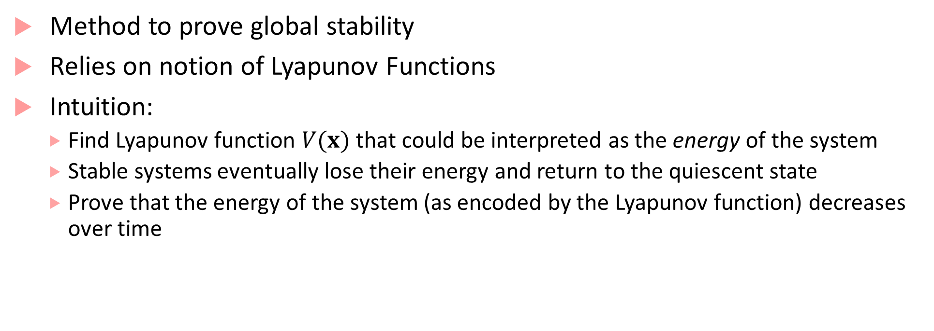
Lyapunov’s second method
Method to prove global stability
Relies on notion of Lyapunov Functions
Intuition:
  Find Lyapunov function $V(x)$ that could be interpreted as the energy of the system
  Stable systems eventually lose their energy and return to the quiescent state
  Prove that the energy of the system (as encoded by the Lyapunov function) decreases over time

Slide 10
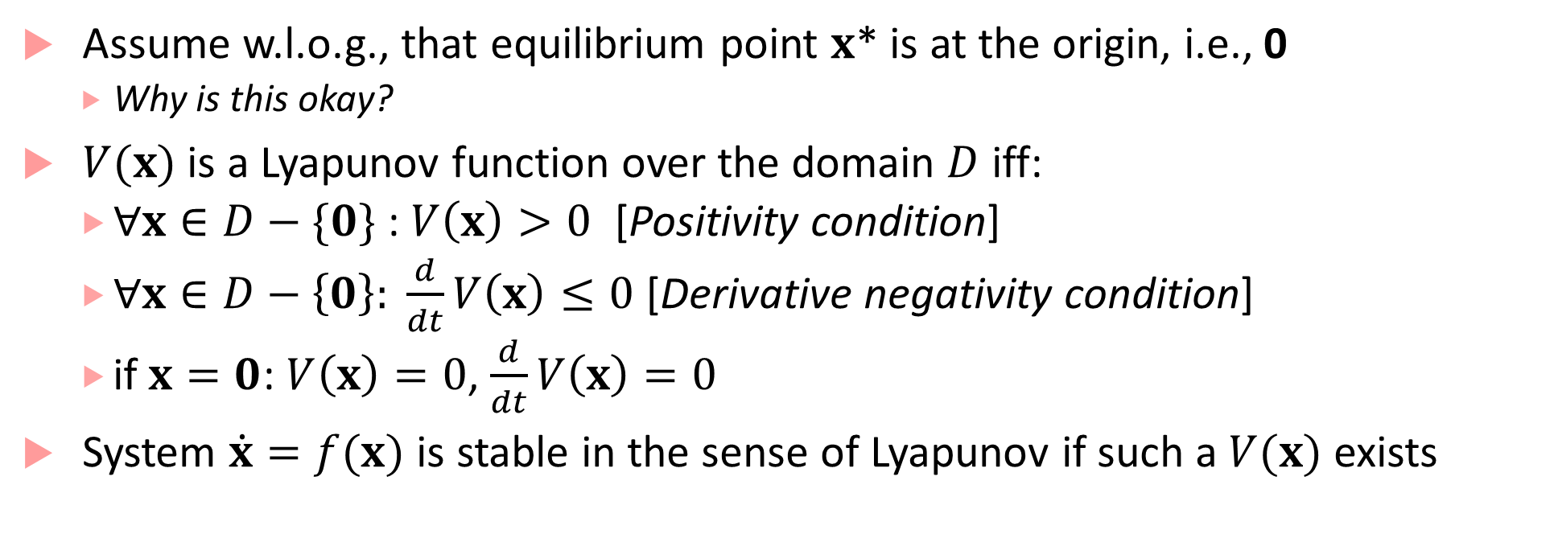
Lyapunov’s Second Method: the math
Assume w.l.o.g., that equilibrium point $x$* is at the origin, i.e., 0
  Why is this okay?
$V(x)$ is a Lyapunov function over the domain $D$ iff:
  $∀x∈D−\{0\}$ : $V\left(x\right)>0$ [Positivity condition]
  $∀x∈D−\left\{0\right\}: \frac{d}{dt}V\left(x\right)≤0$ [Derivative negativity condition]
  if $x=0$: $V\left(x\right)=0$, $\frac{d}{dt}V\left(x\right)=0$
System $\dot{x}=f(x)$ is stable in the sense of Lyapunov if such a $V(x)$ exists

Slide 11






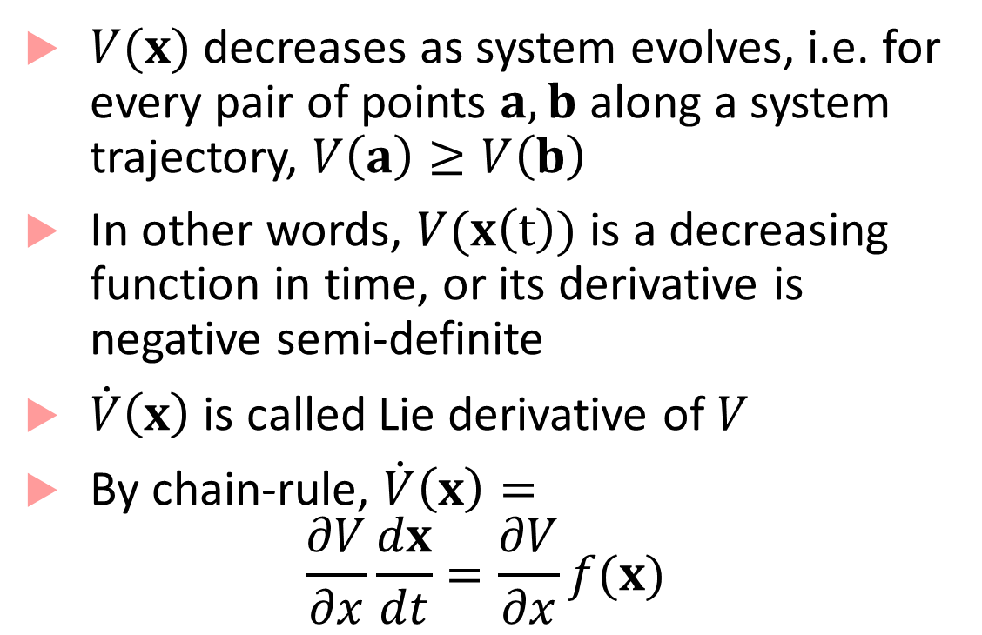



Illustration and Lie-derivative
$$x_{2}$$
$V(x)$ decreases as system evolves, i.e. for every pair of points $a,b$ along a system trajectory, $V\left(a\right)≥V\left(b\right)$
In other words, $V(x\left(t\right))$ is a decreasing function in time, or its derivative is negative semi-definite
$\dot{V}\left(x\right)$ is called Lie derivative of $V$
By chain-rule, $\dot{V}\left(x\right)=$
$$\frac{∂V}{∂x}\frac{dx}{dt}=\frac{∂V}{∂x}f(x)$$
$$x(0)$$
$$0$$
$$x_{1}$$
$$a$$
$$V(a)$$
$$≥$$
$$b$$
$$V(b)$$

Slide 12
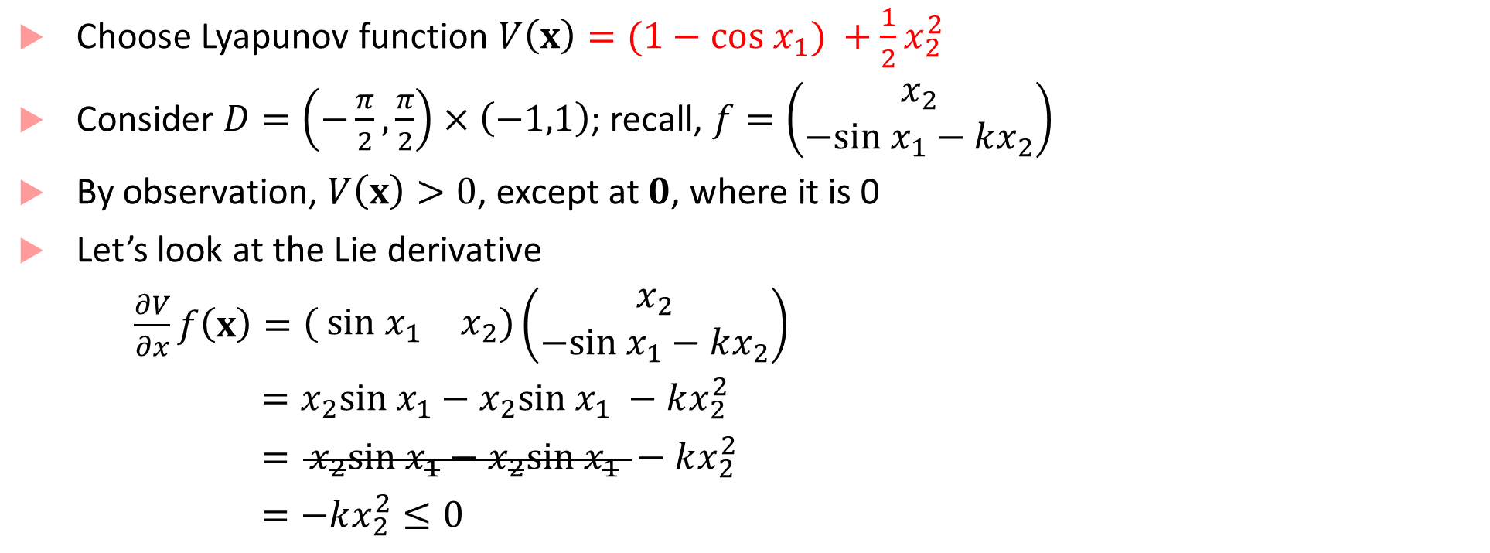
Lyapunov’s second method for pendulum
Choose Lyapunov function $V\left(x\right)=(1−cos x_{1}) +\frac{1}{2}x_{2}^{2}$
Consider $D=\left(−\frac{π}{2},\frac{π}{2}\right)×\left(−1,1\right)$; recall, $f=\left(\begin{matrix}x_{2} \\ −sin x_{1}−kx_{2}\end{matrix}\right)$
By observation, $V\left(x\right)>0$, except at $0$, where it is 0
Let’s look at the Lie derivative
$\frac{∂V}{∂x}f\left(x\right)=\left( \begin{matrix}{sin x}_{1} & x_{2}\end{matrix}\right)\left(\begin{matrix}x_{2} \\ −sin x_{1}−kx_{2}\end{matrix}\right)$
$=x_{2}sin x_{1}−x_{2}sin x_{1} −kx_{2}^{2}$
$= x_{2}sin x_{1}−x_{2}sin x_{1} −kx_{2}^{2}$
$=−kx_{2}^{2}≤0$

Slide 13
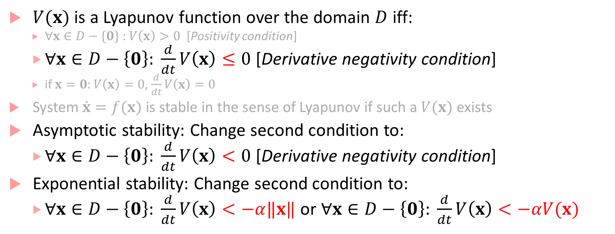
Second method for asymptotic/exponential stability
$V(x)$ is a Lyapunov function over the domain $D$ iff:
  $∀x∈D−\{0\}$ : $V\left(x\right)>0$ [Positivity condition]
  $∀x∈D−\left\{0\right\}: \frac{d}{dt}V\left(x\right)≤0$ [Derivative negativity condition]
  if $x=0$: $V\left(x\right)=0$, $\frac{d}{dt}V\left(x\right)=0$
System $\dot{x}=f(x)$ is stable in the sense of Lyapunov if such a $V(x)$ exists
Asymptotic stability: Change second condition to:
  $∀x∈D−\left\{0\right\}: \frac{d}{dt}V\left(x\right)<0$ [Derivative negativity condition]
Exponential stability: Change second condition to:
  $∀x∈D−\left\{0\right\}: \frac{d}{dt}V\left(x\right)<−α‖x‖$ or $∀x∈D−\left\{0\right\}: \frac{d}{dt}V\left(x\right)<−αV(x)$

Slide 14
Challenges with Lyapunov’s second method
How do we find a Lyapunov function?
  Maybe use the physics of the system to understand what encodes “energy”
  For certain nonlinear systems (those with polynomial dynamics), can some algorithmic methods
  In general a hard problem
Yet, is a powerful approach to prove global stability

Slide 15

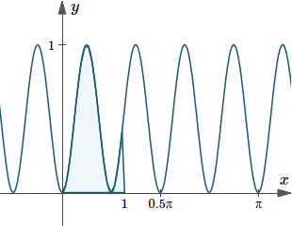

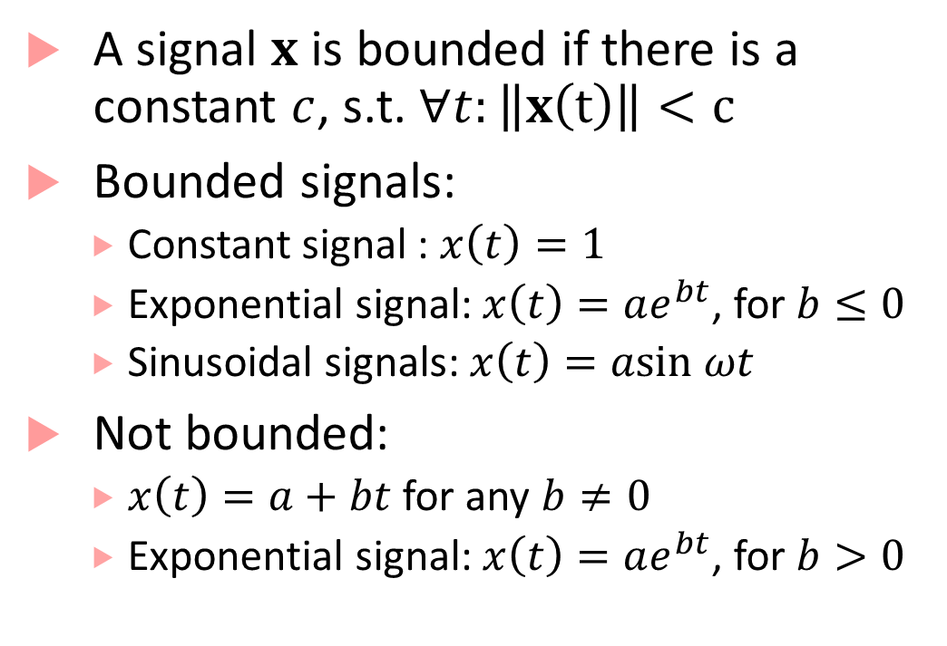









Bounded signals
A signal $x$ is bounded if there is a constant $c$, s.t. $∀t:\left\|x\left(t\right)\right\|<c$
Bounded signals:
  Constant signal : $x\left(t\right)=1$
  Exponential signal: $x\left(t\right)=ae^{bt}$, for $b≤0$
  Sinusoidal signals: $x\left(t\right)=asin ωt$
Not bounded:
  $x\left(t\right)=a+bt$ for any $b≠0$
  Exponential signal: $x\left(t\right)=ae^{bt}$, for $b>0$
$$‖x‖$$
$$‖x‖$$
$$t$$
$$t$$
$$‖x‖$$
$$‖x‖$$
$$t$$
$$‖x‖$$
$$t$$
$$t$$
This Photo by Unknown Author is licensed under CC BY-SA

Slide 16
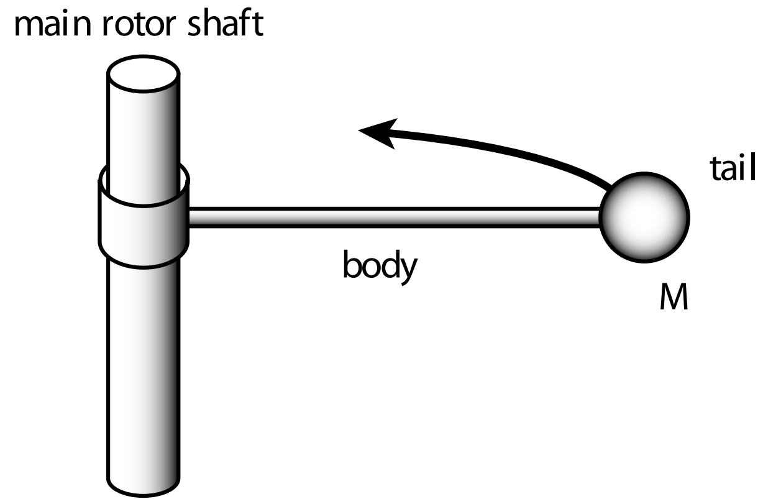
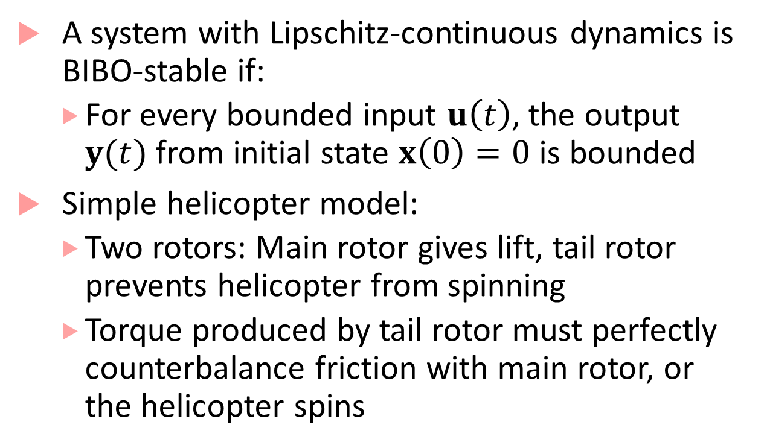
BIBO stability
A system with Lipschitz-continuous dynamics is BIBO-stable if:
  For every bounded input $u\left(t\right)$, the output $y(t)$ from initial state $x\left(0\right)=0$ is bounded
Simple helicopter model:
  Two rotors: Main rotor gives lift, tail rotor prevents helicopter from spinning
  Torque produced by tail rotor must perfectly counterbalance friction with main rotor, or the helicopter spins
Image credit: From Lee & Seshia: Introduction to Embedded Systems - A Cyber-Physical Systems Approach, http://leeseshia.org/

Slide 17
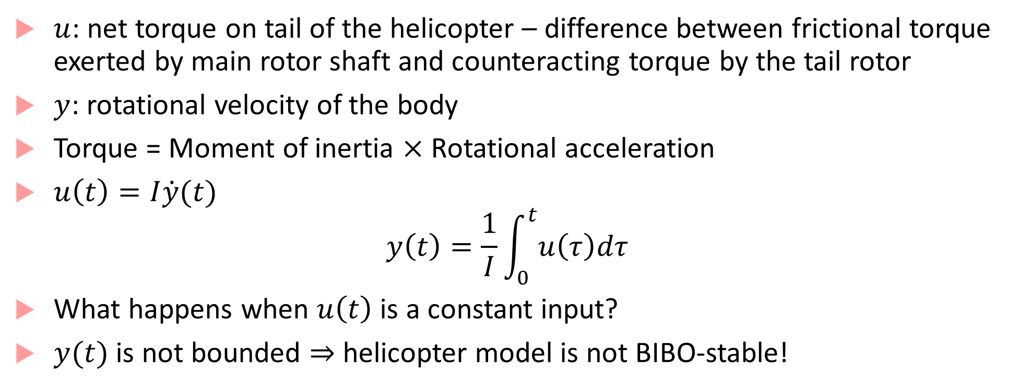
Helicopter Model continued
$u$: net torque on tail of the helicopter – difference between frictional torque exerted by main rotor shaft and counteracting torque by the tail rotor
$y$: rotational velocity of the body
Torque = Moment of inertia $×$ Rotational acceleration
$u\left(t\right)=I\dot{y}(t)$
$$y\left(t\right)=\frac{1}{I}\int_{0}^{t}{u\left(τ\right)dτ}$$
What happens when $u\left(t\right)$ is a constant input?
$y(t)$ is not bounded $⇒$ helicopter model is not BIBO-stable!

Slide 18
Hybrid Dynamical Systems

Slide 19
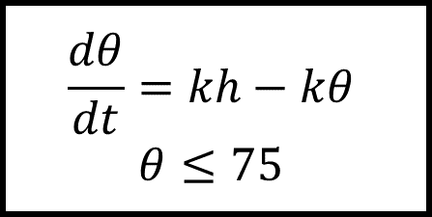
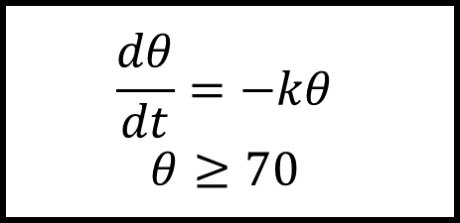

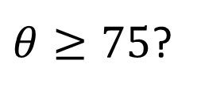
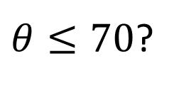
Hybrid Process
Generalization of a timed process
Instead of timed transitions, we can have arbitrary evolution of state/output variables, typically specified using differential equations
off
on
$θ≤70$?
$$\frac{dθ}{dt}=−kθ$$
$$θ≥70$$
$$\frac{dθ}{dt}=kh−kθ$$
$$θ≤75$$
$θ≥75$?
$$70≤θ_{init}≤75$$

Slide 20
Bang-bang control (thermostat) hybrid automaton
off
on
$θ≤70$?
$$\frac{dθ}{dt}=−kθ$$
$$θ≥70$$
$$\frac{dθ}{dt}=kh−kθ$$
$$θ≤75$$
$θ≥75$?
$$70≤θ_{init}≤75$$

Slide 21
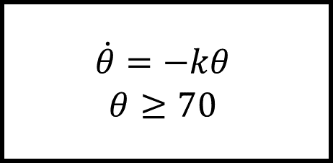

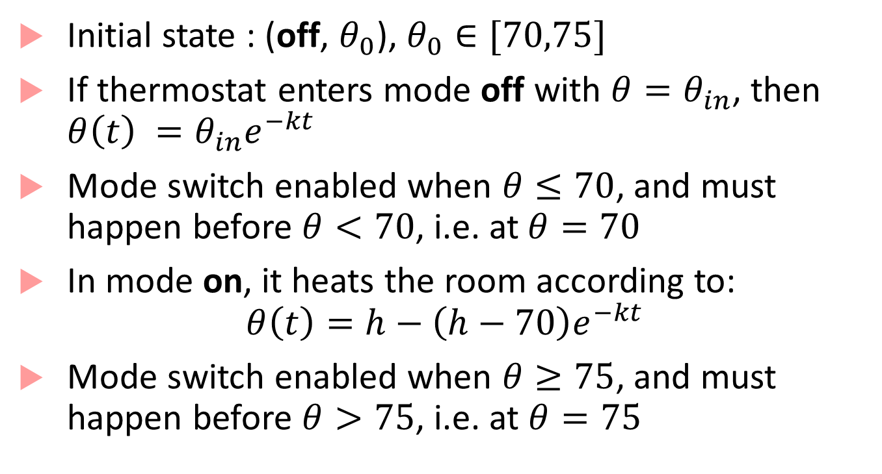
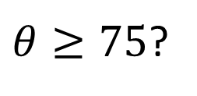
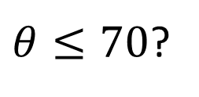
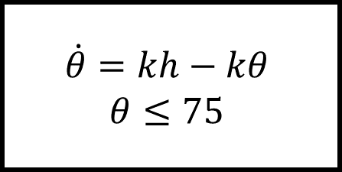
Executions of Thermostat
Initial state : (off, $θ_{0}$), $θ_{0}∈[70,75]$
If thermostat enters mode off with $θ=θ_{in}$, then $θ\left(t\right) ={θ_{in}e}^{−kt}$
Mode switch enabled when $θ≤70$, and must happen before $θ<70$, i.e. at$θ=70$
In mode on, it heats the room according to:
$$θ\left(t\right)=h−\left(h−70\right)e^{−kt}$$
Mode switch enabled when $θ≥75$, and must happen before $θ>75$, i.e. at $θ=75$
$$70≤θ_{init}≤75$$
off
$$\dot{θ}=−kθ$$
$$θ≥70$$
$θ≥75$?
$θ≤70$?
$$\dot{θ}=kh−kθ$$
$$θ≤75$$
on

Slide 22
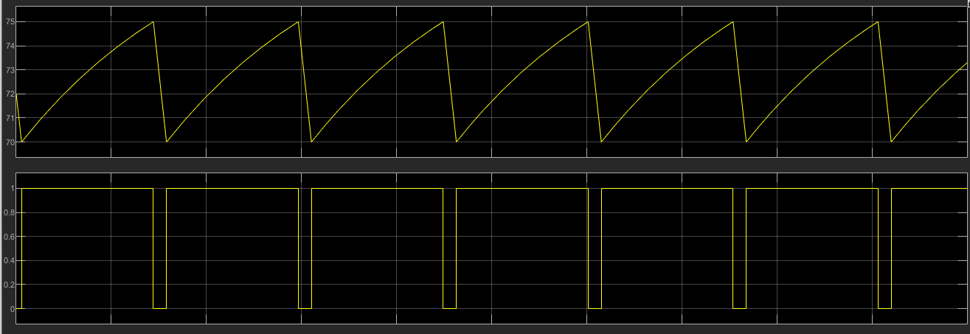
Behavior of thermostat
temperature
mode
time
time

Slide 23

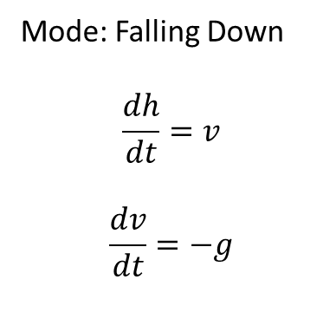

Hybrid Automata: State machines for hybrid processes
Mode: Falling Down
$$\frac{dh}{dt}=v$$
$$\frac{dv}{dt}=−g$$
$$v$$
$$x$$
USC Viterbi
School of Engineering
Department of Computer Science

Slide 24
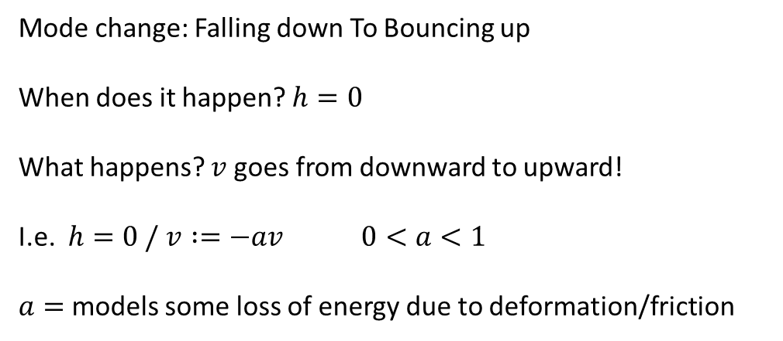

Hybrid Automata: State machines for hybrid processes
Mode change: Falling down To Bouncing up
When does it happen? $h=0$
What happens? $v$goes from downward to upward!
I.e. $h=0 / v :=−av 0<a<1$
$a=$models some loss of energy due to deformation/friction
$x$ = 0
USC Viterbi
School of Engineering
Department of Computer Science

Slide 25

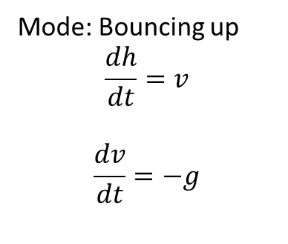
Hybrid Automata: State machines for hybrid processes
Mode: Bouncing up
$$\frac{dh}{dt}=v$$
$$\frac{dv}{dt}=−g$$
$$x$$
$$v$$
USC Viterbi
School of Engineering
Department of Computer Science

Slide 26
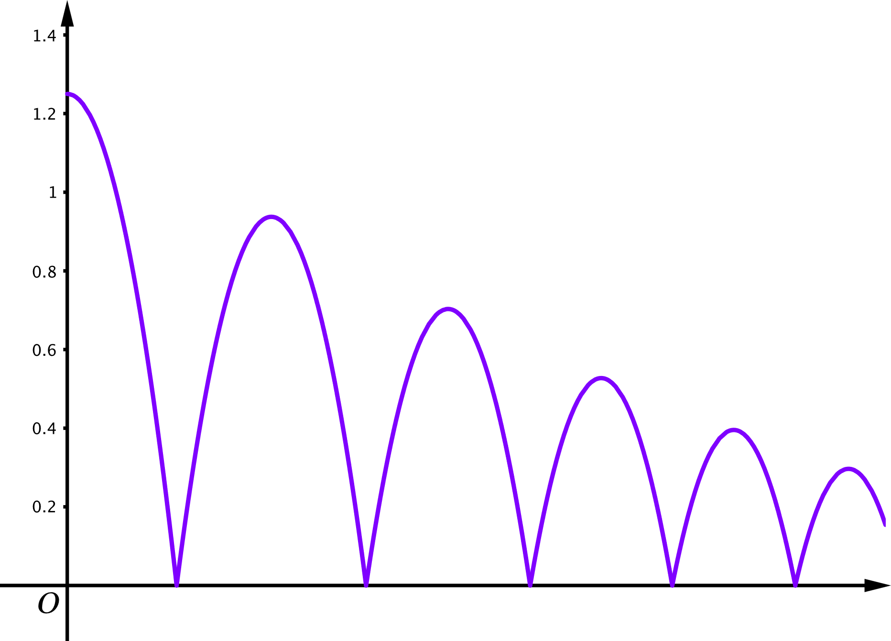
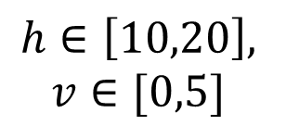
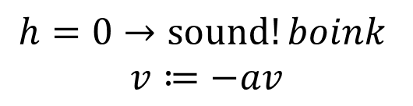




Hybrid automaton for bouncing ball
$$h∈\left[10,20\right],$$
$$v∈[0,5]$$
$$x$$
$$\dot{v}=−g, \dot{h}=v$$
$$h≥0$$
$$h=0→sound!boink$$
$$v≔−av$$
$$t$$
What happens as $h→0$?

Slide 27

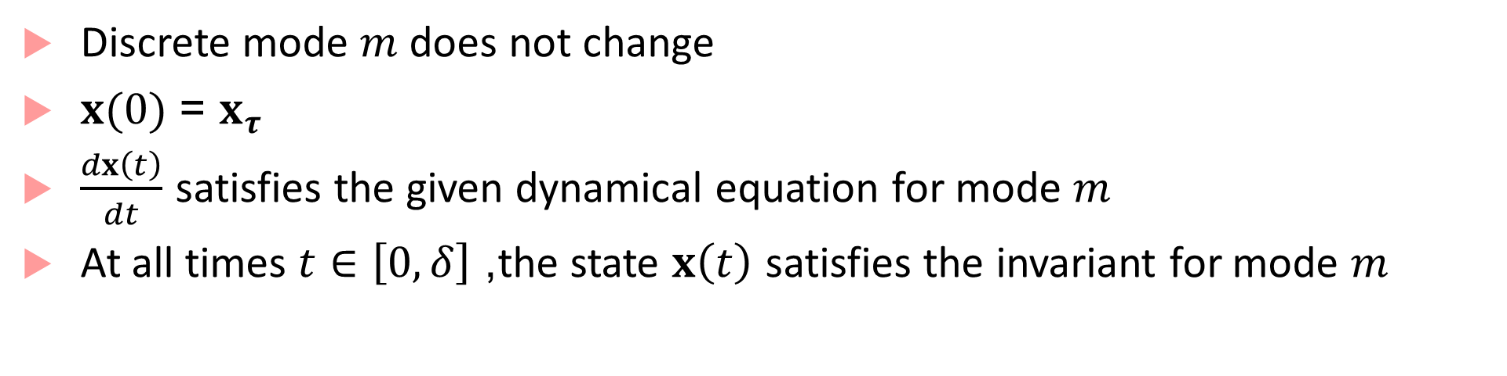



Hybrid Process
$$u(t)/y(t)$$
$$(m,x_{ τ})$$
$$\left(m,x\left(t+δ\right)\right)$$
Continuous action/transition:
$$δ$$
Discrete mode $m$does not change
$x(0)$ = $x_{τ}$
$\frac{dx\left(t\right)}{dt}$ satisfies the given dynamical equation for mode $m$
At all times $t∈\left[0,δ\right]$, the state $x\left(t\right)$ satisfies the invariant for mode $m$

Slide 28

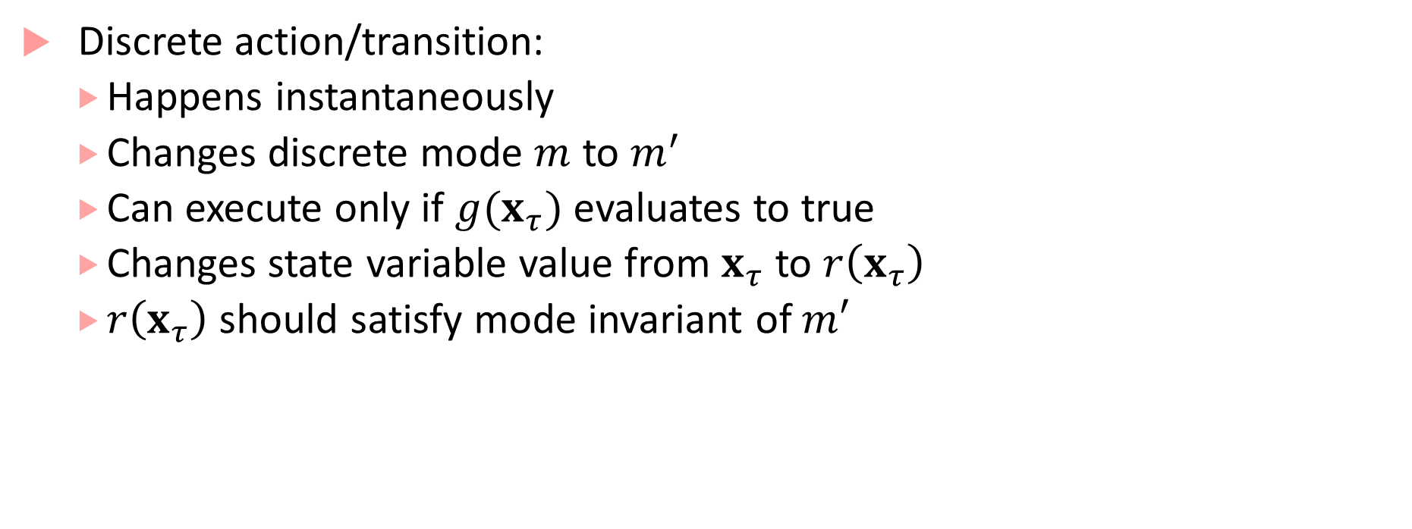
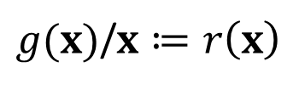

Hybrid Process
$g(x)$/$x≔r\left(x\right)$
Discrete action/transition:
  Happens instantaneously
  Changes discrete mode $m$ to $m^{′}$
  Can execute only if $g(x_{τ})$ evaluates to true
  Changes state variable value from $x_{τ}$ to $r\left(x_{τ}\right)$
  $r\left(x_{τ}\right)$ should satisfy mode invariant of $m′$
$$(m,x_{ τ})$$
$$\left(m′,r\left(x_{τ}\right)\right)$$

Slide 29



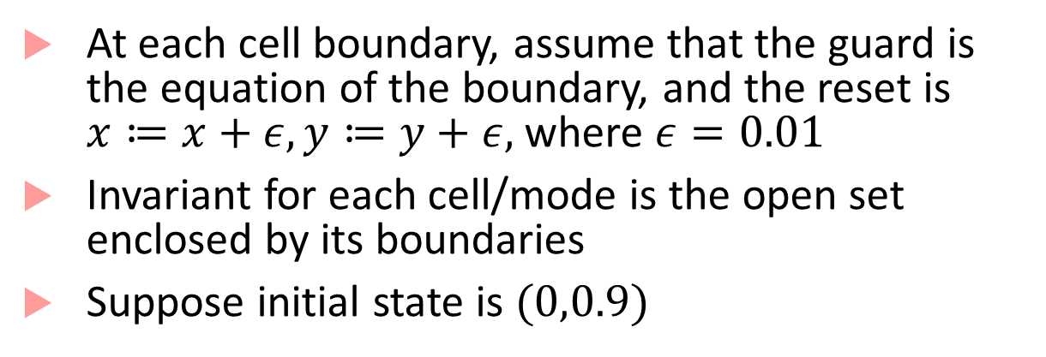



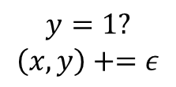


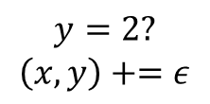









Executions of a hybrid process
At each cell boundary, assume that the guard is the equation of the boundary, and the reset is $x≔x+ε, y≔y+ε,$ where $ε=0.01$
Invariant for each cell/mode is the open set enclosed by its boundaries
Suppose initial state is $(0,0.9)$
(0,3)
$$m_{3}$$
$$m_{4}$$
$$m_{9}$$
$$\dot{x}=1$$ $$\dot{y}=0.5$$ | $$\dot{x}=1$$ $$\dot{y}=−1$$ | $$\dot{x}=0$$ $$\dot{y}=0$$
$$\dot{x}=0$$ $$\dot{y}=1$$ | $$\dot{x}=−1$$ $$\dot{y}=−1$$ | $$\dot{x}=0.5$$ $$\dot{y}=1$$
$$\dot{x}=1$$ $$\dot{y}=1$$ | $$\dot{x}=1$$ $$\dot{y}=0.5$$ | $$\dot{x}=0.5$$ $$\dot{y}=1$$
(0,2)
$$m_{2}$$
$$m_{5}$$
$$m_{8}$$
(0,1)
$$m_{1}$$
$$m_{6}$$
$$m_{7}$$
$$y=1?$$
$$\left(x,y\right)+=ε$$
$$(m_{1},0,0.9)$$
$$\left(m_{1},0.1,1\right)$$
$$\left(m_{2},0.11,1.01\right)$$
$$0.1\sqrt{2}$$
$$y=2?$$
$$\left(x,y\right)+=ε$$
(0,0)
(1,0)
(2,0)
(3,0)
$$0.99$$
$$\left(m_{3},0.12,2.01\right)$$
$$\left(m_{2},0.11,2\right)$$

Slide 30
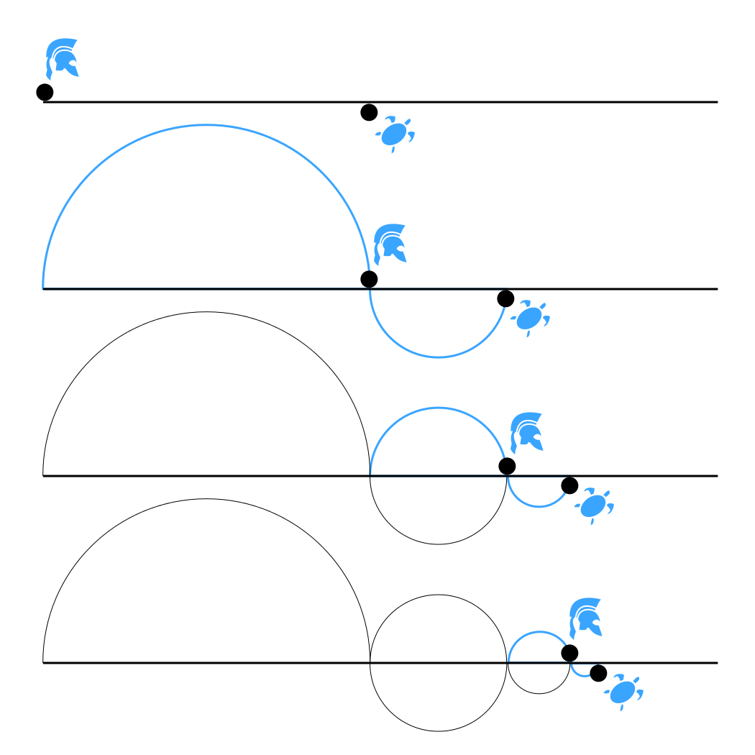
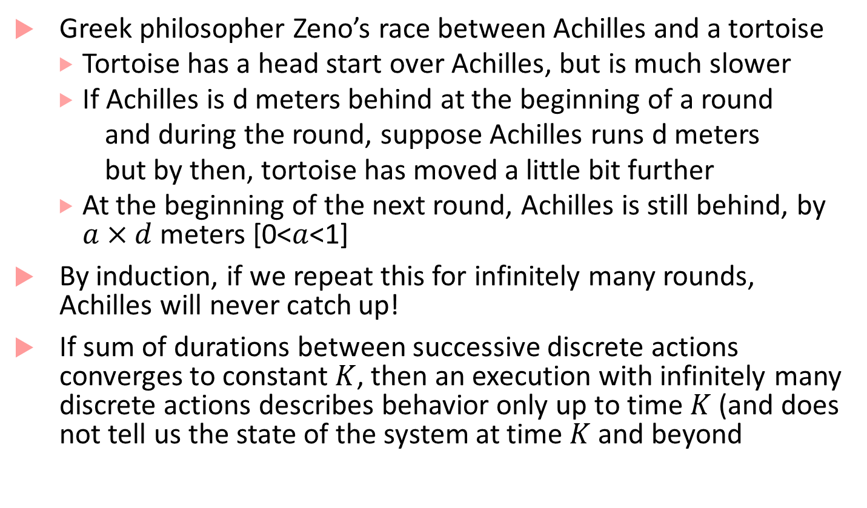
Zeno’s Paradox
Greek philosopher Zeno’s race between Achilles and a tortoise
  Tortoise has a head start over Achilles, but is much slower
  If Achilles is d meters behind at the beginning of a round
  and during the round, suppose Achilles runs d meters
  but by then, tortoise has moved a little bit further
  At the beginning of the next round, Achilles is still behind, by $a×d$ meters [0<$a$<1]
By induction, if we repeat this for infinitely many rounds, Achilles will never catch up!
If sum of durations between successive discrete actions converges to constant$K$, then an execution with infinitely many discrete actions describes behavior only up to time $K$ (and does not tell us the state of the system at time $K$and beyond

Slide 31
Hybrid automaton for bouncing ball
$$h∈\left[10,20\right],$$
$$v∈[0,5]$$
$$x$$
$$\dot{v}=−g, \dot{h}=v$$
$$h≥0$$
$$h=0→sound!boink$$
$$v≔−av$$
$$t$$
As the ball approaches the ground, the number of discrete transitions occurring in any time interval tends to infinity: in the limit, there will be only discrete transitions and time will stop!

Slide 32
How to deal with Zeno behavior
An infinite execution is called Zeno if infinite sum of all the durations is bounded by a constant, and non-Zeno if the sum diverges
Any state in a hybrid process is called Zeno if:
  If every execution starting in state is Zeno
  Non-Zeno if there exists some non-Zeno starting in that state
Hybrid process is non-Zeno if any state that you can reach from the initial state is non-Zeno
Thermostat: non-Zeno, Bouncing ball: Zeno
Dealing with Zeno: remove Zeno-ness through better modeling

Slide 33



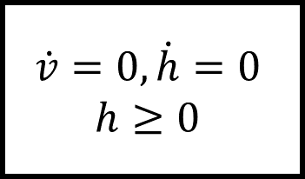

Non-Zeno hybrid process for bouncing ball
$$\dot{v}=−g, \dot{h}=v$$
$$h≥0$$
bounce
$$h=0→sound!boink ;v≔−av$$
$$h∈\left[10,20\right], v∈[0,5]$$
$$h=0∧v<ε→sound!splat ;v≔0$$
$$\dot{v}=0, \dot{h}=0$$
$$h≥0$$
halt

Slide 34
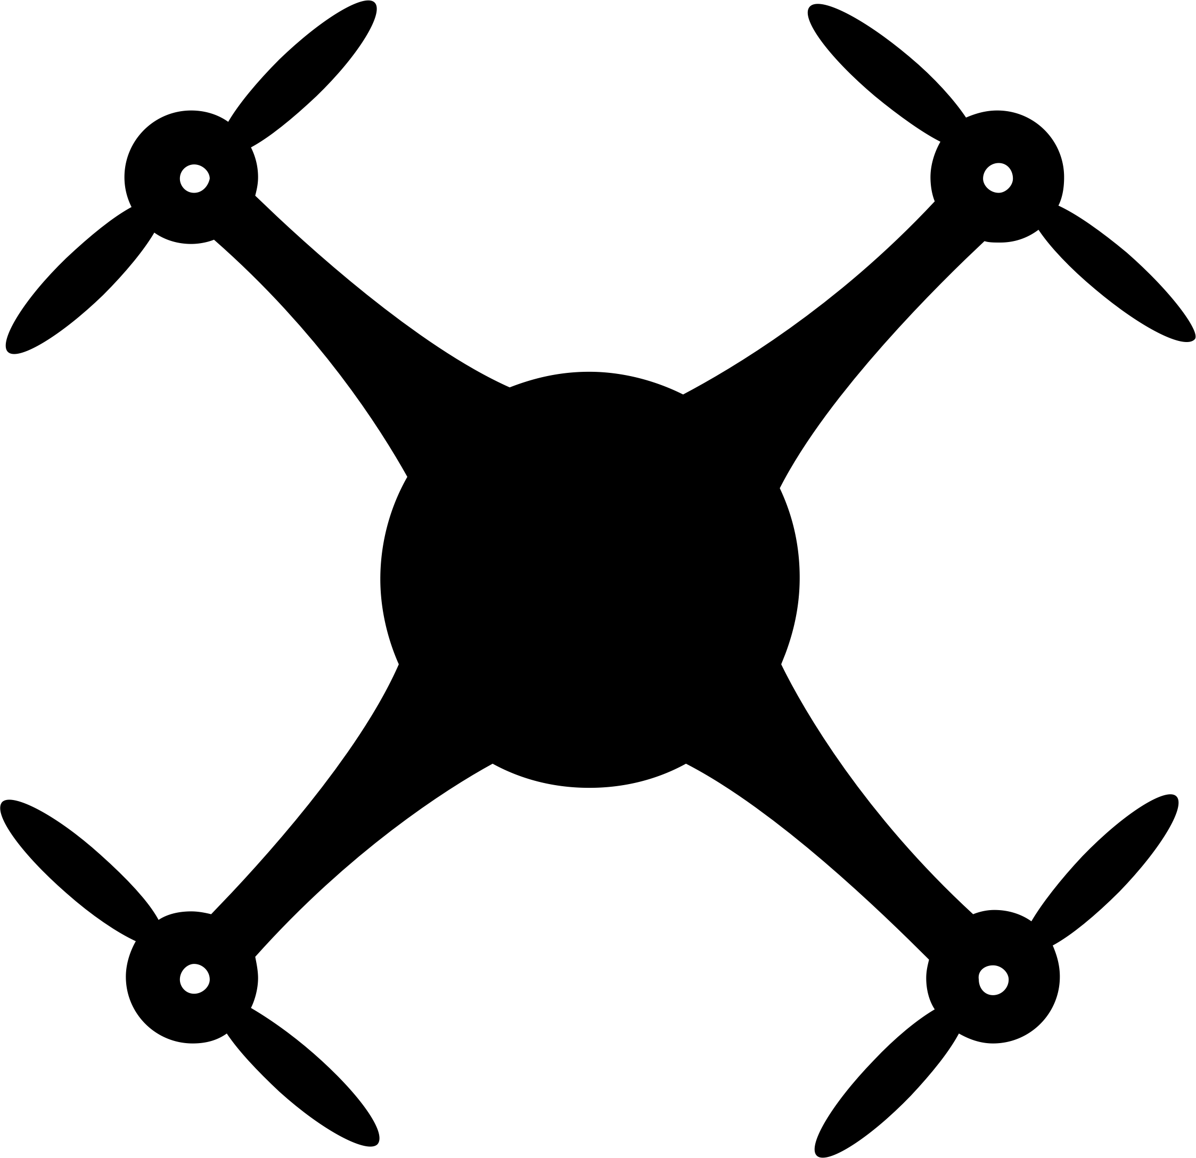
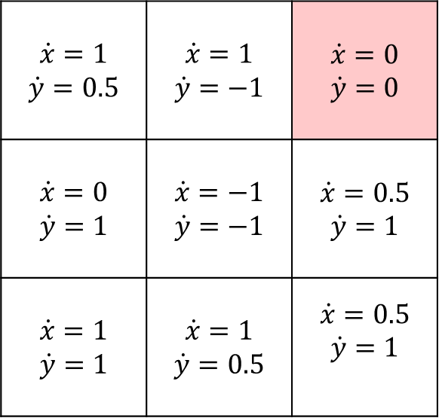

Reachability analysis
Suppose the grid world represents the configuration space of a robot
How do we analyze: Does the robot reach the error cell?
  Easy if we have only one initial state: just simulate!
What if the initial position of the robot is not certain (could be a set)?
What if the dynamics are not certain?
(0,3)
$$m_{3}$$
$$m_{4}$$
$$error$$
$$\dot{x}=1$$ $$\dot{y}=0.5$$ | $$\dot{x}=1$$ $$\dot{y}=−1$$ | $$\dot{x}=0$$ $$\dot{y}=0$$
$$\dot{x}=0$$ $$\dot{y}=1$$ | $$\dot{x}=−1$$ $$\dot{y}=−1$$ | $$\dot{x}=0.5$$ $$\dot{y}=1$$
$$\dot{x}=1$$ $$\dot{y}=1$$ | $$\dot{x}=1$$ $$\dot{y}=0.5$$ | $$\dot{x}=0.5$$ $$\dot{y}=1$$
(0,2)
$$m_{2}$$
$$m_{5}$$
$$m_{8}$$
(0,1)
$$m_{1}$$
$$m_{6}$$
$$m_{7}$$
(0,0)
(1,0)
(2,0)
(3,0)
Initial states

Slide 35
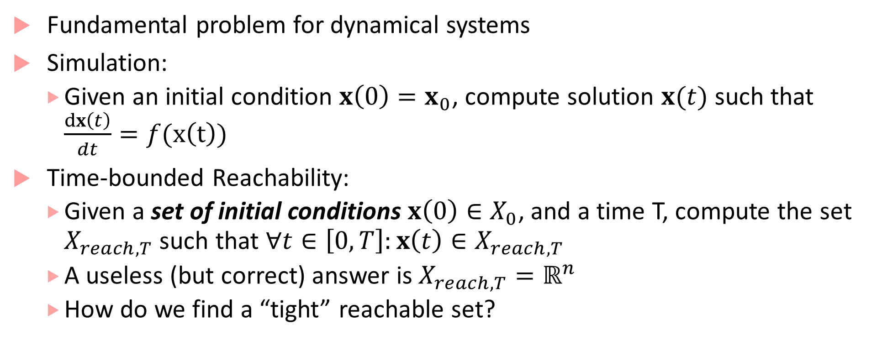
Time-bounded Reachability Analysis
Fundamental problem for dynamical systems
Simulation:
  Given an initial condition $x\left(0\right)=x_{0}$, compute solution $x(t)$ such that $\frac{dx\left(t\right)}{dt}=f(x\left(t\right))$
Time-bounded Reachability:
  Given a set of initial conditions $x\left(0\right)∈X_{0}$, and a time T, compute the set $X_{reach,T}$ such that $∀t∈\left[0,T\right]:x\left(t\right)∈X_{reach,T}$
  A useless (but correct) answer is $X_{reach,T}=ℝ^{n}$
  How do we find a “tight” reachable set?

Slide 36
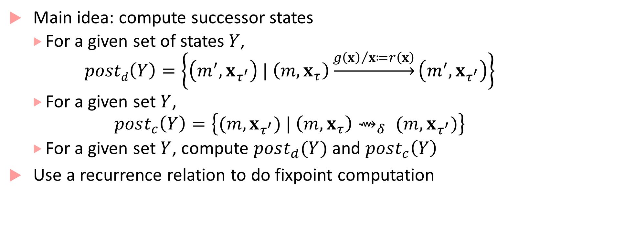
Computing Reachable Sets³
Main idea: compute successor states
  For a given set of states$Y$,
    $$postd\left(Y\right)=\left\{\left(m^{′},x_{τ^{′}}\right) | \left(m,x_{τ}\right)\underset{→}{{g\left(x\right)}/{x≔r\left(x\right)}}\left(m^{′},x_{τ^{′}}\right)\right\}$$
  For a given set $Y$,
    $$post_{c}\left(Y\right)=\left\{(m,x_{τ^{′}}) | \left(m,x_{τ}\right){\text{⇝}}_{δ} (m,x_{τ^{′}})\right\}$$
  For a given set $Y$, compute $post_{d}(Y)$ and $post_{c}\left(Y\right)$
Use a recurrence relation to do fixpoint computation

Slide 37

Fixpoint computation of reachable states
Computation:
  Initialize $Y_{0}≔X_{0}$ (initial set of states)
  Recur: $Y_{k+1}≔Y_{k}∪post_{d}\left(Y_{k}\right)∪post_{c}(Y_{k})$
  Terminate if: $Y_{k+1 }=Y_{k}$
    Time-bounded: when the sum of time elapsed on all continuous transitions is $≥T$
Problems:
  Termination not guaranteed for general case
  $post_{c}\left(Y_{k}\right)$ is not easy to compute in general
  Error in computing $post_{c}\left(Y_{k}\right)$ can blow-up leading to answers that are too conservative
Many Tools: SpaceEx, Flow*, C2E2, dReach, CORA (and a few others)

Slide 38
Stability of hybrid systems
Hybrid systems can have surprising results with respect to stability
No uniform method like Lyapunov analysis for analyzing all hybrid systems
Example: Piecewise Linear (PWL) Dynamical System
  Special class of hybrid system, in which each mode has linear dynamics, guards, resets are all linear/affine
  Each mode in the PWL system can have stable dynamics (by doing eigen-value analysis), but resulting hybrid system may be unstable!

Slide 39




Example
$$x_{2}=−0.2x_{1} ?$$
$$\dot{x}=\left(\begin{matrix}−1 & −100 \\ 10 & −1\end{matrix}\right)x$$
$$\dot{x}=\left(\begin{matrix}−1 & 10 \\ −100 & −1\end{matrix}\right)x$$
$$x_{2}=5x_{1} ?$$
Dynamics in each mode are stable!

Slide 40




Simulation results
$$x_{2}$$
$$x_{2}=5x_{1}$$
$$x_{2}=−0.2x_{1}$$
Initial State
$$x_{1}$$

Slide 41

Stability analysis for hybrid systems
Two main approaches^{1,2}:
  Find a common Lyapunov function that works for all modes
    I.e. for each mode $m$, dynamics are $\dot{x}=f_{m}\left(x\right)$, find $V\left(x\right)$ such that: $∀m∀x_{≠0}:\frac{∂V}{∂x}f_{m}\left(x\right)<0$, and $∀x_{≠0} V\left(x\right)>0$
    Usually hard to find a “one-size-fits-all” Lyapunov function
  Find multiple Lyapunov functions, one for each mode
    In each mode its Lyapunov function value decreases, and at the switching instant the destination mode’s Lyapunov function value does not increase
    $V_{m}(x)$ value decreases every time mode $m$ is entered
    Finding Lyapunov functions satisfying these conditions is again hard

Slide 42

Design Application: Autonomous Guided Vehicle
Objective: Steer vehicle to follow a given track
Control inputs: linear vehicle speed $\left(v\right)$, vehicle angular velocity $(ω)$, start/stop
Constraints on control inputs:
  $v∈\left\{v_{max}, v_{max}/2,0\right\}$
  $ω∈\{−π,0,π\}$
Designer choice: $v=v_{max}$ only if $ω=0$, otherwise $v=\frac{v_{max}}{2}$

Slide 43





















On/Off control for Path following
$$y$$
Turn right
Go straight
$$\dot{x}=(v_{max}/2)\cos{θ}$$
$$\dot{y}=\left({v_{max}}/2\right)\sin{θ}$$
$$\dot{θ}=−π$$
$$d≥ε$$
$$d≤ε?$$
$$\dot{x}=v_{max}\cos{θ}$$
$$\dot{y}=v_{max}\sin{θ}$$
$$\dot{θ}=0$$
$$−ε≤d≤ε$$
$$θ$$
$$x$$
$$d≥ε?$$
$$d$$
$$ss?start∧$$
$$d≥ε?$$
$$ss?stop$$
Track
$$ss?stop$$
$$d≤−ε?$$
$$d≥−ε?$$
$$ss?start∧$$
$$−ε≤d≤ε?$$
$$\dot{x}=0$$
$$\dot{y}=0$$
$$\dot{θ}=0$$
$$\dot{x}=(v_{max}/2)\cos{θ}$$
$$\dot{y}=\left({v_{max}}/2\right)\sin{θ}$$
$$\dot{θ}=π$$
$$d≤−ε$$
When $d∈\left[−ε,+ε\right]$, controller decides that vehicle goes straight, otherwise executes a turn command to bring error back in the interval
$$ss?stop$$
$$x≔x_{0}$$
$$y≔y_{0}$$
$$θ≔θ_{0}$$
$$ss?start∧$$
$$d≤−ε?$$
Stationary
Turn left

Slide 44
Design Application: Robot Coordination
Autonomous mobile robots in a room, goal for each robot:
  Reach a target at a known location
  Avoid obstacles (positions not known in advance)
  Minimize distance travelled
Design Problems:
  Cameras/vision systems can provide estimates of obstacle positions
    When should a robot update its estimate of the obstacle position?
  Robots can communicate with each other
    How often and what information can they communicate?
  High-level motion planning
    What path in the speed/direction-space should the robots traverse?

Slide 45












Path planning with obstacle avoidance
$$y$$
Assumptions:
  Two-dimensional world
  Robots are just points
  Each robot travels with a fixed speed
Dynamics for Robot $R_{i}$:
  $\dot{x_{i}}=v \cos{θ_{i}}$; $\dot{y_{i}}=v \sin{θ_{i}}$
Design objectives:
  Eventually reach $\left(x_{f},y_{f}\right)$
  Always avoid Obstacle1 and Obstacle 2
  Minimize distance travelled
$$R_{2}$$
$$\left(v,θ_{2}\right)$$
Obstacle 2
$$p_{o2}=\left(x_{o2},y_{o2}\right)$$
$$p_{2}=\left(x_{2},y_{2}\right)$$
$$\left(x_{f},y_{f}\right)$$
Goal
Obstacle 1
$$R_{1}$$
$$p_{o1}=\left(x_{o1},y_{o1}\right)$$
$$\left(v,θ_{1}\right)$$
$$p_{1}=\left(x_{1},y_{1}\right)$$
$$x$$

Slide 46
Divide path/motion planning into two parts
Computer vision tasks
Actual path planning task
Assume computer vision algorithm identifies obstacles, and labels them with some easy-to-represent geometric shape (such as a bounding boxes)
  In this example, assume a sonar-based sensor, so we will use circles
Assuming the vision algorithm is correct, do path planning based on the estimated shapes of obstacles
Design challenge:
  Estimate of obstacle shape is not the smallest shape containing the obstacle
  Shape estimate varies based on distance from obstacle

Slide 47








Estimation error
$$p_{o1}=\left(x_{o1},y_{o1}\right)$$
Robot $R_{1}$ maintains radii $e_{1}$ and $e_{2}$ that are estimates of obstacle sizes
Every $τ$ seconds, $R_{1}$ executes following update to get estimates of shapes of each obstacle
  $$e_{1}≔\min\left(e_{1}, r_{1}+a\left(\left\|p_{1}−p_{o1}\right\|−r_{1}\right)\right)$$
  We don’t know $r_{1}$, but we are guaranteed that we get a radius of an estimated shape of the obstacle $r$ that is exactly: $r_{1}+a\left(d\left(p_{1},p_{o_{1}}\right)−r_{1}\right)$
  $p_{1}$ is position of $R_{1}$
Computation of $R_{2}$ is symmetric
$e_{2}≔\min\left(e_{2}, r_{2}+a\left(\left\|p_{1}−p_{o2}\right\|−r_{2}\right)\right)$
Estimated shape
from distance $d′$
$$r_{1}$$
Estimated shape
from distance $d$
$$e^{′}$$
$$e$$
Smallest shape
bounding obstacle
Estimated radius $e=r+a(d−r)$,
where $a∈[0,1]$ is a constant

Slide 48











Path planning
$$y$$
Choose shortest path $ρ_{3}$ to target (to minimize time)
If estimate of obstacle 1 intersects $ρ_{3}$, calculate two paths that are tangent to obstacle 1 estimate
If estimate of obstacle 2 intersects $ρ_{3}$, or obstacle 1, calculate tangent paths
Plausible paths: $ρ_{1}$ and $ρ_{2}$
Calculate shorter one as the planned path
$$ρ_{1}$$
$$(x_{f},y_{f})$$
$$p_{o1}$$
$$ρ_{4}$$
$$ρ_{3}$$
$$p_{o2}$$
$$ρ_{2}$$
$$p_{1}$$
$$x$$

Slide 49

Dynamic path planning
Path planning inputs:
  Current position of robot
  Target position
  Position of obstacles and estimates
Output:
  Direction for motion assuming obstacle estimates are correct
May be useful to execute planning algorithm again as robot moves!
  Because estimates will improve closer to the obstacles
  Invoke planning algorithm every$τ$ seconds

Slide 50

Communication improves planning
Every robot has its own estimate of the obstacle
$R_{2}$’s estimate of obstacle might be better than $R_{1}$’s
Strategy: every $τ$ seconds, send estimates to other robot, and receive estimates
For estimate $e_{i}$, use final estimate = $\min\left(e_{i},e_{i}^{recv}\right)$
Re-run path planner

Slide 51




















Improved path planning through communication
$$y$$
$$y$$
New path available
because estimate of obstacle 1 improved after receiving estimate from $R_{2}$
$$ρ_{1}$$
$$ρ_{1}$$
$$(x_{f},y_{f})$$
$$(x_{f},y_{f})$$
$$p_{o1}$$
$$ρ_{4}$$
$$p_{o1}$$
$$ρ_{4}^{′}$$
$$ρ_{3}$$
$$p_{1}(0)$$
$$ρ_{3}$$
$$ρ_{2}$$
$$ρ_{2}$$
$$p_{o2}$$
$$p_{o2}$$
$$p_{1}$$
$$p_{1}(τ)$$
Old path
$$x$$
$$x$$

Slide 52

Hybrid State Machine for Communicating Robot

Slide 53
Advantage of using hybrid processes
Hybrid models combine computation, communication and control
Most real-world controllers are digital/discrete-time controllers: hybrid process/automata models describe underlying mathematical model for most CPS applications!
We can perform design-space exploration through simulations and check safety/correctness through formal techniques such as reachability analysis

Slide 54
Bibliography
H. Lin and P. J. Antsaklis, "Stability and Stabilizability of Switched Linear Systems: A Survey of Recent Results," in IEEE Transactions on Automatic Control, vol. 54, no. 2, pp. 308-322, Feb. 2009.
Branicky, Michael S. "Multiple Lyapunov functions and other analysis tools for switched and hybrid systems." IEEE Transactions on automatic control 43.4 (1998): 475-482.
Talk by Goran Frehse, pdf of slides here: http://qmc.cs.aau.dk/slides/slides-frehse.pdf
SpaceEx: http://spaceex.imag.fr/
Flow*: https://flowstar.org/
dReach: http://dreal.github.io/dReach/
CORA: http://www.i6.in.tum.de/Main/SoftwareCORA

