Slide 1
Autonomous Cyber-Physical Systems: Course Introduction
Fall 2023: CS 513
Instructor: Jyo Deshmukh
Course materials: https://tinyurl.com/2df7fkv4

Slide 2
What is a Cyber-Physical System?
Different ways to answer this question!
Wikipedia: A Cyber-Physical system (CPS) is a mechanism controlled or monitored by software algorithms.
NSF: engineered systems built from, and depending upon, the seamless integration of algorithms and physical components
From a historical perspective CPS combines elements of cybernetics, mechatronics, control theory, process science, embedded systems, distributed control, and more recently communication.
One common saying: CPS = Control + Computation + Communication

Slide 3
Our focus on CPS in this course
Control
Systems where the behavior of the physical components is strongly influenced by the software components
Systems where there the communication between the physical component and the software component may be direct or through a network
Systems in which the primary role played by software is control (in contrast to passive monitoring)
Communi-cation
Computation
CPS

Slide 4
One view of a CPS
Actuators
Physical component
Sensors
Environment/Plant
Communication Network
Controller
(Some embedded code)

Slide 5
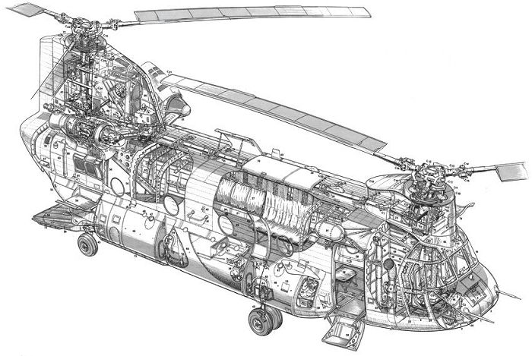
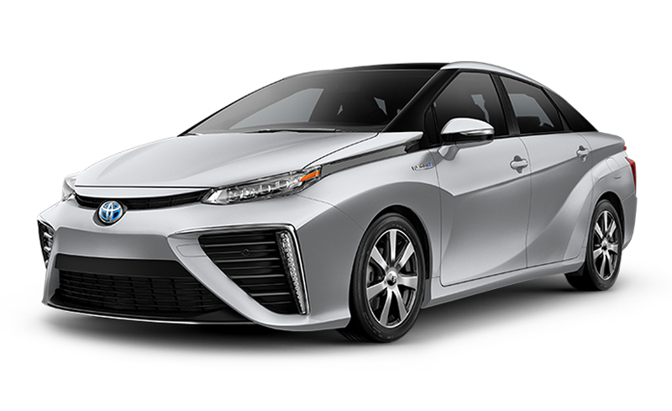
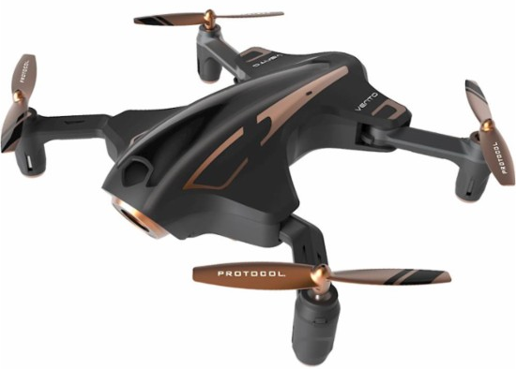
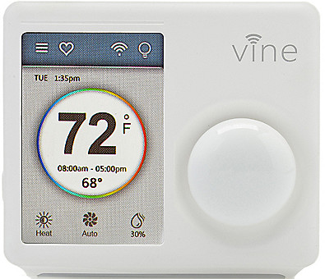
Examples
[All images from Google image search]

Slide 6
What’s an autonomous CPS?
Autonomous: without the need for human intervention or control
Autonomous CPS = CPS with no human operator!
Semi-autonomous: CPS with autonomy under specific conditions but requiring a human operator otherwise.
Today, several CPS examples are semi-autonomous, and getting to fully autonomous

Slide 7
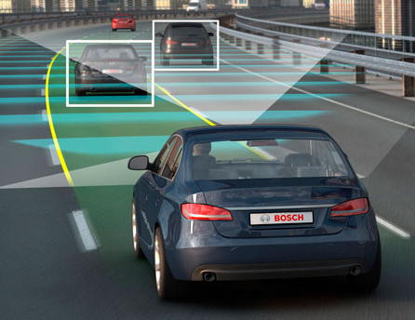
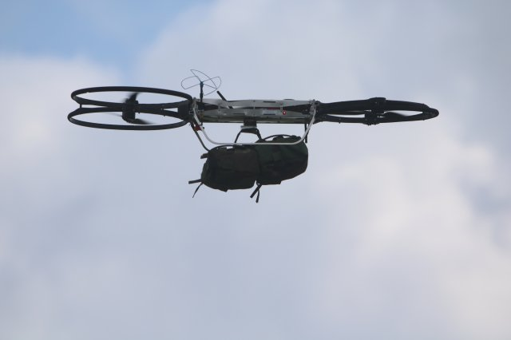
Autonomous/Semi-autonomous CPS
Image credit: Motor Authority
Image credit: army.mil
Image credit: Google images

Slide 8
Course Objectives
Gain basic familiarity with CPS topics
Computational models
Control algorithms
Ingredients for autonomy
Challenge Problems/Case studies
Model-Based Software Development Paradigm for CPS
Developing models for physical components + software + communication
Software Engineering: Writing checkable requirements and tests
Software testing for CPS
Learn autonomous software stack through case studies in autonomy

Slide 9
Key theme of the course: Safe Autonomy
ACPS are safety-critical, and/or mission-critical with huge implications on human health, well-being, economy, etc.

Slide 10
Course Overview
Part I: Models of Computation, Model-based Control Design
Synchronous & Asynchronous Models, Timed Models, Dynamical System Models, Hybrid Models, Basics of Control
Part II: Safety: Specifications, Monitoring, Test Generation, Verification
Temporal Logic, Test Generation, Falsification
Part III: Ingredients of Autonomy
Basics of modern perception, planning, decision-making, reinforcement learning

Slide 11
How will we evaluate ourselves?
4 Written Homework Assignments
Focus on theory
2 Mini-Projects
Learn how to code the controller for a self-driving car subsystem
Learn how to use a vision-based perception module as a sensor
Class Project

Slide 12
Class Project
Purpose:
Freedom to choose your own advanced application
Write formal requirements
Generate tests/proofs using verification/falsification/test generation
Show the application of formal reasoning
Expected outcome:
Dynamical Model of an ACPS application (Python/Simulink-Matlab/JuliaSim/…)
Model in a simulator (Carla, AirSim, IsaacSim, Sumo, …)
Research project
For application projects:
You could try to deploy it on the chosen hardware platform
We have a few to play with – first-come-first-serve, email us about these!

Slide 13
Example Projects (do not have to pick any of these)
Design an eVTOL to follow a specific route plan (specified formally)
Vehicle model and controller to automatically change lanes
Explore multi-vehicle simulators for collaborative merging, autonomous intersection control
Pedestrian/bicycle detection and avoidance
Traffic simulator for vehicle platooning
Create a model of the human heart and design a pacemaker
Create a blood-glucose dynamics model and design an automatic insulin infusion pump
Train a ground robot that uses LIDAR/Cameras and train it using reinforcement learning
Some fun past projects: automated pet feeder, automatic race-car training from human players, aggressive UAV maneuvers, hydroponic plant system, interfacing the Toyota HSR, wildfire detection and multi-agent wildfire mapping

Slide 14
Project Timeline
Project teams of 2: exceptional cases: teams of 1 or 3
Team size proportional to expectation on outcome
Use Piazza for forming teams
Identify team members by Labor Day week
Single-page Project Proposal due by 1st week of October
TAs will provide proposal format
Final Project Deliverable
10-page project report (for research), 5-page report (for demos)
Final Project Presentation on last day of classes

Slide 15
Grading and Evaluation Breakdown
Assignments: 40% (10x4)
Mini-Projects: 30% (15x2)
Project: 35%
Proposal: ungraded
Final Report: 5% (talk) , 20% (final report or demo)
Class participation: 5%
Participation in Slack
Q&A, Office hours, …

Slide 16
Learning curve will be sharper if:
You have no knowledge of Matlab/Python
Matlab/Python is easy to learn, with several online resources and tutorials, but it may take you some time if you have never used it!
You do not remember high-school level calculus or logic

Slide 17
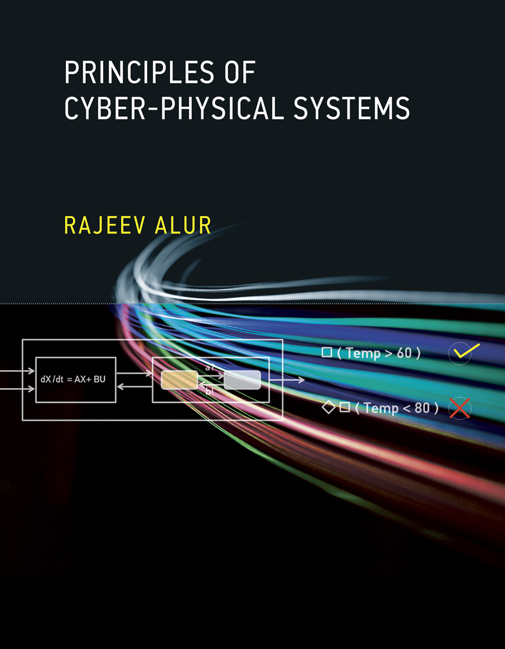
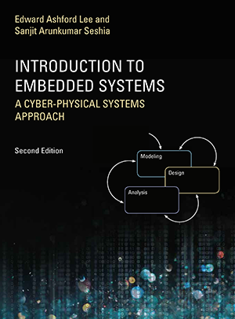
Textbooks: None. Supplementary reading:
Principles of Cyber-Physical Systems by Rajeev Alur
$56-63 on Amazon
Free e-book available on USC libraries
Introduction to Embedded Systems: A CPS approach
- Free at: https://ptolemy.berkeley.edu/books/leeseshia/

Slide 18
Office Hours, Class Timings
Class Timing: 2:00-5:20
First 5 mins: recap of last lecture + outline of this lecture + announcements
Last 20 mins: optional questions, discussions, etc.
Office Hours: Monday, 11:00am-12:00pm (or by appointment)
TAs: Sam Williams, Jeremy Morgan, Navid Hashemi
Office Hours: TBD
Grader: TBD

Slide 19
Logistics
Piazza:
I am utterly ignorant about it and have never used this ☺
My wonderful TAs will (hopefully) teach me how to use it this semester
From Piazza (courtesy of Jeremy):
This term we will be using Piazza for class discussion. The system is highly catered to getting you help fast and efficiently from classmates, the TAs, and myself. Rather than emailing questions to the teaching staff, I encourage you to post your questions on Piazza. If you have any problems or feedback for the developers, email team@piazza.com. Find our class page at: https://piazza.com/usc/fall2023/csci513/info
Slack channel: uscviterbiclass.slack.com (fall23-csci-513-30161)

Slide 20
Questions?

