Slide 1
Automata Theory, Logic, and Formal Verification
Spring 2026: CSCI 624
Instructor: Jyo Deshmukh

Slide 2
What are formal methods?
Mathematically rigorous techniques for reasoning about computer systems
Computer systems can include a broad variety of systems:
  software programs (terminating functional programs, scientific computing, scripts to train your favorite ML model, simulators, etc.)
  reactive systems (distributed and concurrent software for operating systems, email servers, databases, logging, monitoring, etc.)
  interactive systems (web browsers, human-machine interfaces)
  hardware circuits/descriptions (VHDL/Verilog descriptions, SPICE programs, etc.)
  cyber-physical systems (service robots, self-driving cars, airplanes, human-piloted and autonomous drones, medical devices, industrial systems, power grids, etc.)

Slide 3
Some key ideas in formal methods
Specification
  We should be able to describe our expectations on the behavior of the system-under-design (SUD) using a high-level (formal) language
Verification
  Given a computer-interpretable description of the SUD, we should be able to algorithmically decide if the SUD satisfies its specification
Synthesis
  Given a set of high-level (complete or incomplete) specifications of the SUD, and some partial (possibly empty) implementation of the SUD, we should be able to algorithmically synthesize the complete implementation of the SUD (that is guaranteed to satisfy the given specifications)

Slide 4
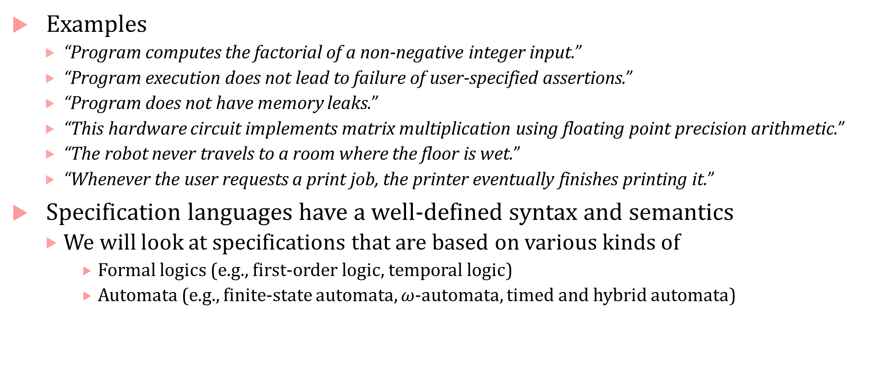
Specifications
Examples
  “Program computes the factorial of a non-negative integer input.”
  “Program execution does not lead to failure of user-specified assertions.”
  “Program does not have memory leaks.”
  “This hardware circuit implements matrix multiplication using floating point precision arithmetic.”
  “The robot never travels to a room where the floor is wet.”
  “Whenever the user requests a print job, the printer eventually finishes printing it.”
Specification languages have a well-defined syntax and semantics
  We will look at specifications that are based on various kinds of
    Formal logics (e.g., first-order logic, temporal logic)
    Automata (e.g., finite-state automata, $ω$-automata, timed and hybrid automata)

Slide 5
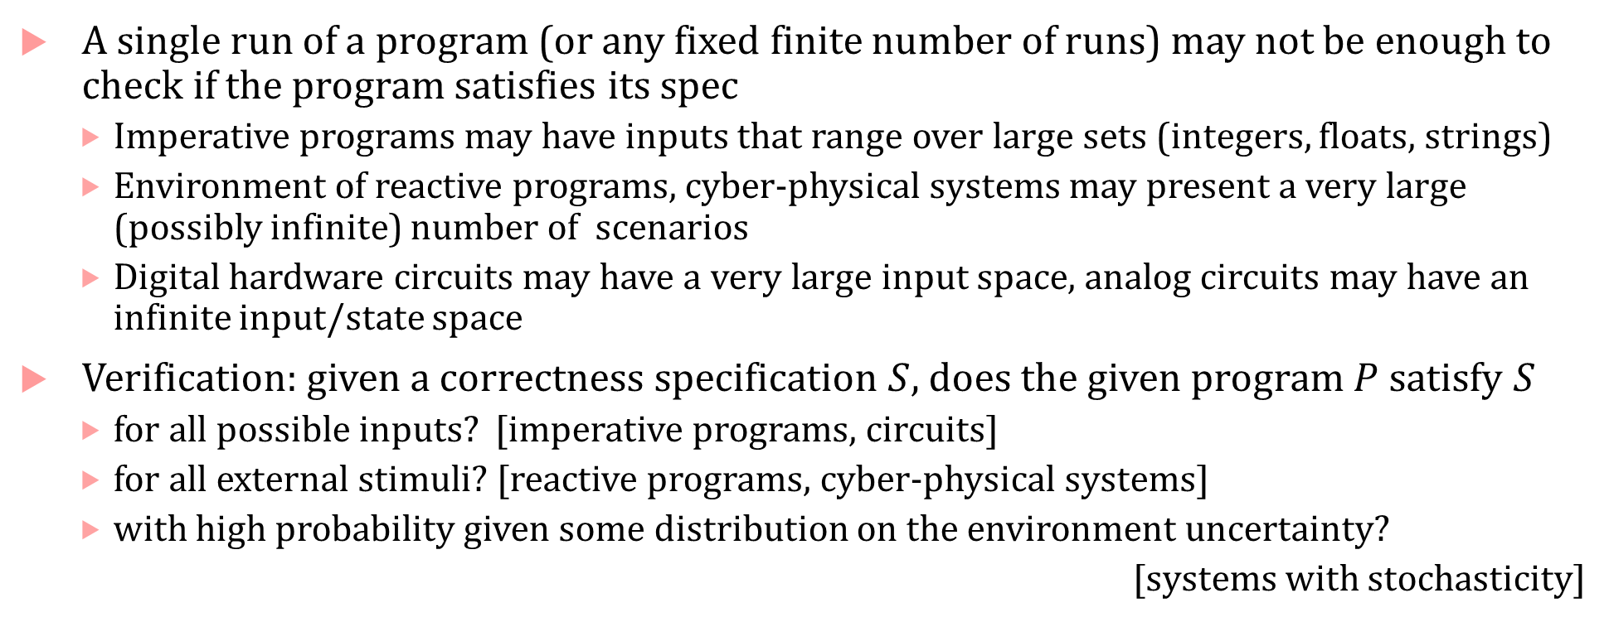
Verification
A single run of a program (or any fixed finite number of runs) may not be enough to check if the program satisfies its spec
  Imperative programs may have inputs that range over large sets (integers, floats, strings)
  Environment of reactive programs, cyber-physical systems may present a very large (possibly infinite) number of scenarios
  Digital hardware circuits may have a very large input space, analog circuits may have an infinite input/state space
Verification: given a correctness specification $S$, does the given program $P$satisfy $S$
  for all possible inputs? [imperative programs, circuits]
  for all external stimuli? [reactive programs, cyber-physical systems]
  with high probability given some distribution on the environment uncertainty?
  [systems with stochasticity]

Slide 6
Verification vs. Testing
Testing: Pick some set of inputs and execute the program on this set. Program is buggy if it violates its specification on any of the test inputs.
Testing can show the presence of bugs, but not the absence of bugs.
  The one test input that causes the bug may be missing from your test-suite
Verification tries to establish the absence of bugs by proving that the program cannot violate its specification under all possible inputs/stimuli etc.

Slide 7
Verification vs. Program Analysis
Static/Program analysis: Learn properties of the program by just inspecting the source code
Static analysis is one way to perform verification for certain kinds of specifications; static analysis is generally fully automatic.
CSCI 610 is a great course to learn all about static analysis
Verification is a general approach that consist of various techniques with different levels of automation: (theorem proving, model checking, static and dynamic analysis, runtime verification, etc.)

Slide 8
Verification for Cyber-physical systems
Formal Verification is not limited to software programs
Suppose you are developing software for controlling a train, and the correctness is specified as, “if the train sees a red signal, it must come to rest within 120 seconds.” You cannot verify this specification on the software alone, but you need to know the time-evolution of the train’s behavior in response to the software commands it receives.
We can model the physical components being controlled by software using dynamical equations (ODEs, PDEs, DAEs, difference equations) and use CPS verification techniques to check the above specification.

Slide 9
Verification for Probabilistic Systems
Many real-world cyber-physical systems (e.g., robots, cars, medical devices), networking software face stochastic uncertainty from their operating environment
For such systems, absolute guarantees are generally difficult to obtain
For example, “self-driving car should not collide with other cars” is a specification that we may never be able to prove because the self-driving car is designed with certain rational assumptions on other cars. What guarantees can we give if other cars are homicidal, perception fails to recognize a pedestrian, or there is a sudden blizzard blinding all sensors?
We can give guarantees modulo assumptions on the environment: if environment assumptions are stochastic, we get probabilistic guarantees

Slide 10
New frontiers: Neural network verification/robustness
Neural networks are a very special kind of a program
Machine learning typically focuses on improving the accuracy of neural networks, verification typically has not been a concern
Many problems for neural networks could be addressed using formal verification approaches:
  Robustness: Do small perturbations in the input to the NN cause large changes in its output (or output labels)?
  Compression: Is a reduced size NN functionally similar to the original NN?
  Safety: Is an NN-controlled dynamical system safe?

Slide 11
Synthesis
Given a set of high-level specifications* automatically generate the program that is guaranteed to satisfy the specs
  * = we also provide some assumptions about the program (e.g., some program skeleton, assumptions about platform on which program will run, assumptions on communication topology, etc.)
  Logic synthesis: produce circuit implementations from high-level descriptions (mature area with several active EDA companies)
  Program synthesis: imperative programs, functional programs
  Reactive synthesis: reactive programs that are not intended to terminate
  Controller synthesis: cyber-physical systems
  Controller/Policy Learning: general decision-making systems
Synthesis is a harder problem than verification, but verification can be used as a step within a broader synthesis framework

Slide 12
What will we learn?
Modeling programs as transition systems
Automatic verification approaches such as model checking
Specification languages such as temporal logic and automata over infinite words and trees
  Connections with first-order logic and monadic second order logic
Techniques to make verification scalable
Models, Specification formalisms and Verification algorithms for Probabilistic Systems
Modeling, Specifying and Verifying Cyber-Physical Systems

Slide 13
Why should people care about formal verification?
History of software development is also a history of software blunders, often those that have catastrophic results
  Ariane 5 rocket explosion (integer overflow), Therac-25 radiation treatment killing patients with radiation overdose (race condition), $475M FDIV bug for Intel (missing entries in lookup table used for floating point division), Patriot missile fails to intercept Scud missile (rounding error), software error led to recall of a neonatal ventilator, … several others
  More recently: Tesla car misidentifies a truck as the sky, Uber car fails to act in time to avoid fatal collision with pedestrian walking a bike, Boeing 787 MAX errors, Cruz vehicles failing to recognize emergency vehicles, …

Slide 14
Who cares about formal verification today?
Hardware/EDA industry: has embraced FV for almost two decades
Avionics industry:
  FAA requires software on commercial airplanes to be certified before they can fly
  Rigorous standards for certification, changing even one line of code can trigger multi-year-long certification process (important to do it right!)
Medical devices:
  FDA requires medical device software to be certified
Software industry [a very incomplete list]
  Amazon has a world class formal verification group that uses TLA+ model checker and other tools to verify various cloud services aspects (esp. the Autonomous Reasoning Group in AWS)
  Microsoft Research has a strong rigorous software engineering group responsible for fundamental advances in theory and tools for formal verification
  Several chip designers and EDA companies have historically had formal methods groups
Increasingly: the automotive industry [Toyota, Robert Bosch GmbH, Ford, GM, Volvo, and several others have teams doing research/practice of verification]

Slide 15
About the course

Slide 16
This is a theory-ish course!
There will be no programming assignments*!
The course will require you to exercise your mathematical and logical skills
I will give guidance and help with proof techniques, formalizing problems, etc.
  Or you will teach me new tricks, gadgets, proof strategies
That said …
You are encouraged to download and play with formal verification tools such as model checkers, theorem provers, SMT solvers, monitoring and specification tools
My personal conviction is that formal methods/verification can advance as a field only through well-engineered tools: it is important to build tools.
The purpose of this course: understanding the technology behind the tools.
* unless you really want one

Slide 17
Course structure
Lecture-oriented + supplementary reading from textbooks if necessary
Three textbooks will cover most of the material for the course
  (should be available through libraries.usc.edu as ebooks)
  Principles of Model Checking by Christel Baier and Joost Pieter Katoen, MIT Press
  Verifying Cyber-Physical Systems by Sayan Mitra, MIT Press
  Principles of Cyber-Physical Systems by Rajeev Alur, MIT Press
4 homework assignments
  Can work on homework in teams:
    collaborate if you desire
    feel free to use LLMs
  Homework content: design algorithms, write proofs
  Instructor-guided¹ Peer-grading (you grade each others’ homework assignments)
[1] With a liberal interpretation of the word guidance.

Slide 18
Grade and Grading
Homework assignment 1 and 3 is 15% each
Homework assignment 2 and 4 is 20% each
I am required to have a project for this class
  Project is 30% (let’s do a 5% presentation and 25% report grade)
  Can be anything loosely related to this class that you intend to submit to a good conference
Grades should depend on
  Correctness of proofs/algorithms
  Partial credit galore if your proof/algorithm is hunting in the right area
  Extra credit for elegance

Slide 19
Reading materials
I will email PDFs of the papers a week or two weeks in advance
If you can read thoroughly
  Take notes, try to prove things yourself
  Note some smart trick or gadget used in a tricky proof
Else If you can read the intro and browse through main results
  Ponder about the bigger picture of the paper
Else
  Ask ChatGPT or your favorite LLM to summarize the paper for you, read the summary. Use nice prompts like,
    “Why is proving Theorem 2 difficult,” “Why is assumption <blah> needed,” “Why was this considered novel when it came out,” “How have people improved this?”

Slide 20
Office hours
By appointment
Jyo’s office: GCS 202P

Slide 21
Introductions…

