Slide 1
Automata Theory, Logic, and Formal Verification Labelled Transition Systems
Spring 2026: CSCI 624
Instructor: Jyo Deshmukh

Slide 2
Overview
Labeled Transition Systems: Notations, Terminology
Kripke structures
Modeling Concurrent Systems [BK: Chapter 2, Alur Chapters 2,4]
Equivalences and Abstractions [BK: Chapter 7]

Slide 3
Transition Systems
Any computation can be represented as a transition system
Variables can be discrete-valued or continuous-valued
Time can be logical, discrete, or continuous (dense)
Transition system representation models a computation (program) as a directed graph
Nodes are configurations or states of the system
Edges model state changes or system transitions
Labelled transition systems (LTSs) :
Transitions have names (drawn from a finite or infinite set of labels)
There is a finite (or infinite) set of atomic propositions
States are labeled with some subset of the set of atomic propositions

Slide 4
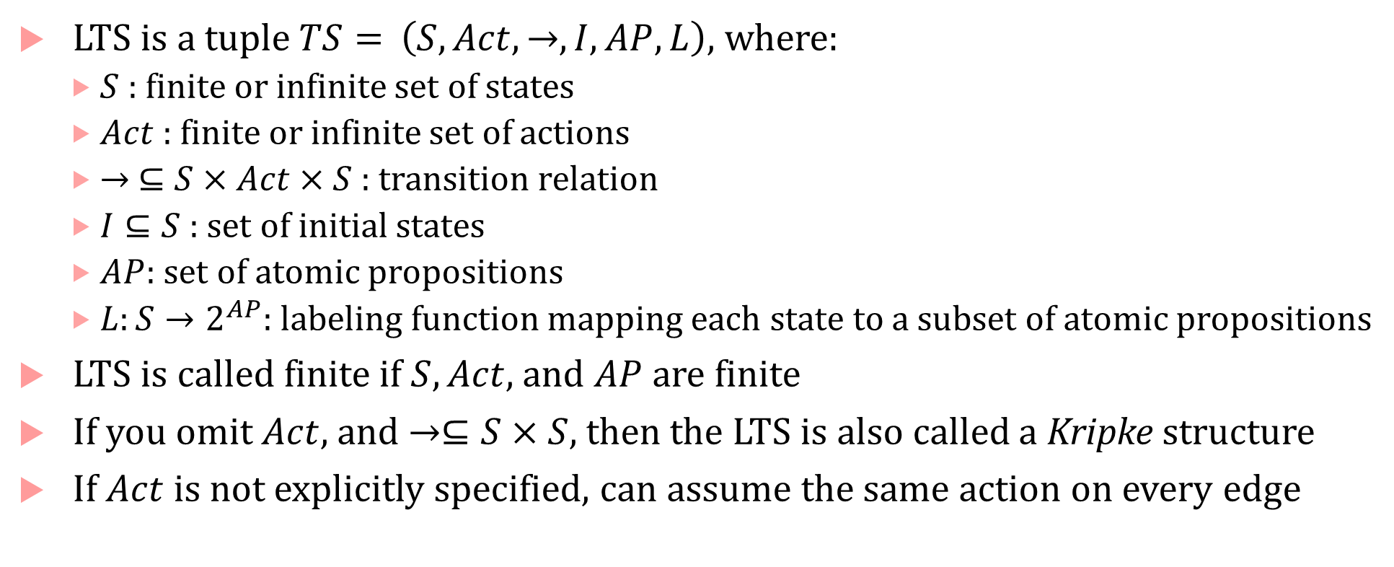
LTS formal definition
LTS is a tuple $TS=$ $\left(S, Act, →, I, AP, L\right)$, where:
$S$ : finite or infinite set of states
$Act$ : finite or infinite set of actions
$→ ⊆S×Act×S$ : transition relation
$I⊆S$ : set of initial states
$AP$: set of atomic propositions
$L:S→2^{AP}$: labeling function mapping each state to a subset of atomic propositions
LTS is called finite if $S, Act,$ and $AP$ are finite
If you omit $Act$, and $→⊆S×S$, then the LTS is also called a Kripke structure
If $Act$is not explicitly specified, can assume the same action on every edge

Slide 5
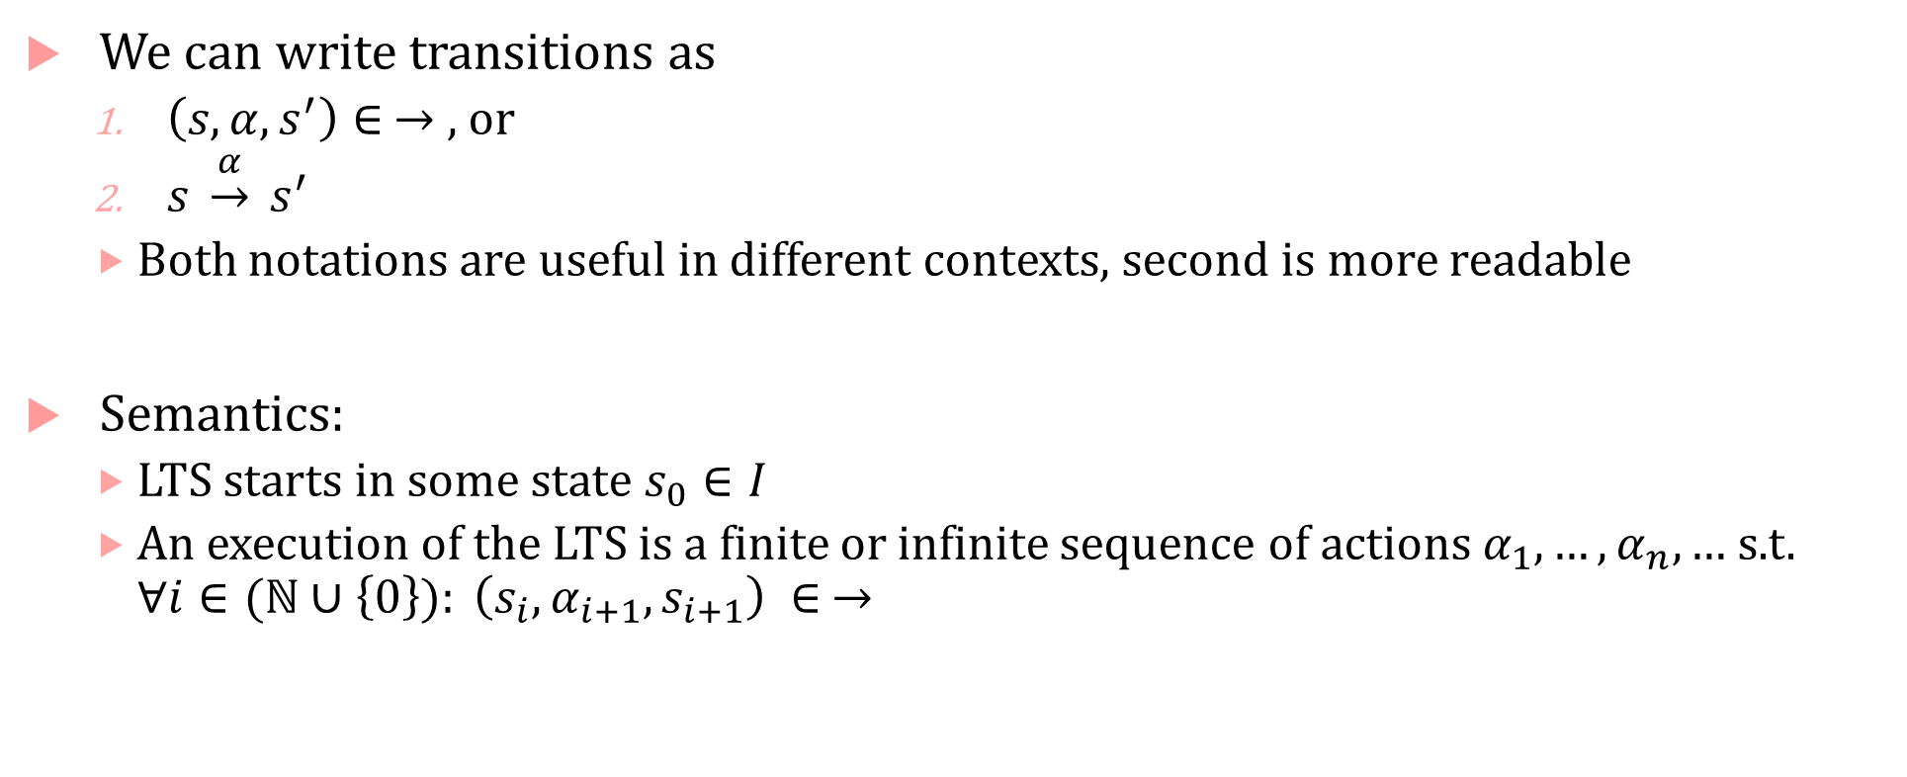
Transitions
We can write transitions as
$\left(s,α,s^{′}\right)∈ →$ , or
$s \underset{→}{α} s^{′}$
Both notations are useful in different contexts, second is more readable
Semantics:
LTS starts in some state $s_{0}∈I$
An execution of the LTS is a finite or infinite sequence of actions $α_{1},…, α_{n},…$ s.t. $∀i∈(ℕ∪\left\{0\right\}): \left(s_{i},α_{i+1}, s_{i+1}\right) ∈ →$

Slide 6
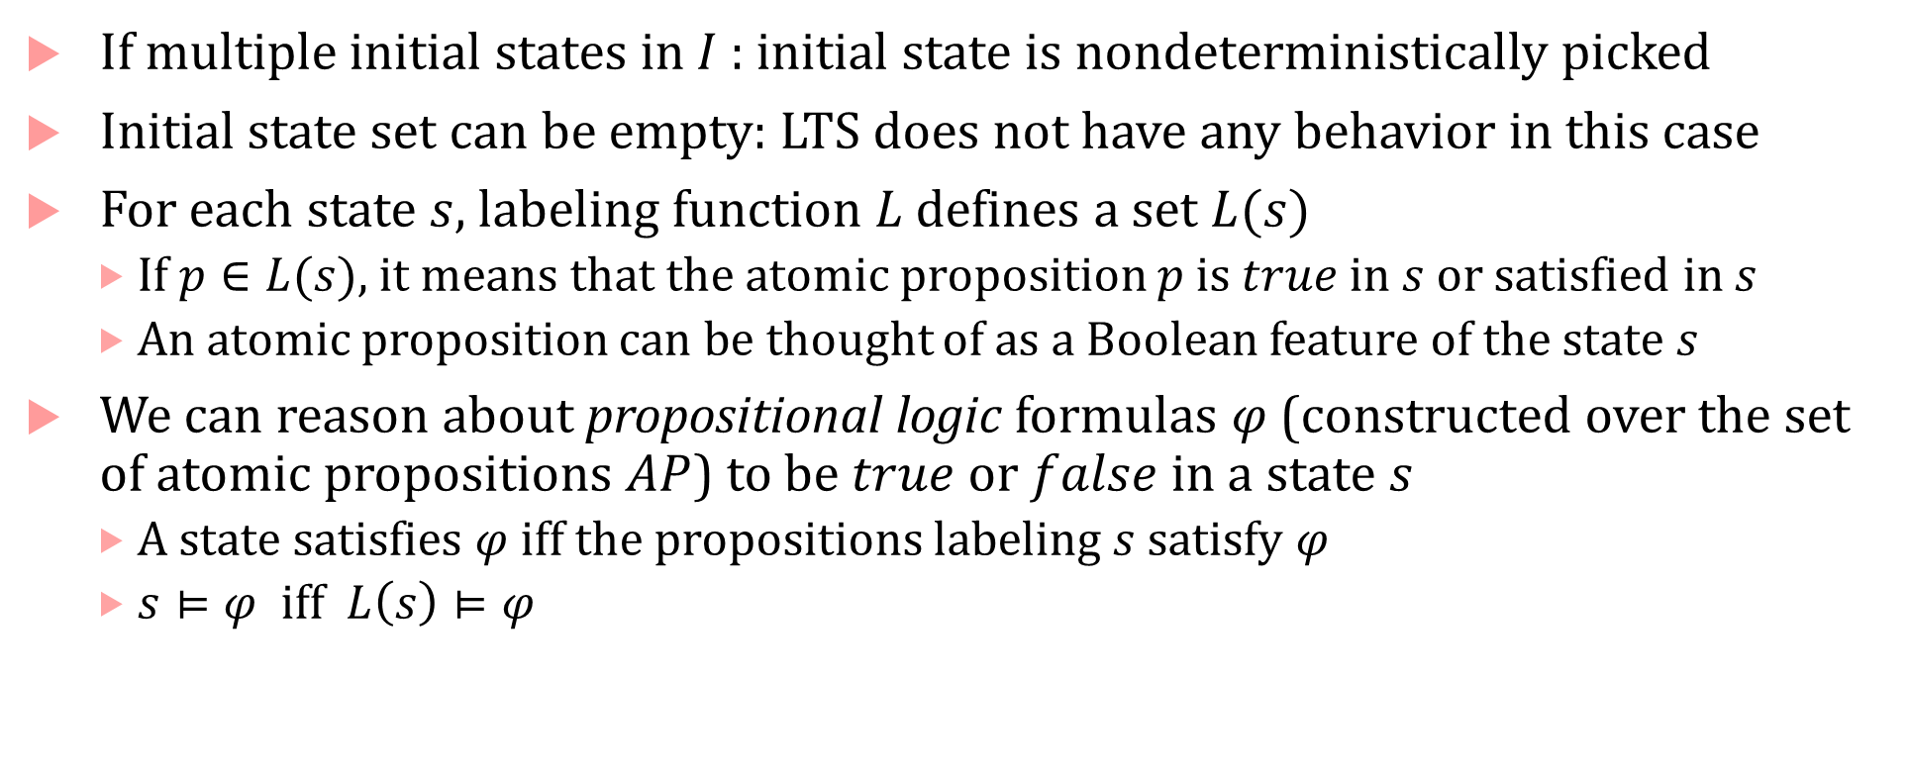
Initial states & Atomic propositions
If multiple initial states in $I$: initial state is nondeterministically picked
Initial state set can be empty: LTS does not have any behavior in this case
For each state $s$, labeling function $L$ defines a set $L(s)$
If $p∈L(s)$, it means that the atomic proposition $p$ is $true$ in $s$ or satisfied in $s$
An atomic proposition can be thought of as a Boolean feature of the state $s$
We can reason about propositional logic formulas $φ$ (constructed over the set of atomic propositions $AP$) to be $true$ or $false$in a state $s$
A state satisfies $φ$ iff the propositions labeling $s$ satisfy $φ$
$s⊨φ$ iff $L\left(s\right)⊨φ$

Slide 7



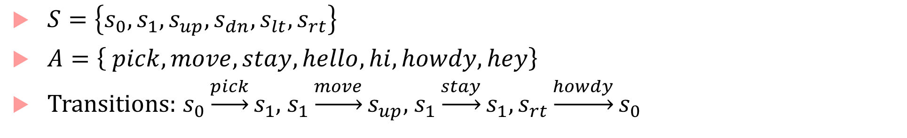



Example of LTS
$$s_{0}$$
hello
hey
pick
stay
$$s_{up}$$
move
$$s_{1}$$
move
$$s_{dn}$$
hi
move
move
howdy
$$s_{lt}$$
$$s_{rt}$$
$S=\left\{s_{0},s_{1},s_{up},s_{dn},s_{lt},s_{rt}\right\}$
$A=\left\{ pick, move,stay, hello,hi,howdy,hey\right\}$
Transitions: $s_{0}\underset{→}{pick}s_{1}$, $s_{1}\underset{→}{move}s_{up}$, $s_{1}\underset{→}{stay}s_{1}, s_{rt}\underset{→}{howdy}s_{0}$

Slide 8
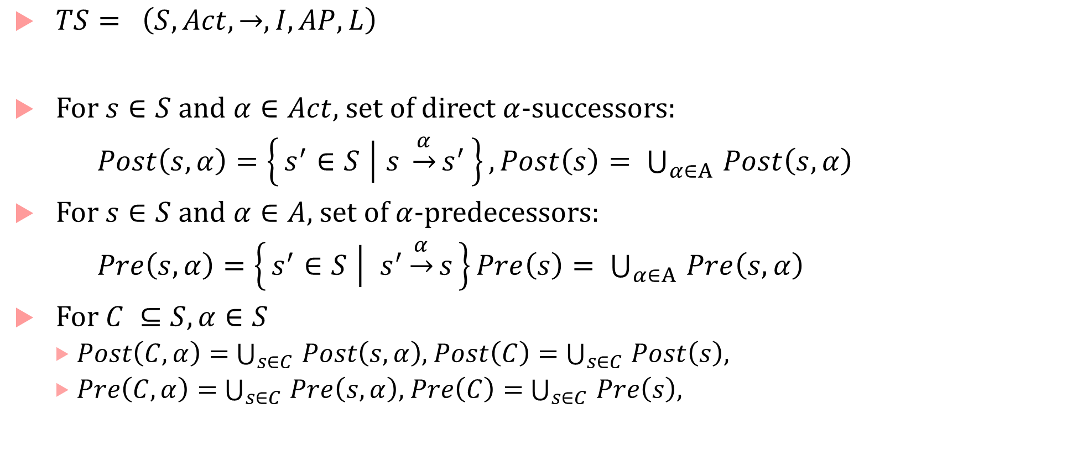
Successors and Predecessors
$TS= \left(S, Act, →, I, AP, L\right)$
For $s∈S$ and $α∈Act$, set of direct $α$-successors:
$Post\left(s,α\right)=\left\{s^{′}∈S ∣ s \underset{→}{α}s^{′}\right\}, Post\left(s\right)= \bigcup_{α∈A }{Post\left(s,α\right)}$
For $s∈S$ and $α∈A$, set of $α$-predecessors:
$Pre\left(s,α\right)=\left\{s^{′}∈S ∣ s^{′}\underset{→}{α}s\right\}Pre\left(s\right)= \bigcup_{α∈A }{Pre\left(s,α\right)}$
For $C ⊆S, α∈S$
$Post\left(C,α\right)=$ $\bigcup_{s∈C }{Post\left(s,α\right)}$, $Post\left(C\right)=$ $\bigcup_{s∈C }{Post\left(s\right)}$,
$Pre\left(C,α\right)=$ $\bigcup_{s∈C }{Pre\left(s,α\right)}$, $Pre\left(C\right)=$ $\bigcup_{s∈C }{Pre\left(s\right)}$,

Slide 9
Example of LTS
$$s_{0}$$
hello
hey
pick
stay
$$s_{up}$$
move
$$s_{1}$$
move
$$s_{dn}$$
hi
move
move
howdy
$$s_{lt}$$
$$s_{rt}$$
$S=\left\{s_{0},s_{1},s_{up},s_{dn},s_{lt},s_{rt}\right\}$
$A=\left\{ pick, move,stay, hello,hi,howdy,hey\right\}$
Transitions: $s_{0}\underset{→}{pick}s_{1}$, $s_{1}\underset{→}{move}s_{up}$, $s_{1}\underset{→}{stay}s_{1}, s_{rt}\underset{→}{howdy}s_{0}$

Slide 10
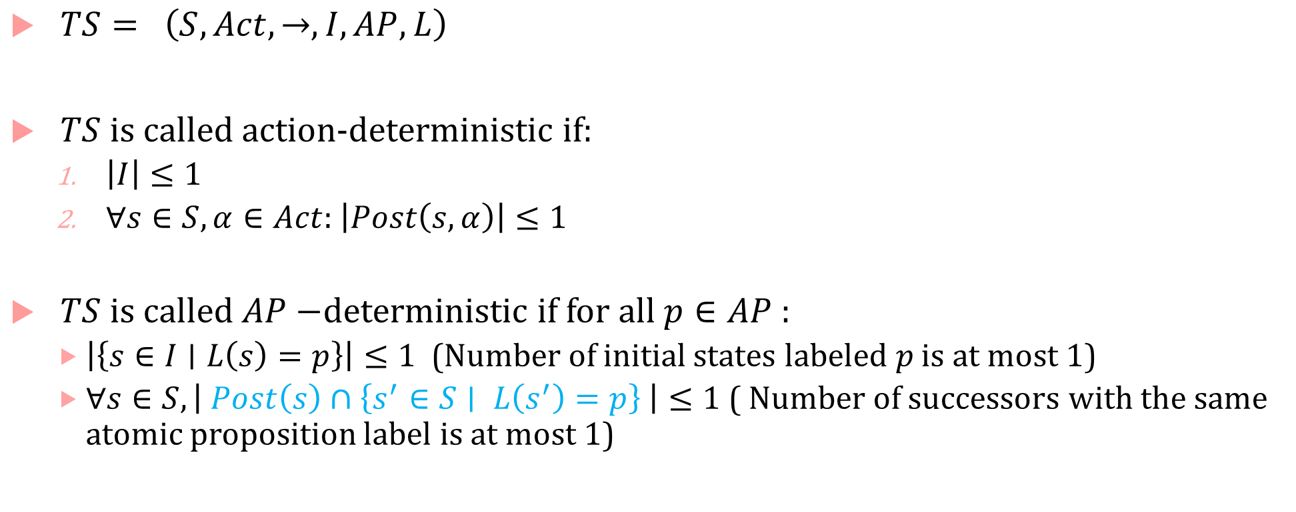
Deterministic Transition System
$TS= \left(S, Act, →, I, AP, L\right)$
$TS$ is called action-deterministic if:
$\left|I\right|≤1$
$∀s∈S,α∈Act$: $\left|Post\left(s,α\right)\right|≤1$
$TS$ is called $AP−$deterministic if for all $p∈AP$:
$\left|\left\{s∈I∣L\left(s\right)=p\right\}\right|≤1$ (Number of initial states labeled $p$ is at most 1)
$∀s∈S, \left| Post\left(s\right)∩\left\{s^{′}∈S∣ L\left(s^{′}\right)=p\right\} \right|≤1$ ( Number of successors with the same atomic proposition label is at most 1)

Slide 11
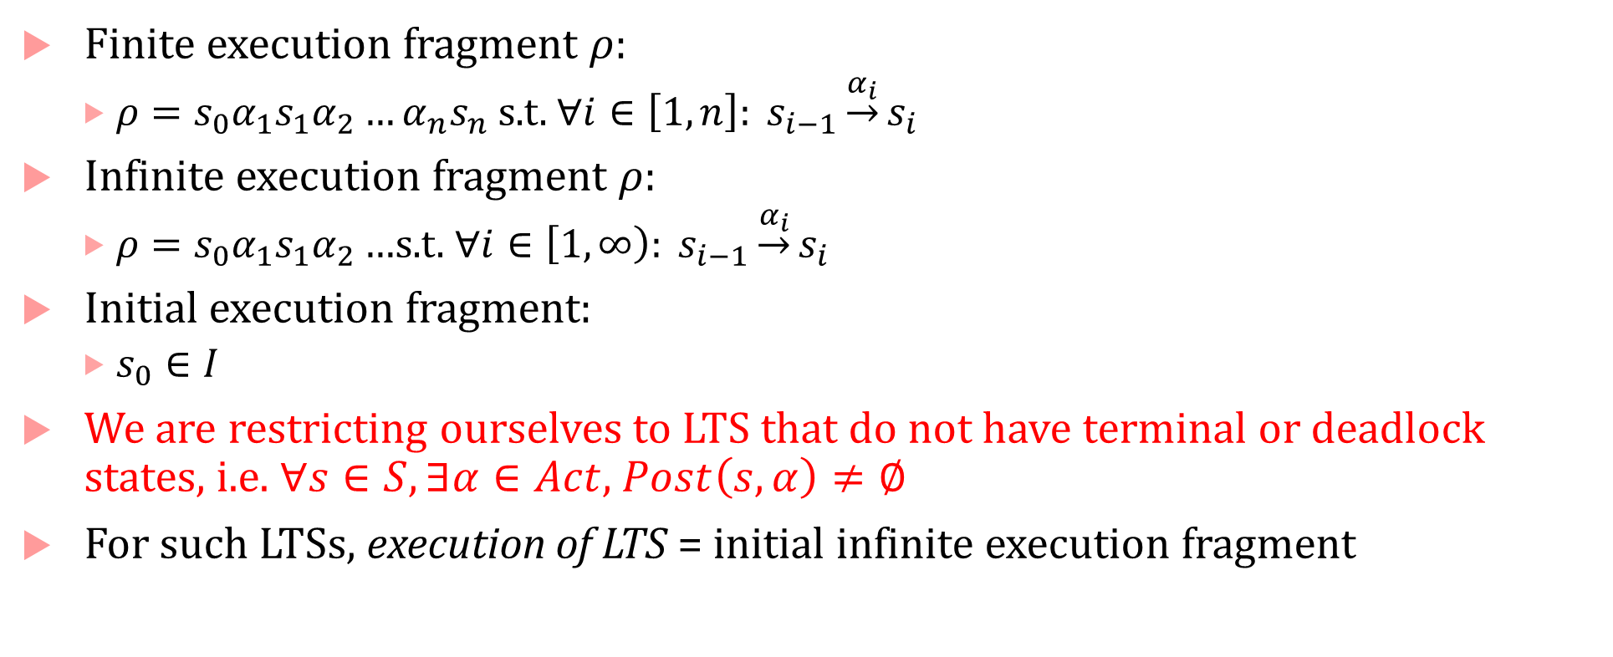
Executions
Finite execution fragment $ρ$:
$ρ=s_{0}α_{1}s_{1}α_{2}…α_{n}s_{n}$ s.t. $∀i∈\left[1,n\right]: s_{i−1}\underset{→}{α_{i}}s_{i}$
Infinite execution fragment $ρ$:
$ρ=s_{0}α_{1}s_{1}α_{2}…$s.t. $∀i∈\left[1,∞\right): s_{i−1}\underset{→}{α_{i}}s_{i}$
Initial execution fragment:
$s_{0}∈I$
We are restricting ourselves to LTS that do not have terminal or deadlock states, i.e. $∀s∈S,∃α∈Act$, $Post\left(s,α\right)≠∅$
For such LTSs, execution of LTS = initial infinite execution fragment

Slide 12



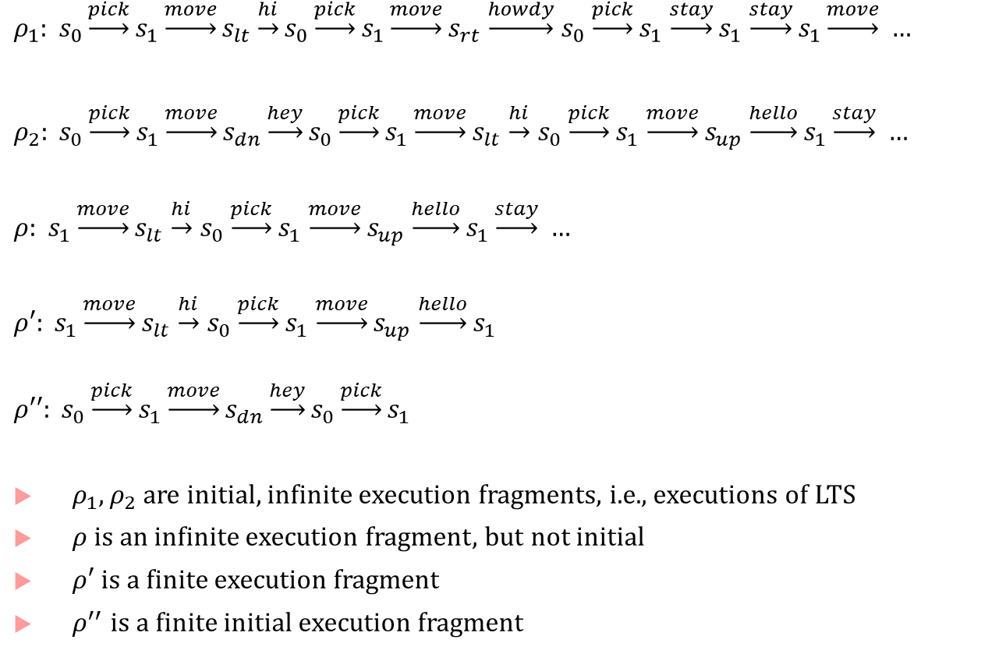



Execution example
$ρ_{1}: s_{0}\underset{→}{pick}s_{1}\underset{→}{move}s_{lt}\underset{→}{hi}s_{0}\underset{→}{pick}s_{1}\underset{→}{move}s_{rt}$ $\underset{→}{howdy}$ $s_{0}$ $\underset{→}{pick}s_{1}$ $\underset{→}{stay}s_{1}$ $\underset{→}{stay}s_{1}\underset{→}{move} …$
$ρ_{2}: s_{0}\underset{→}{pick}s_{1}\underset{→}{move}s_{dn}\underset{→}{hey}s_{0}\underset{→}{pick}s_{1}\underset{→}{move}s_{lt}$ $\underset{→}{hi}$ $s_{0}$ $\underset{→}{pick}s_{1}$ $\underset{→}{move}s_{up}$ $\underset{→}{hello}s_{1}\underset{→}{stay} …$
$ρ: s_{1}\underset{→}{move}s_{lt}$ $\underset{→}{hi}$ $s_{0}$ $\underset{→}{pick}s_{1}$ $\underset{→}{move}s_{up}$ $\underset{→}{hello}s_{1}\underset{→}{stay} …$
$ρ′: s_{1}\underset{→}{move}s_{lt}$ $\underset{→}{hi}$ $s_{0}$ $\underset{→}{pick}s_{1}$ $\underset{→}{move}s_{up}$ $\underset{→}{hello}s_{1}$
$$ρ′′: s_{0}\underset{→}{pick}s_{1}\underset{→}{move}s_{dn}\underset{→}{hey}s_{0}\underset{→}{pick}s_{1}$$
$ρ_{1},ρ_{2}$ are initial, infinite execution fragments, i.e., executions of LTS
$ρ$ is an infinite execution fragment, but not initial
$ρ′$ is a finite execution fragment
$ρ^{′′}$ is a finite initial execution fragment
$$s_{0}$$
hello
hey
pick
stay
$$s_{up}$$
move
$$s_{1}$$
move
$$s_{dn}$$
hi
move
move
howdy
$$s_{lt}$$
$$s_{rt}$$

Slide 13



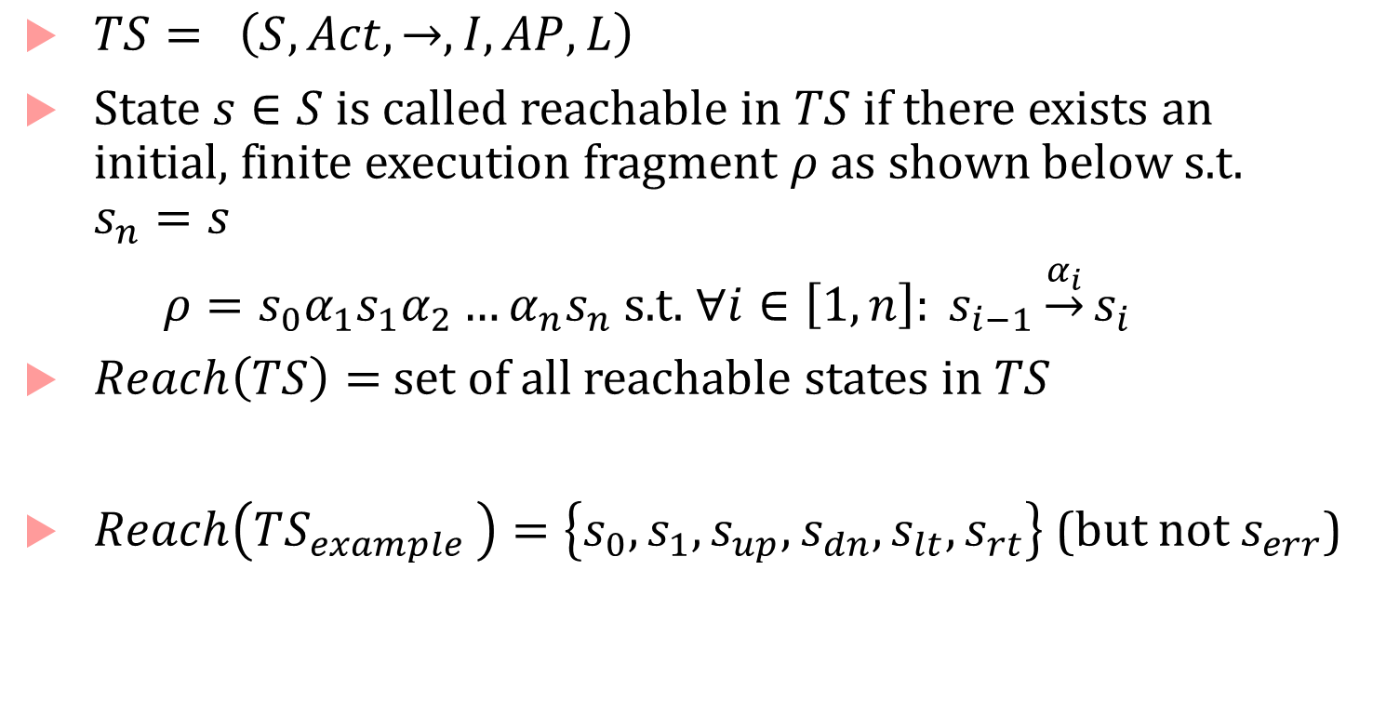





Reachable States
$TS= \left(S, Act, →, I, AP, L\right)$
State $s∈S$ is called reachable in $TS$ if there exists an initial, finite execution fragment $ρ$ as shown below s.t. $s_{n}=s$
$ρ=s_{0}α_{1}s_{1}α_{2}…α_{n}s_{n}$ s.t. $∀i∈\left[1,n\right]: s_{i−1}\underset{→}{α_{i}}s_{i}$
$Reach\left(TS\right)=$ set of all reachable states in $TS$
$Reach\left(TS_{example }\right)=\left\{s_{0},s_{1},s_{up},s_{dn},s_{lt},s_{rt}\right\}$ (but not $s_{err}$)
$$TS_{example}$$
$$s_{0}$$
hello
hey
pick
stay
$$s_{up}$$
move
$$s_{1}$$
move
$$s_{dn}$$
hi
move
move
howdy
$$s_{lt}$$
$$s_{rt}$$
$$s_{err}$$

Slide 14
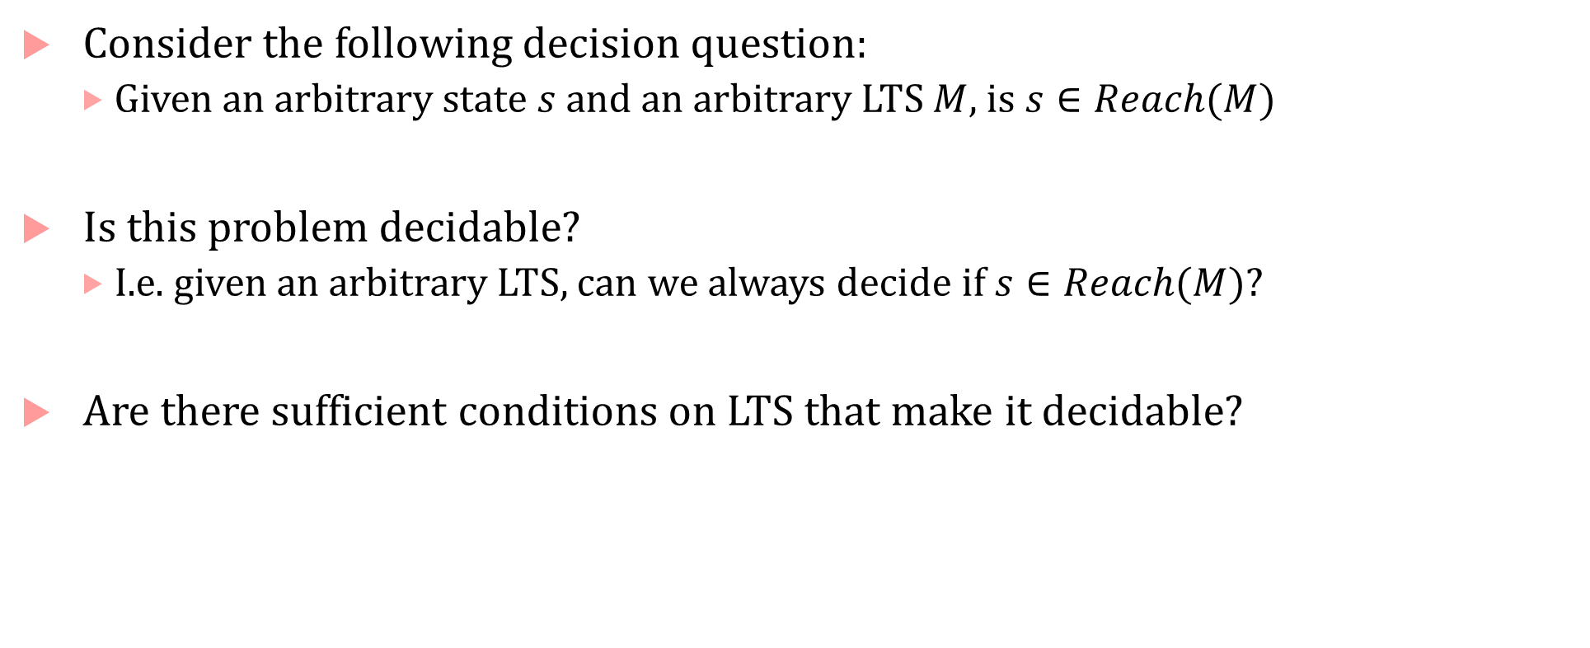
Socratic exercise
Consider the following decision question:
Given an arbitrary state $s$ and an arbitrary LTS $M$, is $s∈Reach(M)$
Is this problem decidable?
I.e. given an arbitrary LTS, can we always decide if $s∈Reach(M)$?
Are there sufficient conditions on LTS that make it decidable?

Slide 15
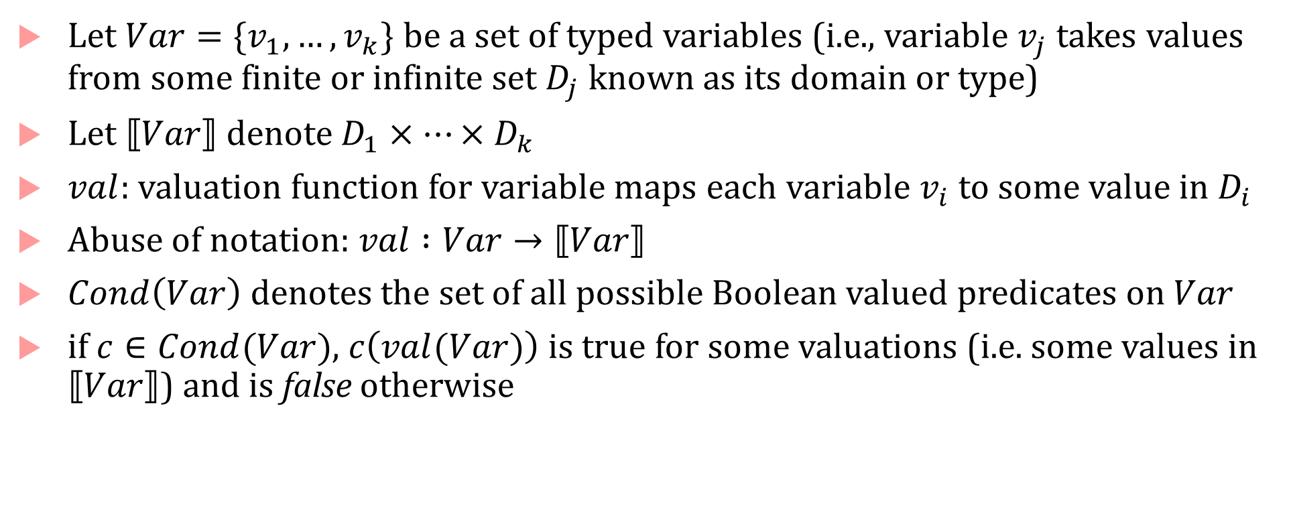
Modeling Programs using LTSs
Let $Var=\{v_{1},…, v_{k}\}$ be a set of typed variables (i.e., variable $v_{j}$ takes values from some finite or infinite set $D_{j}$ known as its domain or type)
Let $⟦Var⟧$ denote $D_{1}×…×D_{k}$
$val$: valuation function for variable maps each variable $v_{i}$ to some value in $D_{i}$
Abuse of notation: $val :Var→⟦Var⟧$
$Cond\left(Var\right)$ denotes the set of all possible Boolean valued predicates on $Var$
if $c∈Cond(Var)$, $c\left(val(Var)\right)$ is true for some valuations (i.e. some values in $⟦Var⟧$) and is false otherwise

Slide 16
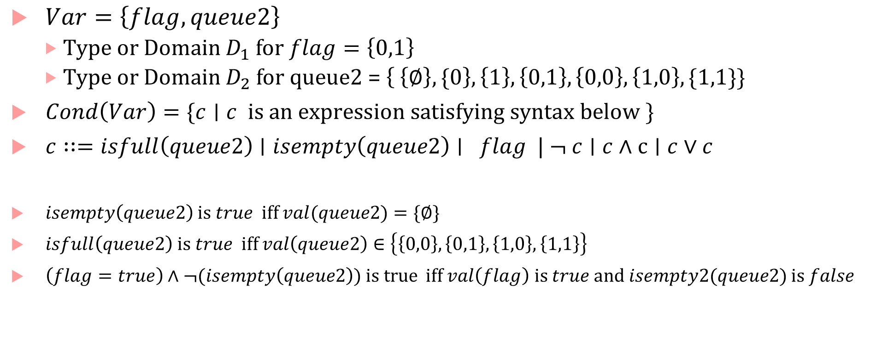
Examples
$Var=\left\{flag, queue2\right\}$
Type or Domain $D_{1}$ for $flag=\left\{0,1\right\}$
Type or Domain $D_{2}$ for queue2 = $\left\{ \left\{∅\right\}, \{0\right\},\left\{1\right\}, \left\{0,1\right\},\left\{0,0\right\},\left\{1,0\right\},\{1,1\}\}$
$Cond\left(Var\right)=\{c∣c is an expression satisfying syntax below \}$
$c∷=isfull\left(queue2\right)∣isempty\left(queue2\right)∣ flag | ¬ c∣c∧c∣c∨c$
$isempty\left(queue2\right)$ is $true$ iff $val(queue2)=\{∅\}$
$isfull\left(queue2\right)$ is $true$ iff $val\left(queue2\right)∈\left\{\left\{0,0\right\},\left\{0,1\right\},\left\{1,0\right\},\left\{1,1\right\}\right\}$
$\left(flag=true\right)∧¬(isempty\left(queue2\right))$is true iff $val\left(flag\right)$ is $true$ and $isempty2(queue2)$ is $false$

Slide 17
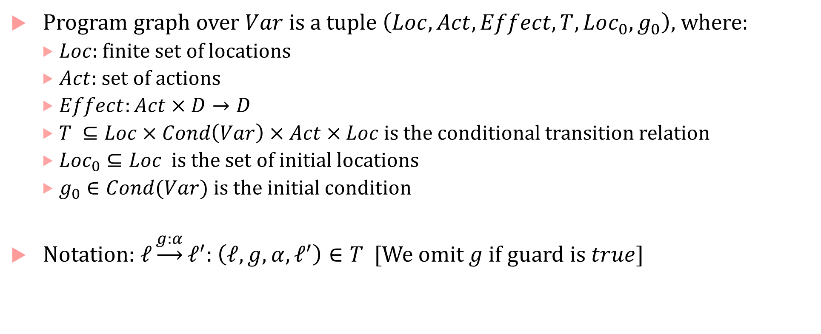
Program graphs
Program graph over $Var$ is a tuple $\left(Loc, Act, Effect, T,Loc_{0},g_{0}\right)$, where:
$Loc$: finite set of locations
$Act$: set of actions
$Effect:Act×D→D$
$T ⊆Loc×Cond\left(Var\right)×Act×Loc$ is the conditional transition relation
$Loc_{0}⊆Loc$ is the set of initial locations
$g_{0}∈Cond(Var)$ is the initial condition
Notation: $ℓ\underset{→}{g:α}ℓ^{′}$: $\left(ℓ,g,α, ℓ^{′}\right)∈T$ [We omit $g$ if guard is $true$]

Slide 18
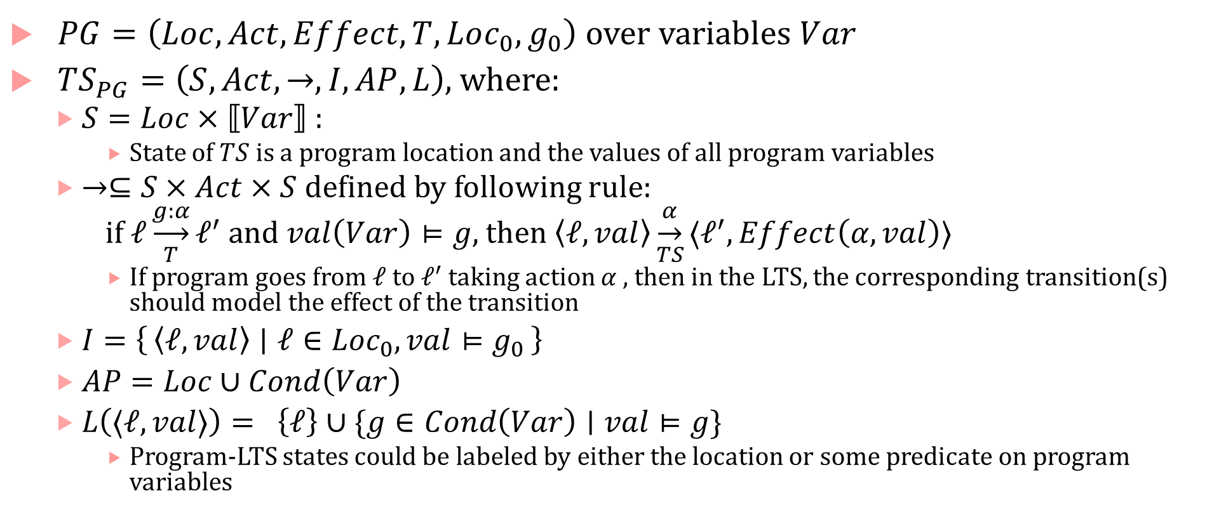
LTS semantics of a program graph
$PG=\left(Loc, Act, Effect, T,Loc_{0},g_{0}\right)$ over variables $Var$
$TS_{PG}=\left(S,Act, →, I, AP, L\right)$, where:
$S=Loc×⟦Var⟧$ :
State of $TS$ is a program location and the values of all program variables
$→⊆S×Act×S$ defined by following rule:
if $ℓ\underset{T}{\underset{→}{g:α}}ℓ^{′}$ and $val\left(Var\right)⊨g$, then $\left\langle ℓ, val\right\rangle \underset{TS}{\underset{→}{α}}⟨ℓ^{′}, Effect\left(α, val\right)⟩$
If program goes from $ℓ$ to $ℓ^{′}$ taking action $α ,$ then in the LTS, the corresponding transition(s) should model the effect of the transition
$I=\left\{\left\langle ℓ, val\right\rangle ∣ ℓ∈Loc_{0}, val⊨g_{0}\right\}$
$AP=Loc∪Cond\left(Var\right)$
$L\left(⟨ℓ,val⟩\right)= \left\{ℓ\right\}∪\{g∈Cond\left(Var\right)∣val⊨g\}$
Program-LTS states could be labeled by either the location or some predicate on program variables

Slide 19
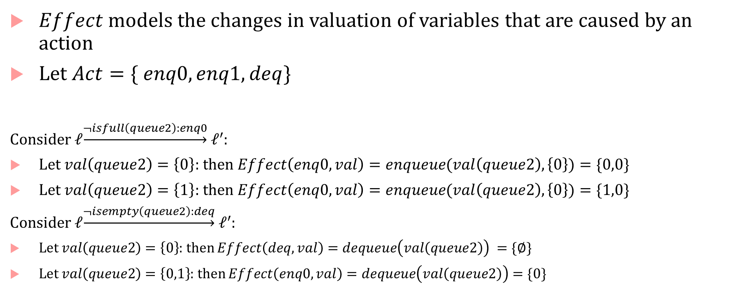
Effect and (e)valuation
$Effect$ models the changes in valuation of variables that are caused by an action
Let $Act=\{ enq0, enq1, deq\}$
Consider $ℓ\underset{→}{¬isfull\left(queue2\right):enq0} ℓ^{′}$:
Let $val\left(queue2\right)=\left\{0\right\}$: then $Effect\left(enq0,val\right)=enqueue(val\left(queue2\right),\left\{0\right\})=\{0,0\}$
Let $val\left(queue2\right)=\left\{1\right\}$: then $Effect\left(enq0,val\right)=enqueue(val\left(queue2\right),\left\{0\right\})=\{1,0\}$
Consider $ℓ\underset{→}{¬isempty\left(queue2\right):deq} ℓ^{′}$:
Let $val\left(queue2\right)=\left\{0\right\}$: then $Effect\left(deq,val\right)=dequeue\left(val\left(queue2\right)\right) =\{∅\}$
Let $val\left(queue2\right)=\left\{0,1\right\}$: then $Effect\left(enq0,val\right)=dequeue\left(val\left(queue2\right)\right)=\{0\}$

Slide 20
LTS can model almost any computation
Sequential hardware circuits
Registers get new values every tick (depends on old values, input values, the circuit function)
States = valuations of registers and input variables
Actions = just one action “clock tick”
Transition relation = transitions between circuit states
Labels : truth values of any chosen “named wire” in the circuit (e.g., input, register, output, etc.)
Dynamical Systems
States are valuations of state variables of the system (can be continuous or discrete)
Actions can be taken by an external agent/controller
Transitions defined by the system dynamics (can be continuous or discrete)
Propositions defined by predicates on state variables, Labels = truth values of propositions for each state

Slide 21






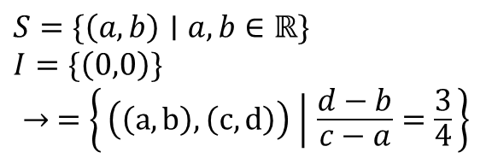
LTS model of an ODE
(0,0)
$\frac{dx_{1}}{dt}=4;\frac{dx_{2}}{dt}=3$; $x_{1}\left(0\right)=0, x_{2}\left(0\right)=0$
(2,1.5)
(3,2.25)
$$S=\{\left(a,b\right)∣a,b∈ℝ\}$$
$$I=\{\left(0,0\right)\}$$
$$→ =\left\{\left(\left(a,b\right),\left(c,d\right)\right) ∣ \frac{d−b}{c−a}=\frac{3}{4}\right\}$$
$$(8,6)$$
(4,3)
$$(6,4.5)$$
(5.5,4.125)
$$(4,3)$$
(6,4.5)
$$(0,0)$$
$$(2,1.5)$$
$$x_{1}$$
What is the set of reachable states of this LTS?
(8,6)

Slide 22
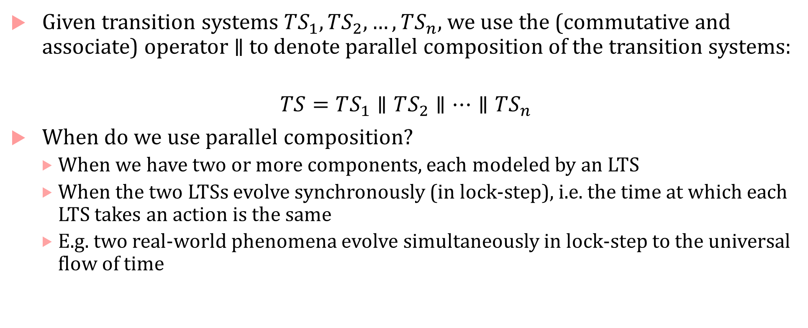
Concurrent Evolution/Parallelism and Communication
Given transition systems $TS_{1},TS_{2},…, TS_{n}$, we use the (commutative and associate) operator $∥$ to denote parallel composition of the transition systems:
$$TS=TS_{1}∥TS_{2}∥…∥TS_{n}$$
When do we use parallel composition?
When we have two or more components, each modeled by an LTS
When the two LTSs evolve synchronously (in lock-step), i.e. the time at which each LTS takes an action is the same
E.g. two real-world phenomena evolve simultaneously in lock-step to the universal flow of time

Slide 23
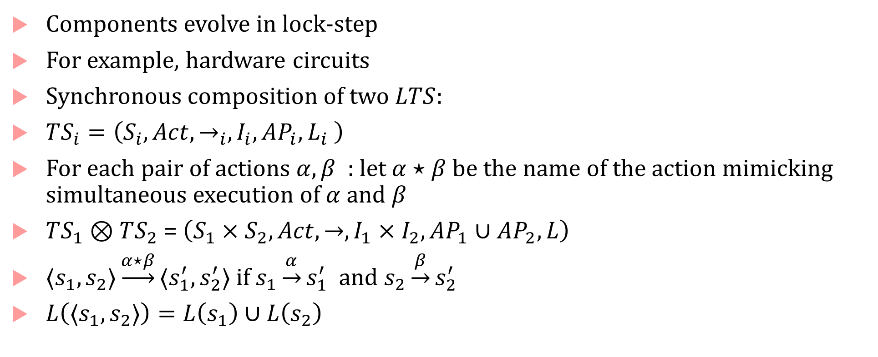
Synchronous composition
Components evolve in lock-step
For example, hardware circuits
Synchronous composition of two $LTS$:
$TS_{i}=\left(S_{i},Act,→_{i},I_{i},AP_{i},L_{i} \right)$
For each pair of actions $α, β$ : let $α⋆β$ be the name of the action mimicking simultaneous execution of $α$ and $β$
$TS_{1}⊗TS_{2}$ = $\left(S_{1}×S_{2},Act, →,I_{1}×I_{2},AP_{1}∪AP_{2},L\right)$
$⟨s_{1},s_{2}⟩\underset{→}{α⋆β}⟨s_{1}^{′},s_{2}^{′}⟩$ if $s_{1}\underset{→}{α}s_{1}^{′}$ and $s_{2}\underset{→}{β}s_{2}^{′}$
$L\left(⟨s_{1},s_{2}⟩\right)=L\left(s_{1}\right)∪L\left(s_{2}\right)$

Slide 24

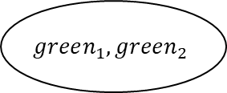
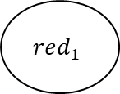
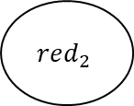
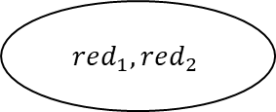

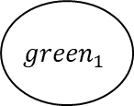

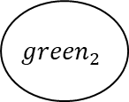


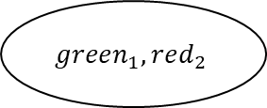



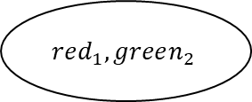
When LTSs evolve asynchronously (no shared notion of time)
Programs may not use a common global clock: Synchronizing time quite involved!
Programs communicate through messages (e.g. distributed/cloud-based systems)
We cannot assume an order in which actions of different LTSs execute
Most inclusive model: interleaved order (all permutations in which actions execute)
$$red_{1}$$
$$red_{2}$$
$$red_{1},red_{2}$$
$$2$$
$$1$$
$$1$$
$$1$$
$$2$$
$$2$$
$$2$$
$$1$$
$$red_{1},green_{2}$$
$$green_{1},red_{2}$$
$${green}_{1}$$
$${green}_{2}$$
$$1$$
$$2$$
$$1$$
$$green_{1},green_{2}$$
$$2$$
$$TS_{1}$$
$$TS_{2}$$

Slide 25
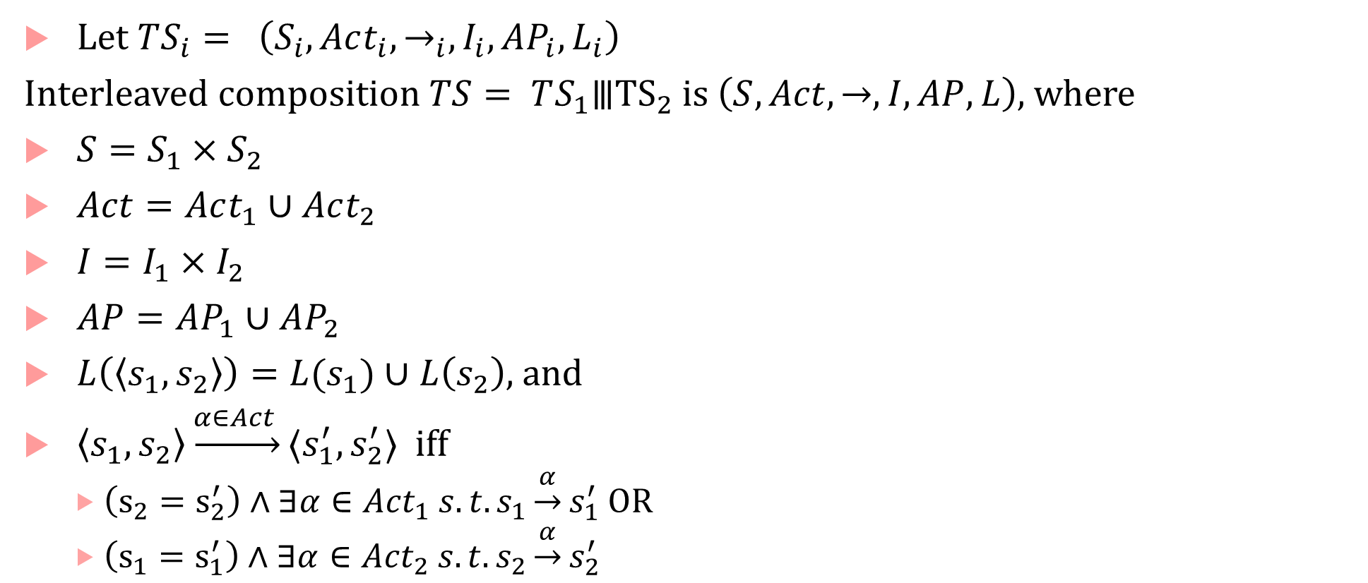
Interleaved composition of LTSs
Let $TS_{i}= \left(S_{i}, Act_{i}, →_{i}, I_{i}, AP_{i}, L_{i}\right)$
Interleaved composition $TS= TS_{1}⦀{TS}_{2}$ is $\left(S, Act, →, I, AP, L\right)$, where
$S=S_{1}×S_{2}$
$Act=Act_{1}∪Act_{2}$
$I=I_{1}×I_{2}$
$AP=AP_{1}∪AP_{2}$
$L\left(\left\langle s_{1},s_{2}\right\rangle \right)=L(s_{1})∪L\left(s_{2}\right)$, and
$\left\langle s_{1},s_{2}\right\rangle \underset{→}{α∈Act }⟨s_{1}^{′},s_{2}^{′}⟩$ iff
$\left(s_{2}=s_{2}^{′}\right)∧∃α∈{Act}_{1} s.t. s_{1}\underset{→}{α}s_{1}^{′}$ OR
$\left(s_{1}=s_{1}^{′}\right)∧∃α∈{Act}_{2} s.t. s_{2}\underset{→}{α}s_{2}^{′}$

Slide 26
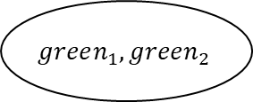
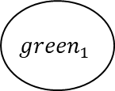




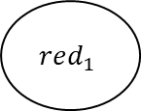

Interleaved LTS
LTS states nondeterministically choose which action to execute ($1$ or $2$)
$$red_{1}$$
$$red_{2}$$
$$red_{1},red_{2}$$
$$2$$
$$1$$
$$1$$
$$1$$
$$2$$
$$2$$
$$2$$
$$1$$
$$red_{1},green_{2}$$
$$green_{1},red_{2}$$
$${green}_{1}$$
$${green}_{2}$$
$$1$$
$$2$$
$$1$$
$$green_{1},green_{2}$$
$$2$$
$$TS_{1}$$
$$TS_{2}$$

Slide 27
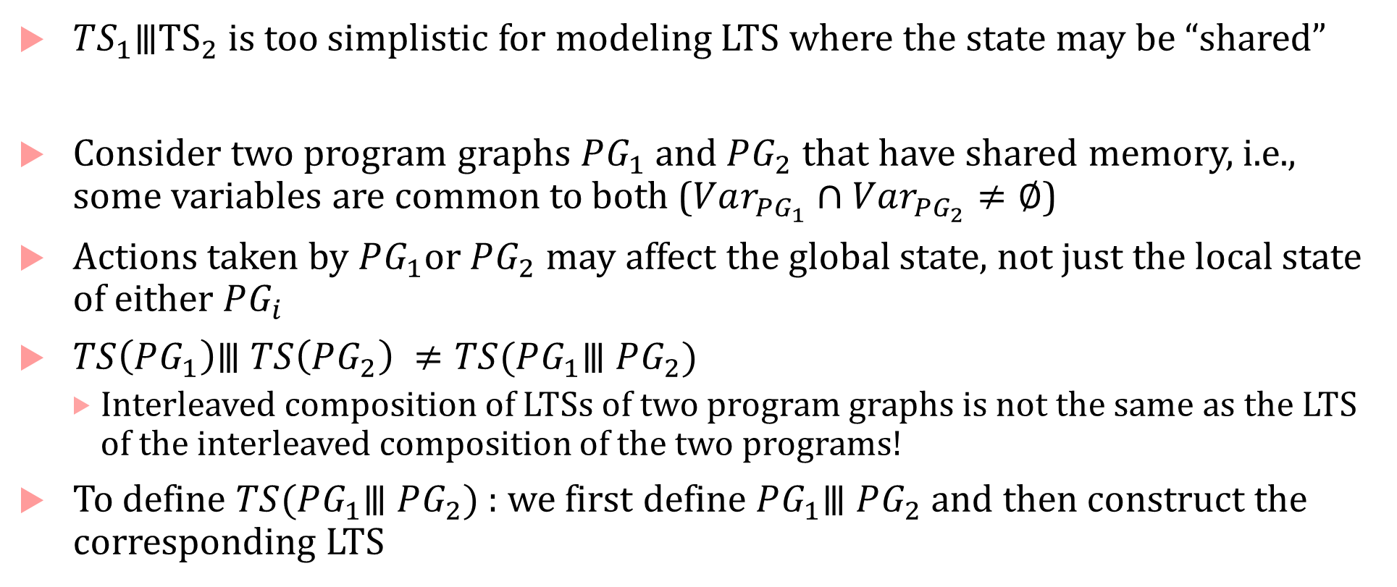
Shared memory/Asynchronous Message Passing
$TS_{1}⦀{TS}_{2}$ is too simplistic for modeling LTS where the state may be “shared”
Consider two program graphs $PG_{1}$ and $PG_{2}$ that have shared memory, i.e., some variables are common to both ($Var_{PG_{1}}∩Var_{PG_{2}}≠∅$)
Actions taken by $PG_{1}$or $PG_{2}$ may affect the global state, not just the local state of either $PG_{i}$
$TS\left(PG_{1}\right)⦀ TS\left(PG_{2}\right) ≠TS(PG_{1}⦀ PG_{2})$
Interleaved composition of LTSs of two program graphs is not the same as the LTS of the interleaved composition of the two programs!
To define $TS(PG_{1}⦀ PG_{2})$ : we first define $PG_{1}⦀ PG_{2}$and then construct the corresponding LTS

Slide 28

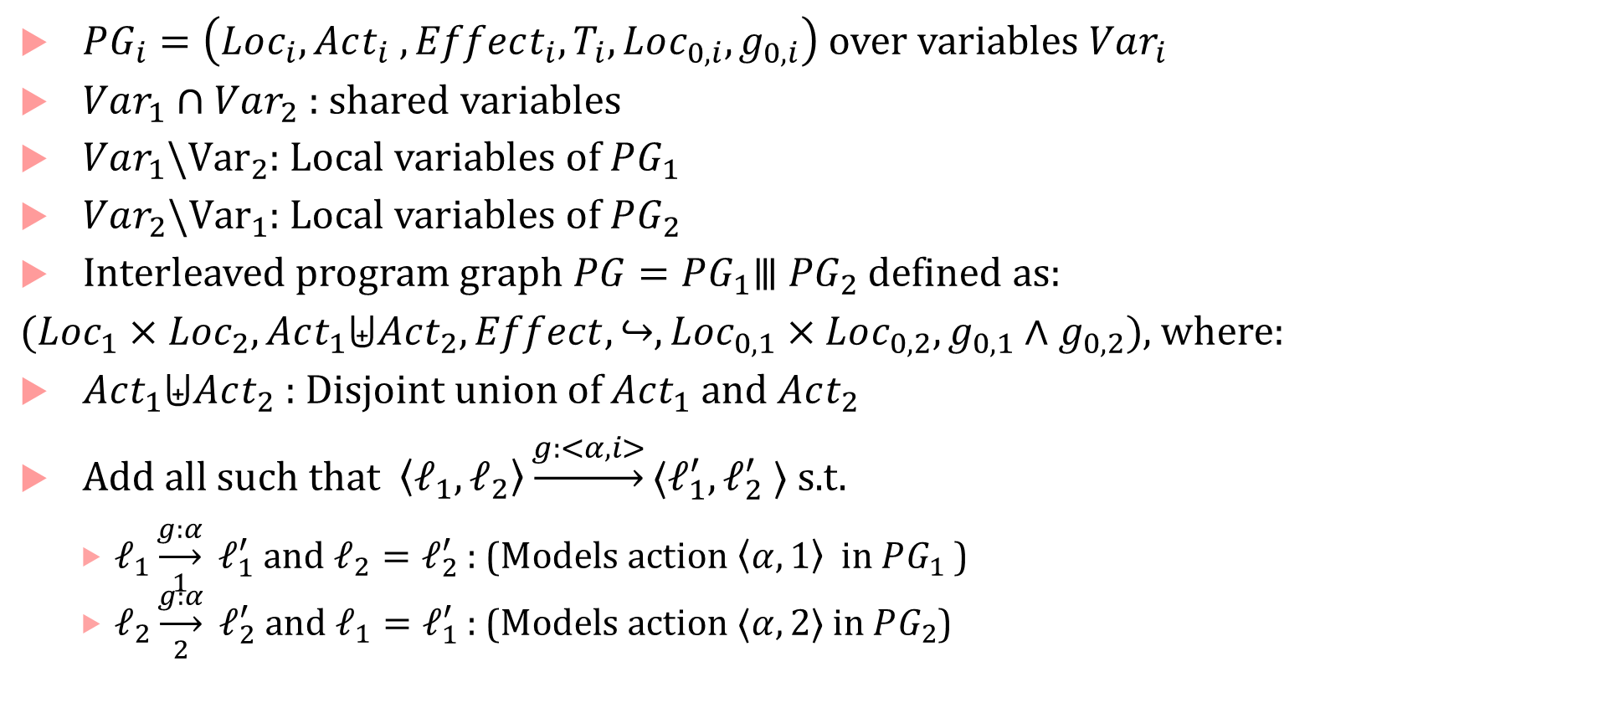
Interleaving of program graphs
$PG_{i}=\left(Loc_{i}, Act_{i} ,Effect_{i}, T_{i},Loc_{0,i},g_{0,i}\right)$ over variables $Var_{i}$
$Var_{1}∩Var_{2}$ : shared variables
$Var_{1}\backslash {Var}_{2}$: Local variables of $PG_{1}$
$Var_{2}\backslash {Var}_{1}$: Local variables of $PG_{2}$
Interleaved program graph $PG=PG_{1}⦀ PG_{2}$ defined as:
$(Loc_{1}×Loc_{2}, Act_{1}⨄Act_{2},Effect,↪,Loc_{0,1}×Loc_{0,2}, g_{0,1}∧g_{0,2})$, where:
$Act_{1}⨄Act_{2}$ : Disjoint union of $Act_{1}$ and $Act_{2}$
Add all such that $\left\langle ℓ_{1}, ℓ_{2}\right\rangle \underset{→}{g:<α,i>}⟨ℓ_{1}^{′},ℓ_{2}^{′} ⟩$ s.t.
$ℓ_{1}\underset{1}{\underset{→}{g:α}} ℓ_{1}^{′}$ and $ℓ_{2}=ℓ_{2}^{′}$ : (Models action $\left\langle α,1\right\rangle$ in $PG_{1}$ )
$ℓ_{2}\underset{2}{\underset{→}{g:α}} ℓ_{2}^{′}$ and $ℓ_{1}=ℓ_{1}^{′}$ : (Models action $⟨α,2⟩$ in $PG_{2}$)
$⟨α,i⟩$ : action $α$ is taken by program $PG_{i}$

Slide 29
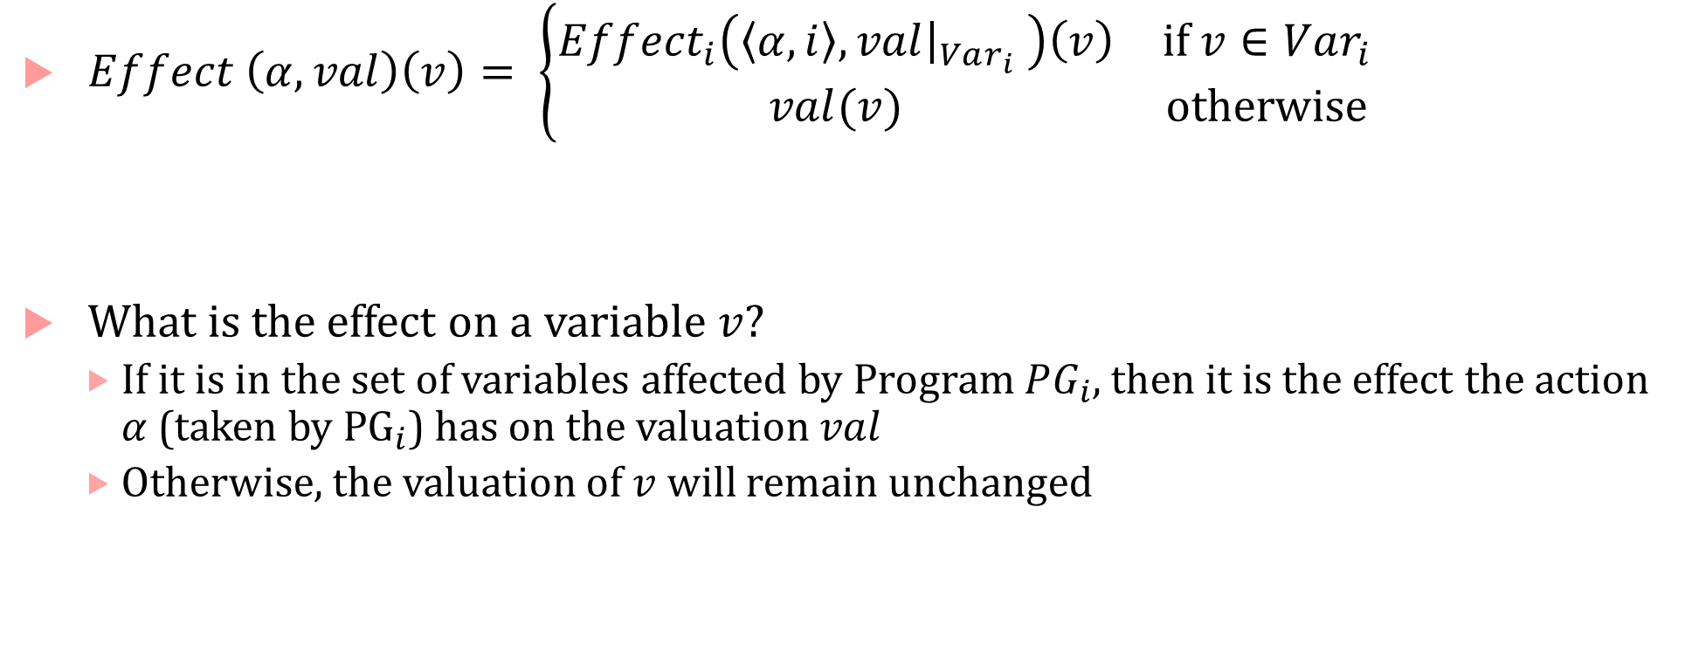
Interleaving Program graphs
$Effect \left(α,val\right)\left(v\right)= \left\{\begin{matrix}Effect_{i}\left(\left\langle α,i\right\rangle ,val{\left.​\right|}_{Var_{i}} \right)\left(v\right) & if v∈Var_{i} \\ val(v) & otherwise\end{matrix}\right.$
What is the effect on a variable $v$?
If it is in the set of variables affected by Program $PG_{i}$, then it is the effect the action $α$ (taken by ${PG}_{i}$) has on the valuation $val$
Otherwise, the valuation of $v$ will remain unchanged

Slide 30
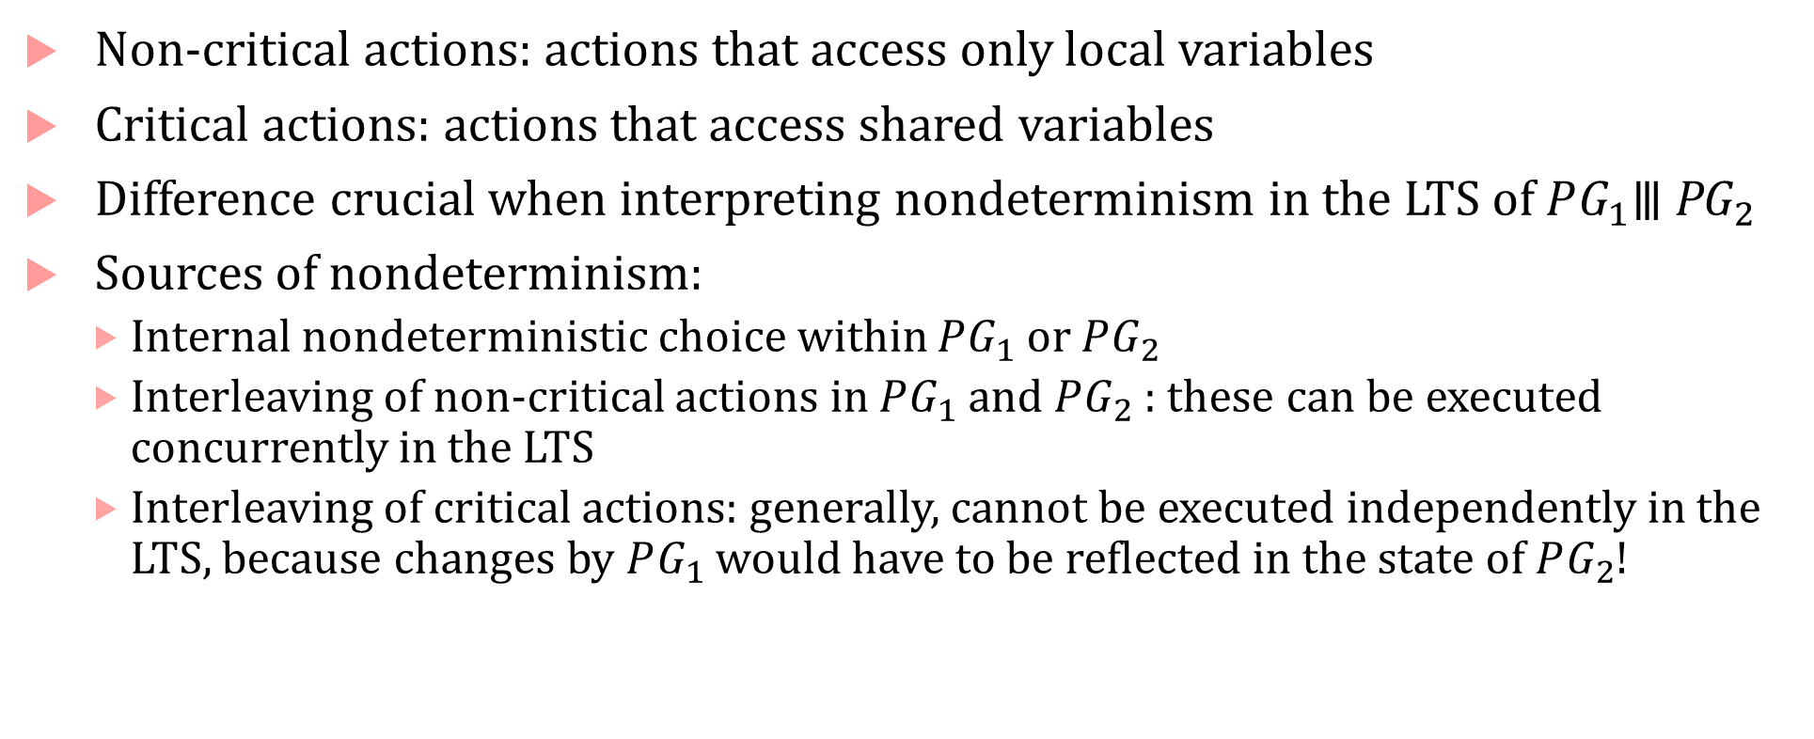
Nondeterminism in program graph interleaving
Non-critical actions: actions that access only local variables
Critical actions: actions that access shared variables
Difference crucial when interpreting nondeterminism in the LTS of $PG_{1}\text{⦀} {\text{PG}}_{2}$
Sources of nondeterminism:
Internal nondeterministic choice within $PG_{1}$ or $PG_{2}$
Interleaving of non-critical actions in $PG_{1}$ and $PG_{2}$ : these can be executed concurrently in the LTS
Interleaving of critical actions: generally, cannot be executed independently in the LTS, because changes by $PG_{1}$ would have to be reflected in the state of $PG_{2}$!

Slide 31
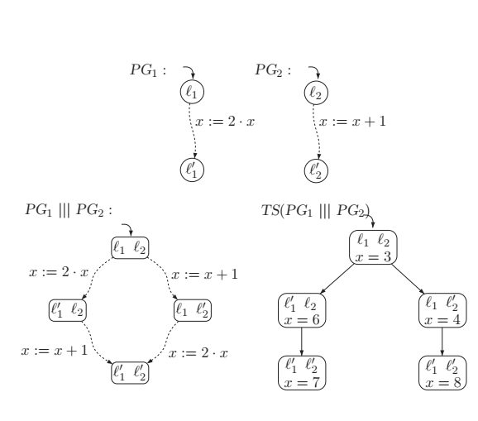
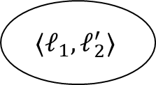
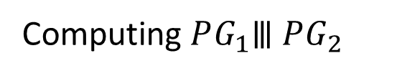
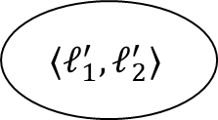

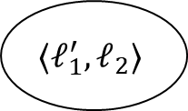

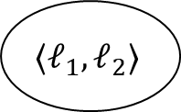

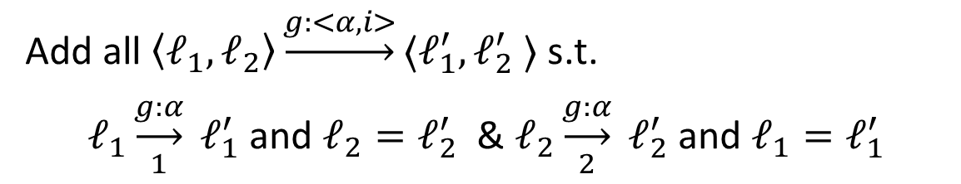

Interleaved Program Graphs
Computing $PG_{1}⦀ PG_{2}$
$$⟨ℓ_{1},ℓ_{2}⟩$$
$$x≔2⋅x$$
$$x≔x+1$$
Add all $\left\langle ℓ_{1}, ℓ_{2}\right\rangle \underset{→}{g:<α,i>}⟨ℓ_{1}^{′},ℓ_{2}^{′} ⟩$ s.t.
$ℓ_{1}\underset{1}{\underset{→}{g:α}} ℓ_{1}^{′}$ and $ℓ_{2}=ℓ_{2}^{′}$ & $ℓ_{2}\underset{2}{\underset{→}{g:α}} ℓ_{2}^{′}$ and $ℓ_{1}=ℓ_{1}^{′}$
$$⟨ℓ_{1}^{′},ℓ_{2}⟩$$
$$⟨ℓ_{1},ℓ_{2}^{′}⟩$$
$$x≔x+1$$
$$x≔2⋅x$$
$$⟨ℓ_{1}^{′},ℓ_{2}^{′}⟩$$
Figure on the top left copied from the Principles of Model Checking book by Baier and Katoen

Slide 32
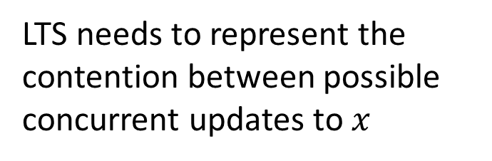
Interleaved Transition System
LTS needs to represent the contention between possible concurrent updates to $x$
Figures copied from the Principles of Model Checking book by Baier and Katoen

Slide 33
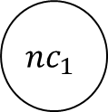

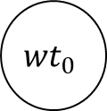


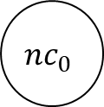




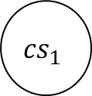
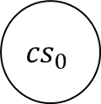
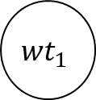

Mutual Exclusion using Peterson’s algorithm
$$PG_{0}$$
$$PG_{1}$$
$$nc_{0}$$
$$nc_{1}$$
$$wantCS_{0}≔1;$$
$$turn≔1$$
$$wantCS_{1}≔1;$$
$$turn≔0$$
$$wantCS_{0}≔0$$
$${wt}_{0}$$
$$wantCS_{1}≔0$$
$${wt}_{1}$$
$$\left(wantCS_{1}=0\right)∨$$
$$\left(turn=0\right)$$
$$\left(wantCS_{0}=0\right)∨$$
$$\left(turn=1\right)$$
$${cs}_{0}$$
$${cs}_{1}$$
Assignment are either atomic
or strictly in the order shown
For simplicity, we will assume that they are atomic to construct $TS\left(PG_{0}⦀PG_{1}\right)$

Slide 34

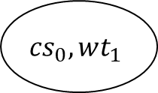




















$$PG_{0}⦀PG_{1}$$
$$nc_{0},nc_{1}$$
$$wantCS_{0}≔0$$
$$wantCS_{0}≔1;$$
$$turn≔1$$
$$wantCS_{1}≔1;$$
$$turn≔0$$
$$wantCS_{1}≔0$$
$${cs}_{0},nc_{1}$$
$$\left(wantCS_{0}=0\right)∨$$
$$\left(turn=1\right)$$
$${wt}_{0},nc_{1}$$
$${nc}_{0},wt_{1}$$
$$\left(wantCS_{1}=0\right)∨$$
$$\left(turn=0\right)$$
$${nc}_{0},cs_{1}$$
$$wantCS_{1}≔1;$$
$$turn≔0$$
$$wantCS_{0}≔1;$$
$$turn≔0$$
$${wt}_{0},wt_{1}$$
$$\left(wantCS_{0}=0\right)∨$$
$$\left(turn=1\right)$$
$$\left(wantCS_{1}=0\right)∨$$
$$\left(turn=0\right)$$
$${cs}_{0},wt_{1}$$
$$wt_{0},cs_{1}$$
$$\left(wantCS_{1}=0\right)∨$$
$$\left(turn=0\right)$$
$$\left(wantCS_{0}=0\right)∨$$
$$\left(turn=1\right)$$
$$wantCS_{1}≔0$$
$$wantCS_{0}≔0$$
$${cs}_{0},cs_{1}$$

Slide 35













Constructing $TS(PG_{0}⦀PG_{1})$
State: $⟨ℓ_{0},ℓ_{1},val\left({wantCS}_{0},{wantCS}_{1},turn\right)⟩$
$$nc_{0},nc_{1}$$
$$⟨nc_{0},nc_{1},0,0,1⟩$$
$$⟨nc_{0},nc_{1},0,0,0⟩$$
$$wantCS_{0}≔1;$$
$$turn≔1$$
$$wantCS_{1}≔1;$$
$$turn≔0$$
$$⟨wt_{0},nc_{1}1,0,1⟩$$
$$⟨nc_{0},wt_{1},0,1,0⟩$$
$${wt}_{0},nc_{1}$$
$${nc}_{0},wt_{1}$$
$$wantCS_{1}≔1;$$
$$turn≔0$$
$$wantCS_{0}≔1;$$
$$turn≔1$$
$${wt}_{0},wt_{1}$$
$$⟨wt_{0},wt_{1},1,1,0⟩$$
$$⟨wt_{0},wt_{1},1,1,1⟩$$

Slide 36



















Interleaved Transition System
State: $⟨ℓ_{0},ℓ_{1},val\left({wantCS}_{0},{wantCS}_{1},turn\right)⟩$
$$⟨nc_{0},nc_{1},0,0,1⟩$$
$$⟨nc_{0},nc_{1},0,0,0⟩$$
$${wt}_{0},wt_{1}$$
$$⟨wt_{0},nc_{1}1,0,1⟩$$
$$\left(wantCS_{0}=0\right)∨$$
$$\left(turn=1\right)$$
$$\left(wantCS_{1}=0\right)∨$$
$$\left(turn=0\right)$$
$$⟨nc_{0},wt_{1},0,1,0⟩$$
$${cs}_{0},wt_{1}$$
$$wt_{0},cs_{1}$$
$$\left(wantCS_{1}=0\right)∨$$
$$\left(turn=1\right)$$
$$\left(wantCS_{0}=0\right)∨$$
$$\left(turn=0\right)$$
$$⟨wt_{0},wt_{1},1,1,0⟩$$
$$⟨wt_{0},wt_{1},1,1,1⟩$$
$${cs}_{0},cs_{1}$$
Guard not satisfied, so we cannot have the red/green transitions in $TS$
$$⟨wt_{0},cs_{1},1,1,0⟩$$
$$⟨cs_{0},wt_{1},1,1,1⟩$$
$$⟨cs_{0},cs_{1},1,1,0⟩$$
$$⟨cs_{0},cs_{1},1,1,1⟩$$

Slide 37
Interleaved Transition System
State: $⟨ℓ_{0},ℓ_{1},val\left({wantCS}_{0},{wantCS}_{1},turn\right)⟩$
$$⟨nc_{0},nc_{1},0,0,1⟩$$
$$⟨nc_{0},nc_{1},0,0,0⟩$$
$${wt}_{0},wt_{1}$$
$$⟨wt_{0},nc_{1}1,0,1⟩$$
$$\left(wantCS_{0}=0\right)∨$$
$$\left(turn=1\right)$$
$$\left(wantCS_{1}=0\right)∨$$
$$\left(turn=0\right)$$
$$⟨nc_{0},wt_{1},0,1,0⟩$$
$${cs}_{0},wt_{1}$$
$$wt_{0},cs_{1}$$
$$\left(wantCS_{1}=0\right)∨$$
$$\left(turn=1\right)$$
$$\left(wantCS_{0}=0\right)∨$$
$$\left(turn=0\right)$$
$$⟨wt_{0},wt_{1},1,1,0⟩$$
$$⟨wt_{0},wt_{1},1,1,1⟩$$
$${cs}_{0},cs_{1}$$
Guard not satisfied, so we cannot have the red/green transitions in $TS$
$$⟨wt_{0},cs_{1},1,1,0⟩$$
$$⟨cs_{0},wt_{1},1,1,1⟩$$
$$⟨cs_{0},cs_{1},1,1,0⟩$$
$$⟨cs_{0},cs_{1},1,1,1⟩$$

Slide 38







Final $TS\left(PG_{0}⦀PG_{1}\right)$: Peterson’s mutual exclusion algorithm!
$$⟨nc_{0},nc_{1},0,0,1⟩$$
$$⟨nc_{0},nc_{1},0,0,0⟩$$
$$⟨cs_{0},nc_{1}1,0,1⟩$$
$$⟨wt_{0},nc_{1}1,0,1⟩$$
$$⟨nc_{0},wt_{1},0,1,0⟩$$
$$⟨nc_{0},cs_{1},0,1,0⟩$$
$$⟨wt_{0},wt_{1},1,1,0⟩$$
$$⟨wt_{0},wt_{1},1,1,1⟩$$
$$⟨cs_{0},wt_{1},1,1,0⟩$$
$$⟨wt_{0},cs_{1},1,1,1⟩$$

Slide 39

Other kinds of concurrency
Shared memory program: each process evolves asynchronously
Handshaking :
Set of handshake actions are identified
TSs interact only if they both execute the same handshake action
Channel systems (buffer-based communication) :
A FIFO buffer $c$maintained to store messages
Each $PG$ extended with communication actions:
$c!val$: Transmit value $val$ on channel $c$
$c?x$ : Receive the value from channel c into variable $x$
If you fix channel capacity to $0$, you can model handshake
If channel capacity is greater than $0$, then you can model asynchronous message passing

Slide 40

State space explosion
Number of states in an LTS for a program $PG_{i}$:
$$\left|Loc\right|⋅\prod_{x∈Var_{i}}{{|D}_{x}| }$$
Number of states grows exponentially in the number of program variables!
Each program variable’s domain might be quite large
Concurrency makes things worse: number of states is exponential in the number of concurrent components
Channels add state (many of them)!
Unbounded channels, unbounded variables, complex data structures = potentially infinite state space
How do we reason about such LTSs?

Slide 41
Ameliorating State Explosion
Many different strategies
Abstracting away data if it is not necessary to compute the structure of the LTS
Finding ways to reduce the size of the LTS (by exploiting its structure)
Finding ways to bound how many different program behaviors to consider
Abstract interpretation of data variables
Abstraction-Refinement
Parameterized verification
We will inspect some of these through this course

Slide 42
What will this lecture cover?
Labelled Transition Systems
Compositions of LTSs
Properties of LTSs

