Slide 1
Theory and Algorithms for Formal Verification
Linear Temporal Logic
Spring 2024: CSCI 624
Instructor: Jyo Deshmukh

Slide 2
Outline
LTL Syntax and Semantics
  LTL with past
LTL Examples
LTL Equivalences
Automata-based model checking for LTL
  LTL to GNBA
Complexity of LTL model checking
LTL satisfiability

Slide 3
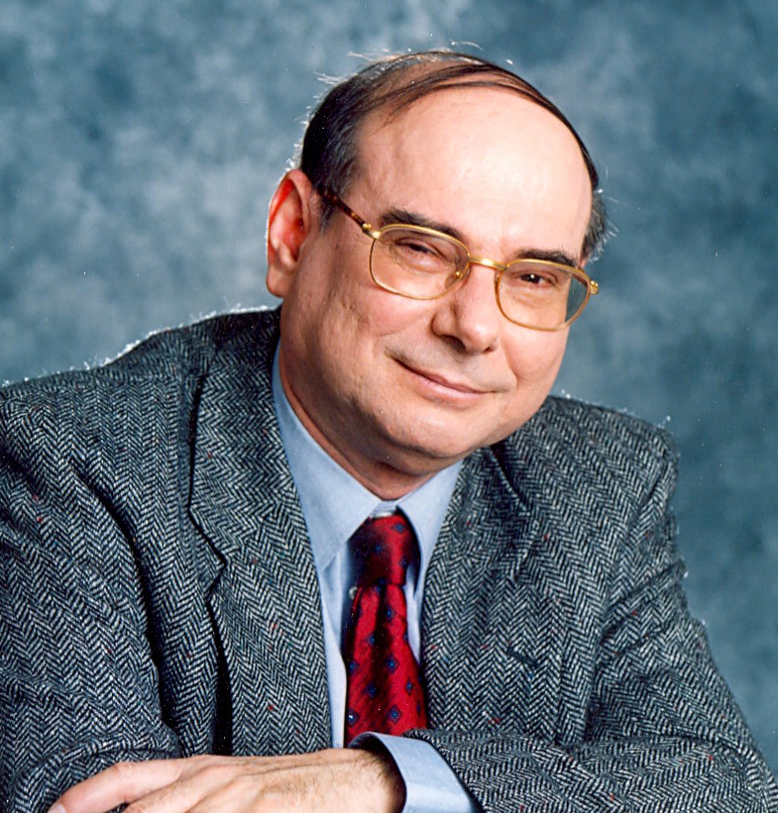
Temporal Logic
(Propositional) Temporal Logic (literally logic of time): specify finite and infinite sequences of Boolean propositions using logical formulae
Grew out of philosophy (tense logic and modal logic)
Amir Pnueli in 1977 used a form of temporal logic for expressing specifications of reactive systems
Won the 1996 Turing Award
Now part of PSL (property specification language, an IEEE standard used in the EDA industry)
Increasingly popular in Robotics, Reinforcement Learning domain to express high-level task objectives
1941-2009

Slide 4
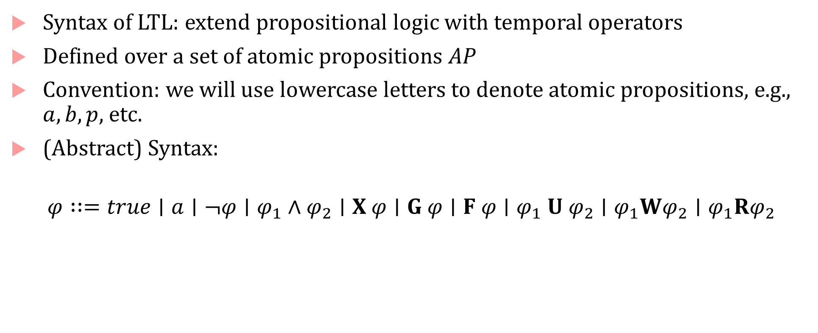
LTL Syntax
Syntax of LTL: extend propositional logic with temporal operators
Defined over a set of atomic propositions $AP$
Convention: we will use lowercase letters to denote atomic propositions, e.g., $a,b,p,$ etc.
(Abstract) Syntax:
$$φ∷=true∣a∣¬φ∣φ_{1}∧φ_{2}∣X φ∣G φ∣F φ∣φ_{1} U φ_{2}∣φ_{1}Wφ_{2}∣φ_{1}Rφ_{2}$$

Slide 5
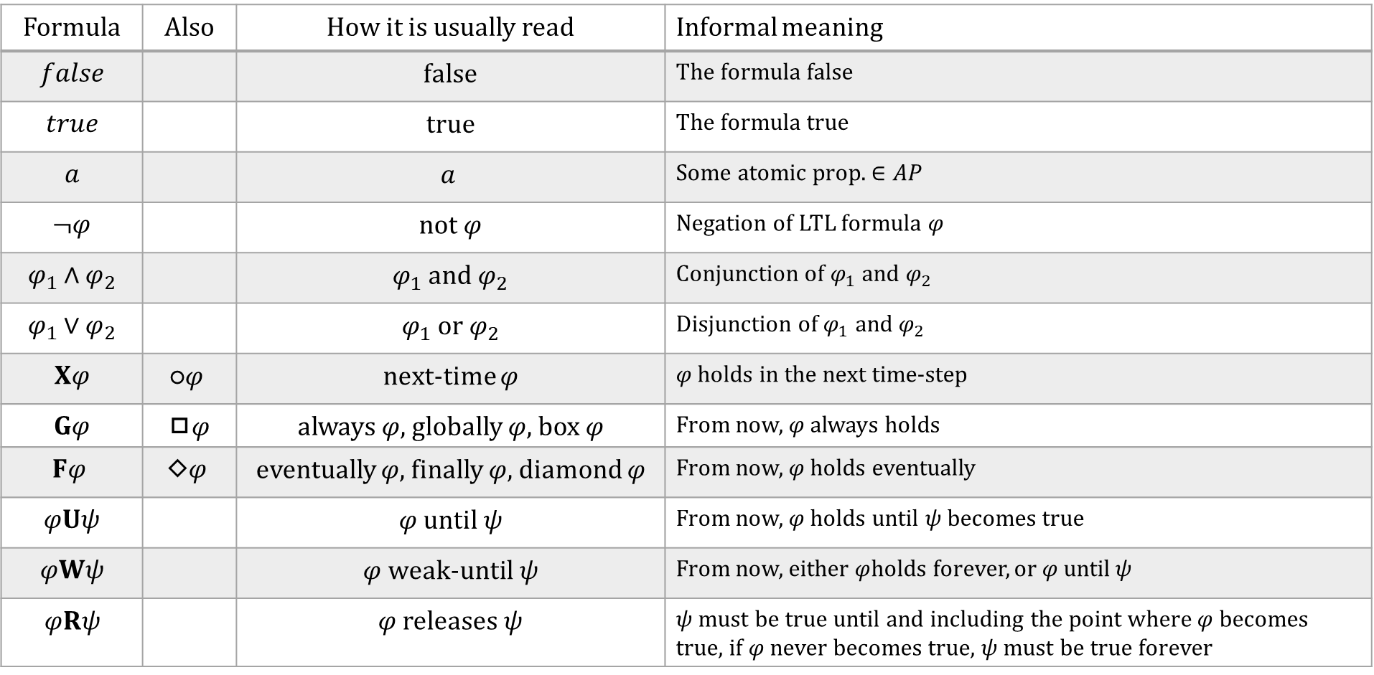
Syntax : English descriptions
Formula | Also | How it is usually read | Informal meaning
$$false$$ |  | false | The formula false
$$true$$ |  | true | The formula true
$$a$$ |  | $$a$$ | Some atomic prop. $∈AP$
$$¬φ$$ |  | not $φ$ | Negation of LTL formula $φ$
$$φ_{1}∧φ_{2}$$ |  | $φ_{1}$ and $φ_{2}$ | Conjunction of $φ_{1}$ and $φ_{2}$
$$φ_{1}∨φ_{2}$$ |  | $φ_{1}$ or $φ_{2}$ | Disjunction of $φ_{1}$ and $φ_{2}$
$$Xφ$$ | $$\text{○}φ$$ | next-time $φ$ | $φ$ holds in the next time-step
$$Gφ$$ | ◻$φ$ | always $φ,$globally $φ$, box $φ$ | From now, $φ$ always holds
$$Fφ$$ | $$\text{◇}φ$$ | eventually $φ$, finally $φ$, diamond $φ$ | From now, $φ$ holds eventually
$$φUψ$$ |  | $φ$ until$ψ$ | From now, $φ$ holds until $ψ$ becomes true
$$φWψ$$ |  | $φ$weak-until$ψ$ | From now, either $φ$holds forever, or $φ$ until$ψ$
$$φRψ$$ |  | $φ$ releases$ψ$ | $ψ$ must be true until and including the point where $φ$ becomes true, if $φ$ never becomes true, $ψ$ must be true forever

Slide 6
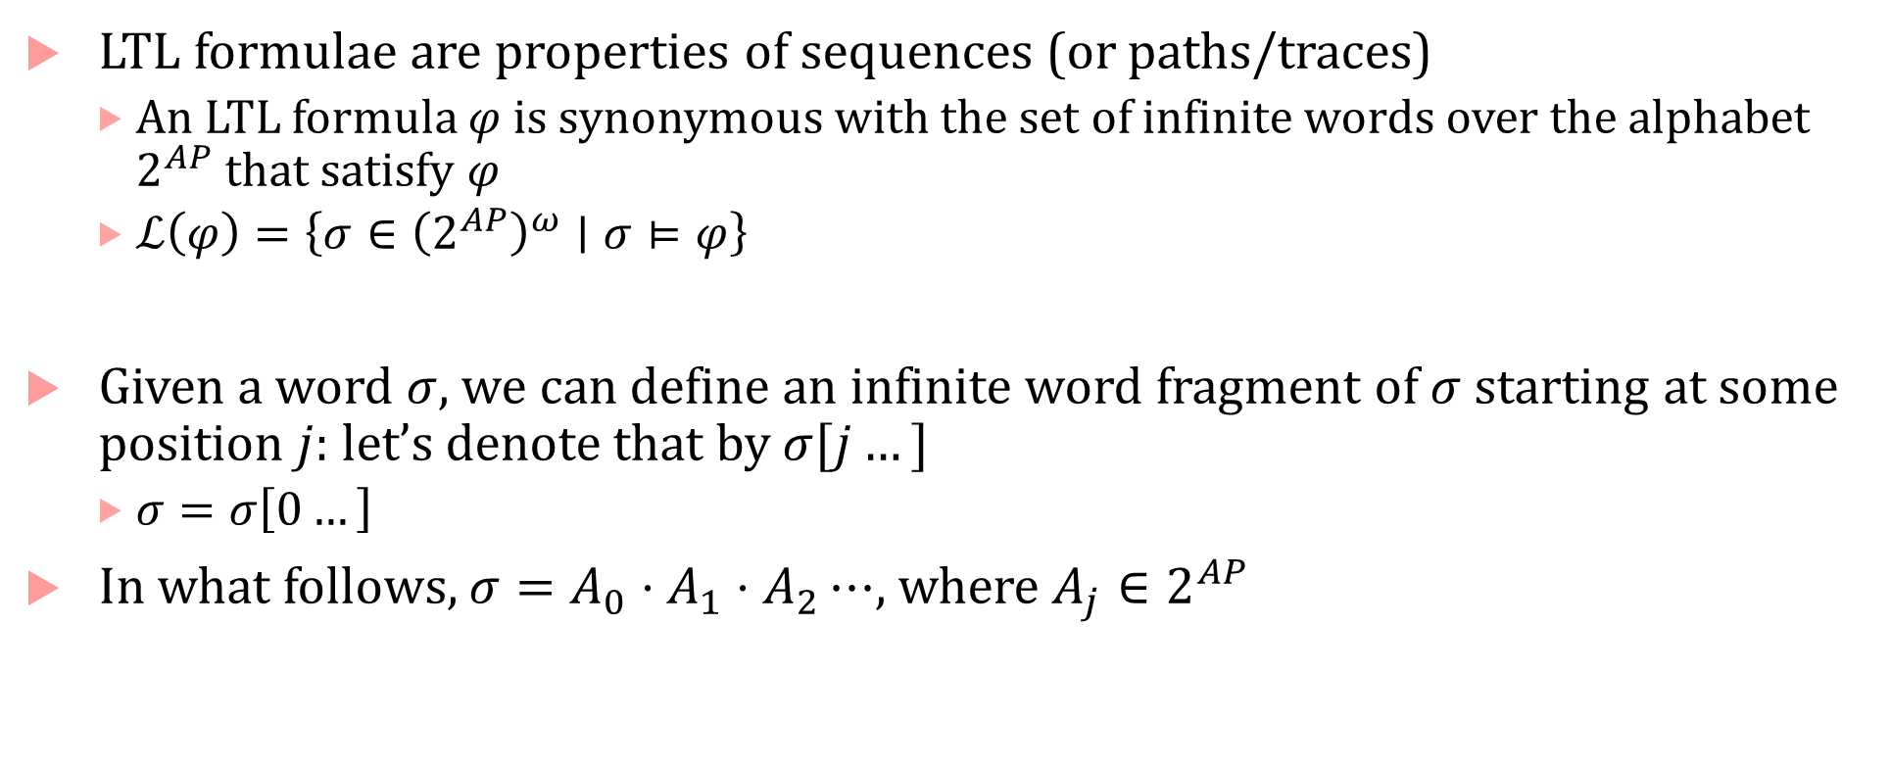
Infinite words and infinite word fragments
LTL formulae are properties of sequences (or paths/traces)
  An LTL formula $φ$ is synonymous with the set of infinite words over the alphabet $2^{AP}$ that satisfy $φ$
  $ℒ\left(φ\right)=\left\{σ∈{\left(2^{AP}\right)}^{ω}∣σ⊨φ\right\}$
Given a word $σ$, we can define an infinite word fragment of $σ$ starting at some position $j$: let’s denote that by $σ[j…]$
  $σ=σ\left[0…\right]$
In what follows, $σ=A_{0}⋅A_{1}⋅A_{2}⋯$, where $A_{j}∈2^{AP}$

Slide 7

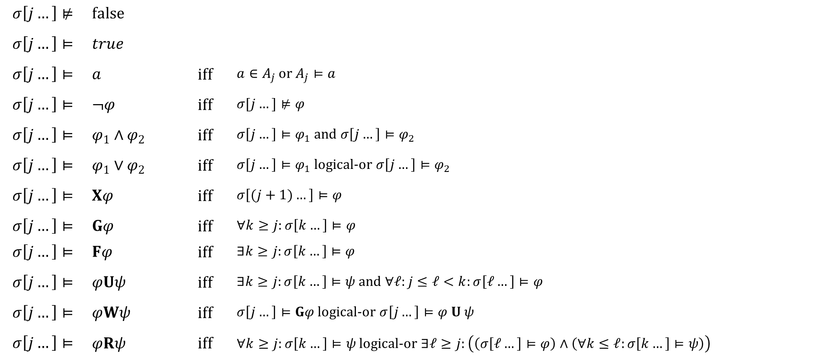
Formal semantics of LTL
When we say $σ⊨φ$, it means $σ\left[0…\right]⊨φ$
$$σ\left[j…\right]⊭$$ | $$false$$
$$σ\left[j…\right]⊨$$ | $$true$$
$$σ\left[j…\right]⊨$$ | $$a$$ | iff | $a∈A_{j}$ or $A_{j}⊨a$
$$σ\left[j…\right]⊨$$ | $$¬φ$$ | iff | $$σ[j…]⊭φ$$
$$σ\left[j…\right]⊨$$ | $$φ_{1}∧φ_{2}$$ | iff | $σ\left[j…\right]⊨φ_{1}$ and $σ\left[j…\right]⊨φ_{2}$
$$σ\left[j…\right]⊨$$ | $$φ_{1}∨φ_{2}$$ | iff | $σ\left[j…\right]⊨φ_{1}$ logical-or $σ\left[j…\right]⊨φ_{2}$
$$σ\left[j…\right]⊨$$ | $$Xφ$$ | iff | $$σ\left[(j+1)…\right]⊨φ$$
$$σ\left[j…\right]⊨$$ | $$Gφ$$ | iff | $∀k≥j:σ\left[k…\right]⊨φ$
$$σ\left[j…\right]⊨$$ | $$Fφ$$ | iff | $∃k≥j:σ\left[k…\right]⊨φ$
$$σ\left[j…\right]⊨$$ | $$φUψ$$ | iff | $∃k≥j:σ\left[k…\right]⊨ψ$ and $∀ℓ:j≤ℓ<k:σ\left[ℓ…\right]⊨φ$
$$σ\left[j…\right]⊨$$ | $$φWψ$$ | iff | $σ\left[j…\right]⊨Gφ$ logical-or $σ\left[j…\right]⊨φ U ψ$
$$σ\left[j…\right]⊨$$ | $$φRψ$$ | iff | $∀k≥j:σ\left[k…\right]⊨ψ$ logical-or $∃ℓ≥j:\left(\left(σ\left[ℓ…\right]⊨φ\right)∧\left(∀k≤ℓ:σ\left[k…\right]⊨ψ\right)\right)$

Slide 8








LTL Semantics examples
0
1
2
3
4
42
$$⋯$$
$$¬p$$
$$p$$
$$¬p$$
$$¬p$$
$$¬p$$
$$p$$
$σ⊨Xp$
  $σ\left[0…\right]⊨Xp$
  $σ\left[1…\right]⊨p$

Slide 9
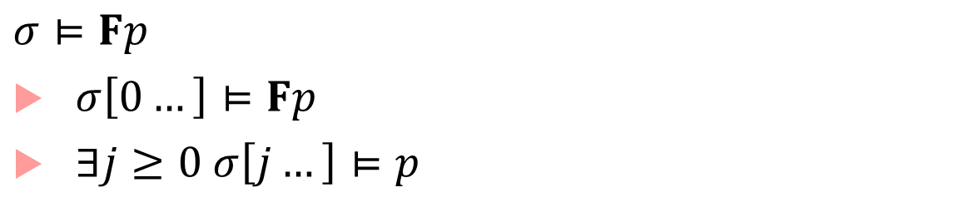



























LTL Semantics examples
0
1
2
3
4
$$⋯$$
42
$$⋯$$
$$j=42$$
$$¬p$$
$$¬p$$
$$¬p$$
$$¬p$$
$$¬p$$
$$p$$
0
1
2
3
4
$$⋯$$
42
$$⋯$$
$$j=0$$
$$p$$
$$¬p$$
$$p$$
$$¬p$$
$$¬p$$
$$p$$
0
1
2
3
4
$$⋯$$
42
$$⋯$$
$$j=1$$
$$¬p$$
$$p$$
$$¬p$$
$$¬p$$
$$¬p$$
$$p$$
$$σ⊨Fp$$
$σ\left[0…\right]⊨Fp$
$∃j≥0 σ\left[j…\right]⊨p$

Slide 10


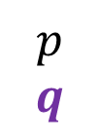



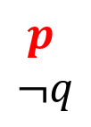
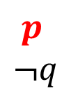




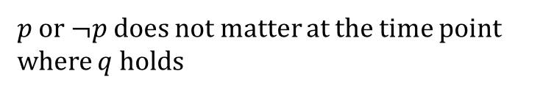



LTL Semantics examples
$σ⊨Gp$
0
1
2
3
4
$$⋯$$
42
$$⋯$$
$$p$$
$$p$$
$$p$$
$$p$$
$$p$$
$$p$$
$σ⊨pUq$
0
1
2
3
4
$$⋯$$
42
$$⋯$$
$$p$$
$$¬q$$
$$p$$
$$¬q$$
$$p$$
$$¬q$$
$$p$$
$$¬q$$
$$p$$
$$q$$
$p$ or $¬p$does not matter at the time point where $q$holds

Slide 11
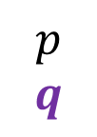
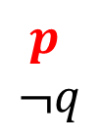


LTL Semantics examples
$σ\left[0…\right]⊨pWq$
0
1
2
3
4
$$⋯$$
42
$$⋯$$
$$p$$
$$p$$
$$p$$
$$p$$
$$p$$
$$p$$
0
1
2
3
4
$$⋯$$
42
$$⋯$$
$$p$$
$$¬q$$
$$p$$
$$¬q$$
$$p$$
$$¬q$$
$$p$$
$$¬q$$
$$p$$
$$q$$

Slide 12

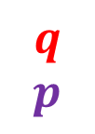

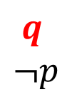



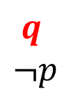



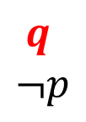
LTL Semantics examples
$σ\left[0…\right]⊨pRq$
0
1
2
3
4
$$⋯$$
42
$$⋯$$
$$q$$
$$q$$
$$q$$
$$q$$
$$q$$
$$q$$
0
1
2
3
4
$$⋯$$
42
$$⋯$$
$$q$$
$$¬p$$
$$q$$
$$¬p$$
$$q$$
$$¬p$$
$$q$$
$$¬p$$
$$q$$
$$p$$
$q$ must hold the time point where $p$holds

Slide 13





LTL: nested operators
$σ\left[0…\right]⊨φ U ψ$
0
1
2
3
4
$$⋯$$
42
$$⋯$$
$$σ\left[0…\right]⊨φ$$
and
$$σ\left[1…\right]⊨φ$$
and
$$σ\left[2…\right]⊨φ$$
and
$$σ\left[3…\right]⊨φ$$
and
$$σ\left[4…\right]⊨ψ$$

Slide 14

Interpreting nested formulas
$GF p$
  $∀i≥0:∃j≥i:σ\left[j…\right]⊨p$
$FG p$
  $∃i≥0:∀j≥i:σ\left[j…\right]⊨p$
$G\left(p⇒Fq\right)$
  $∀i≥0 :\left(σ\left[i…\right]⊨p∧\left(∃j≥i :\left(σ\left[j…\right]⊨q\right)\right)\right)$

Slide 15

Interpreting nested formulas
$GF p$
  Infinitely often $p$
  $GFφ$ also denoted $\overset{∞}{F}φ$ (contrast with $\overset{∞}{∃}$)
$FG p$
  Eventually always $p$
  $FGφ$ also denoted $\overset{∞}{G}φ$ (contrast with $\overset{∞}{∀}$)
$G\left(p⇒Fq\right)$
  Whenver $p$, eventually $q$

Slide 16

Some other interesting formulas
$\bigvee_{q∈α}{\overset{∞}{F} q}$
Büchi condition!
Let $ℱ=\left(α_{1},…, α_{k}\right)$
$\text{Generalized} \text{B}\text{ü}\text{chi} \text{condition}$: $\overset{∞}{F} α_{1}∧\overset{∞}{F} α_{2}∧⋯∧\overset{∞}{F} α_{k}$
Muller condition: $\left(\bigwedge_{q∈α_{1}}{\overset{∞}{F}q}\right)∨⋯∨\left(\bigwedge_{q∈α_{k}}{\overset{∞}{F}q}\right)$

Slide 17
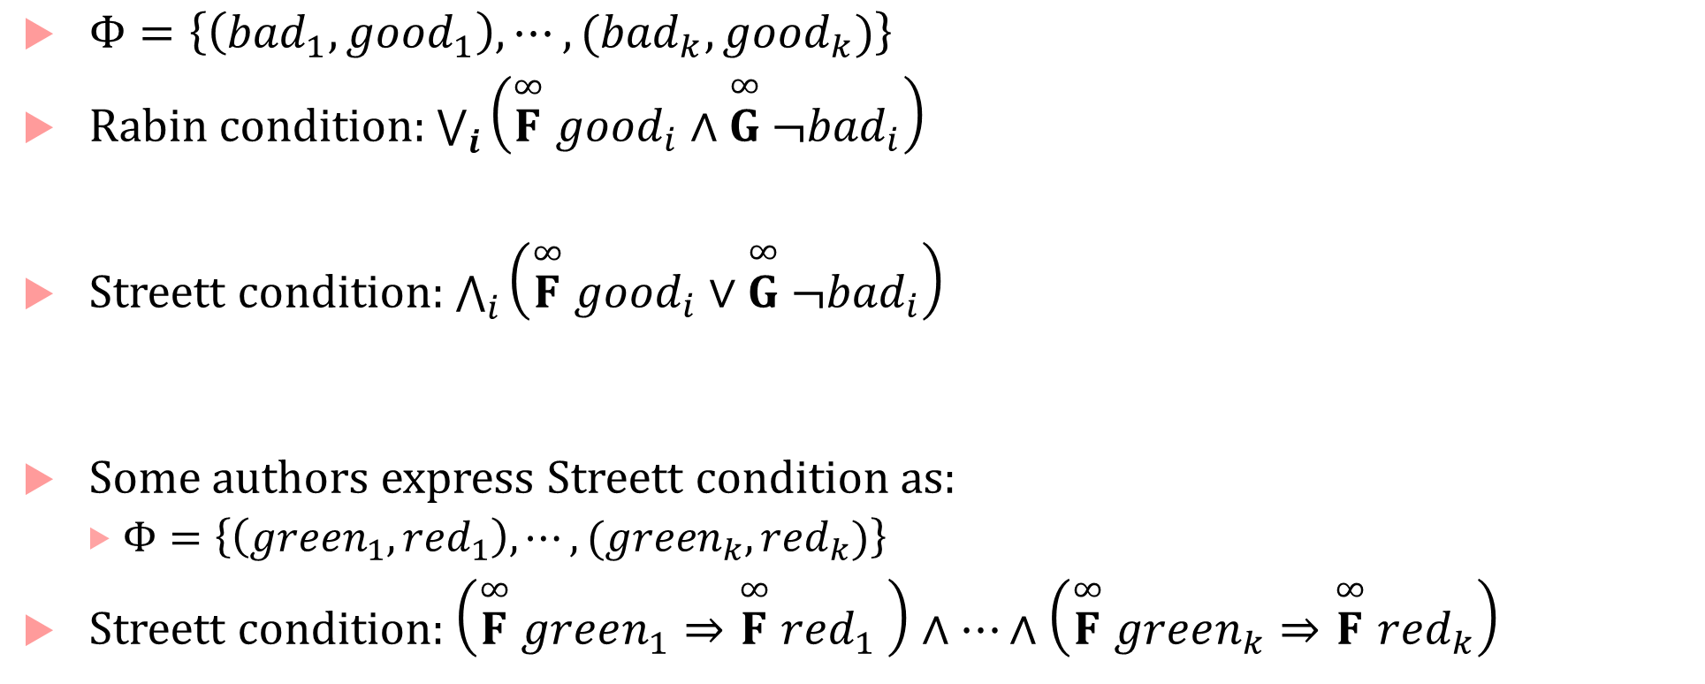
More formulas
$Φ=\left\{\left({bad}_{1},{good}_{1}\right),⋯,({bad}_{k},{good}_{k})\right\}$
Rabin condition: $\bigvee_{i}{\left(\overset{∞}{F} {good}_{i}∧\overset{∞}{G} ¬{bad}_{i}\right)}$
Streett condition: $\bigwedge_{i}{\left(\overset{∞}{F} {good}_{i}∨\overset{∞}{G} ¬{bad}_{i}\right)}$
Some authors express Streett condition as:
  $Φ=\left\{\left({green}_{1},{red}_{1}\right),⋯,({green}_{k},{red}_{k})\right\}$
Streett condition: $\left(\overset{∞}{F} green_{1}⇒\overset{∞}{F} {red}_{1} \right)∧⋯∧\left(\overset{∞}{F} green_{k}⇒\overset{∞}{F} red_{k}\right)$

Slide 18
Mutual Exclusion
Liveness
Fairness
  Strong fairness
  Weak fairness
  Unconditional fairness

Slide 19
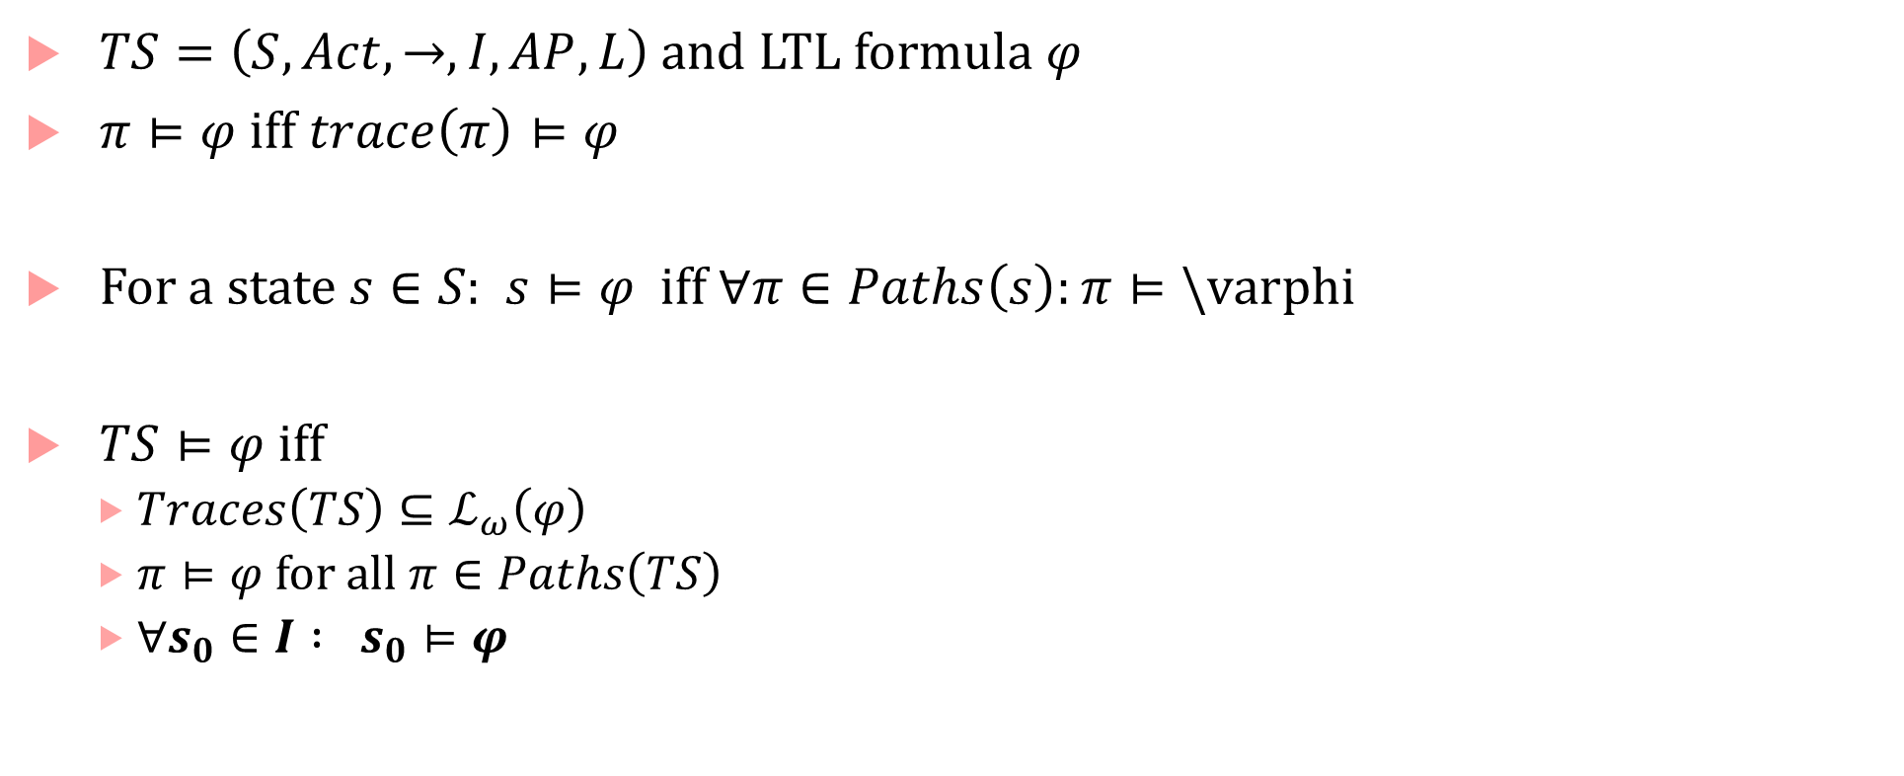
Semantics of LTL over LTS
$TS=\left(S,Act,→,I,AP,L\right)$ and LTL formula $φ$
$π⊨φ$ iff $trace\left(π\right)⊨φ$
For a state $s∈S:$ $s⊨φ$ iff $∀π∈Paths\left(s\right):π⊨\backslash varphi$
$TS⊨φ$ iff
  $Traces\left(TS\right)⊆ℒ_{ω}\left(φ\right)$
  $π⊨φ$ for all $π∈Paths\left(TS\right)$
  $∀s_{0}∈I : s_{0}⊨φ$

Slide 20

LTL Equivalences: Duality
Theorems
$¬Gφ≡F¬φ$
$¬Fφ≡G¬φ$
$¬Xφ ≡X¬φ$
$¬\left(φ U ψ\right)=¬ψ R ¬φ$
$¬\left(φ R ψ\right)=¬ψ U ¬φ$

Slide 21

Related to duality
$φ W ψ≡\left(φ U ψ\right)∨G φ$
$¬\left(φ U ψ\right)≡\left(φ∧¬ψ\right)W \left(¬φ∧¬ψ\right)$
$¬\left(φ W ψ\right)≡\left(φ∧¬ψ\right)U \left(¬φ∧¬ψ\right)$

Slide 22

LTL Equivalences: Idempotency
$FFφ≡Fφ$
$GGφ≡GGφ$
$φ U (φ U ψ)≡φ U ψ$
$\left(φ U ψ\right) U ψ≡φ U ψ$

Slide 23

Absorption laws
$FGF φ≡GF φ$
$GFG φ≡FG φ$
$Fφ≡ φ∨XFφ$
$Gφ≡φ∧ XGφ$
$φ U ψ≡ψ∨\left(φ∧X \left(φ U ψ\right)\right)$
$φ R ψ ≡$ $ψ∧\left(φ∨X \left(φ R ψ\right)\right)$
$φ W ψ ≡$ $ψ∨\left(φ∧X \left(φ W ψ\right)\right)$

Slide 24

Distributive laws
$X \left(φ U ψ\right)≡\left(Xφ\right) U \left(Xψ\right)$
$F\left(φ∨ψ\right) \overset{?}{≡} Fφ∨Fψ$
$G\left(φ∨ψ\right)\overset{?}{≡} Gφ∨Gψ$
$F\left(φ∧ψ\right) \overset{?}{≡} Fφ∧Fψ$
$G\left(φ∧ψ\right)\overset{?}{≡} Gφ∧Gψ$

Slide 25

Proofs
Prove or disprove: $F\left(φ∨ψ\right) ⇒Fφ∨F ψ$
It is true
Prove or disprove: $F\left(φ∨ψ\right)⇐Fφ∨F ψ$
It is true
So, $F\left(φ∨ψ\right)≡Fφ∨F ψ$

Slide 26

Proofs
Prove or disprove: $G\left(φ∨ψ\right)⇐Gφ∨G ψ$
It is true
Prove or disprove: $G\left(φ∨ψ\right) ⇒Gφ∨Gψ$
It is false
So, $G\left(φ∨ψ\right) ≢Gφ∨G ψ$

Slide 27

Recap of distributive rules
$F$ distributes over $∨$, but not $∧$
$G$ distributes over $∧$, but not $∨$
Some more:
1. $φ U \left(ψ_{1}∨ψ_{2}\right)≡\left(φ U ψ_{1}\right)∨(φ U ψ_{2})$
2. $\left(φ_{1}∧φ_{2}\right)U ψ≡\left(φ_{1} U ψ\right)∧(φ_{2} U ψ)$
Similarly for release, weak-until

Slide 28

Expansion laws
$Fφ≡ φ∨XFφ$
$Gφ≡φ∧ XGφ$
$φ U ψ≡ψ∨\left(φ∧X \left(φ U ψ\right)\right)$
$φ R ψ ≡$ $ψ∧\left(φ∨X \left(φ R ψ\right)\right)$
$φ W ψ ≡$ $ψ∨\left(φ∧X \left(φ W ψ\right)\right)$

Slide 29
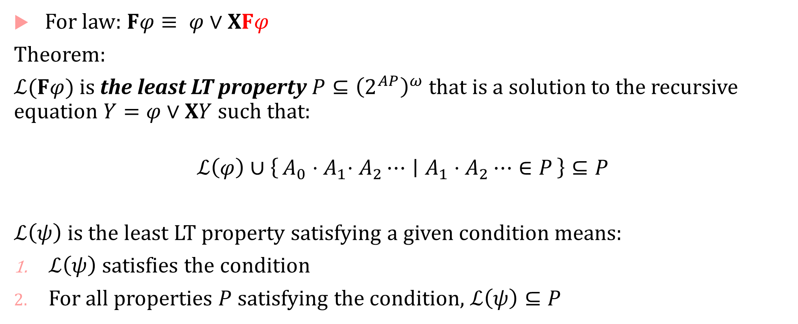
Expansion laws
For law: $Fφ≡ φ∨XFφ$
Theorem:
$ℒ(Fφ)$ is the least LT property $P⊆{\left(2^{AP}\right)}^{ω}$ that is a solution to the recursive equation $Y=φ∨XY$ such that:
$$ℒ\left(φ\right)∪\left\{A_{0}{⋅A}_{1}⋅A_{2}⋯ ∣ A_{1}⋅A_{2}⋯∈P\right\}⊆P$$
$ℒ\left(ψ\right)$ is the least LT property satisfying a given condition means:
$ℒ\left(ψ\right)$ satisfies the condition
For all properties $P$ satisfying the condition, $ℒ\left(ψ\right)⊆P$

Slide 30
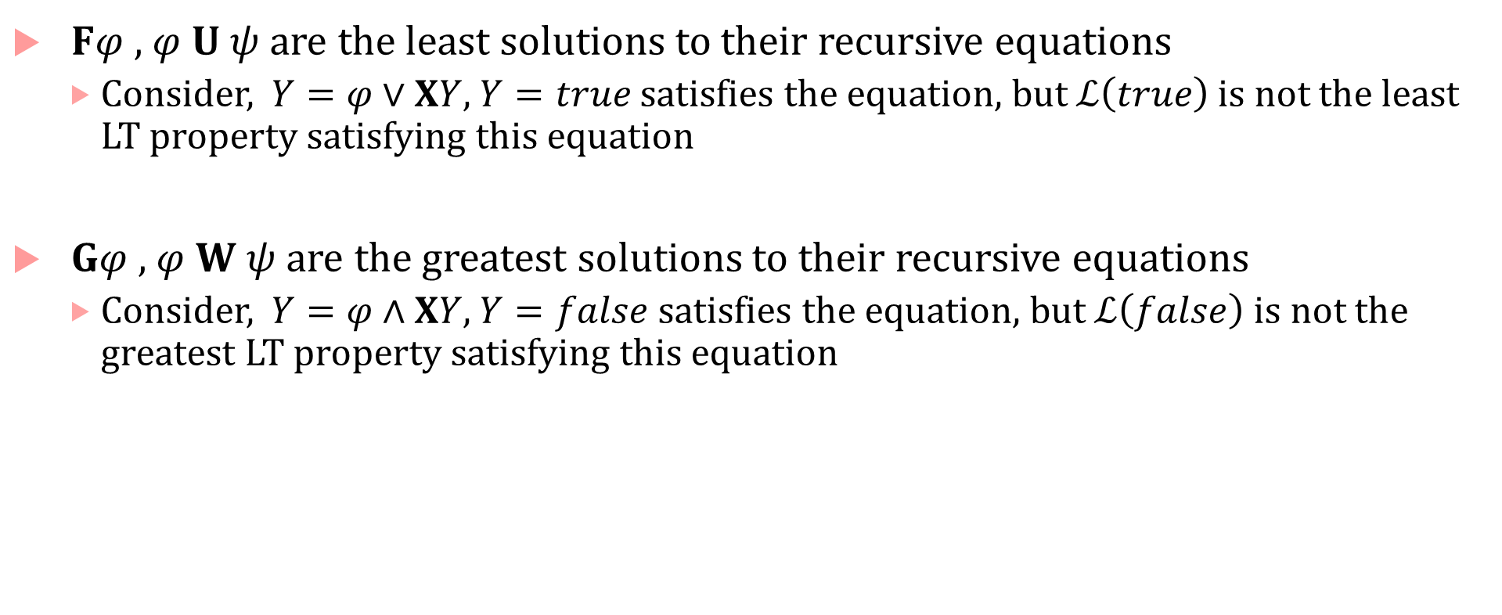
Expansion laws and least/greatest solutions
$Fφ$ , $φ U ψ$ are the least solutions to their recursive equations
  Consider, $Y=φ∨XY$, $Y=true$ satisfies the equation, but $ℒ\left(true\right)$ is not the least LT property satisfying this equation
$Gφ$ , $φ W ψ$ are the greatest solutions to their recursive equations
  Consider, $Y=φ∧XY$, $Y=false$satisfies the equation, but $ℒ\left(false\right)$ is not the greatest LT property satisfying this equation

Slide 31

Redundant operators
$(¬,∧, U)$ are enough to describe all future-tense LTL formulas
$Fφ=true U φ$
$Gφ≡¬F¬φ≡false R φ$
Other operators follow from DeMorgan’s laws

Slide 32
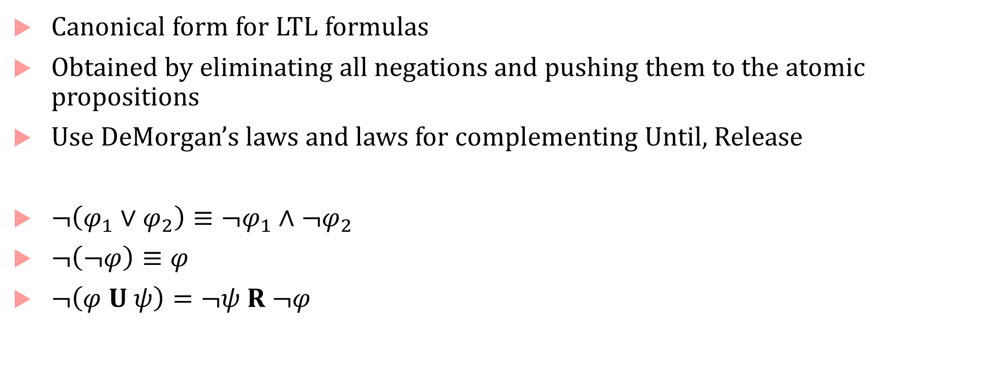
Positive normal form
Canonical form for LTL formulas
Obtained by eliminating all negations and pushing them to the atomic propositions
Use DeMorgan’s laws and laws for complementing Until, Release
$¬\left(φ_{1}∨φ_{2}\right)≡¬φ_{1}∧¬φ_{2}$
$¬\left(¬φ\right)≡φ$
$¬\left(φ U ψ\right)=¬ψ R ¬φ$

Slide 33

PNF for LTL
Two possible grammars (one using weak-until and one using release)
$$φ∷=true \left| false \right| p \left| ¬p \right|φ_{1}∧φ_{2}\left| φ_{1}∨φ_{2} \right| Xφ\left| φ_{1}U φ_{2}\right|φ_{1} R φ_{2}$$
$$φ∷=true \left| false \right| p \left| ¬p \right|φ_{1}∧φ_{2}\left| φ_{1}∨φ_{2} \right| Xφ\left| φ_{1}U φ_{2}\right|φ_{1} W φ_{2}$$

Slide 34

Fairness
Unconditional fairness : $GFφ$
Strong fairness : $\overset{∞}{F}φ⇒\overset{∞}{F}ψ$
  E.g.$φ=(Act\left(s_{j}\right)∈A)$, $ψ=\left(α_{j}∈A\right)$
Weak fairness: $\overset{∞}{G} φ⇒\overset{∞}{F}ψ$

Slide 35
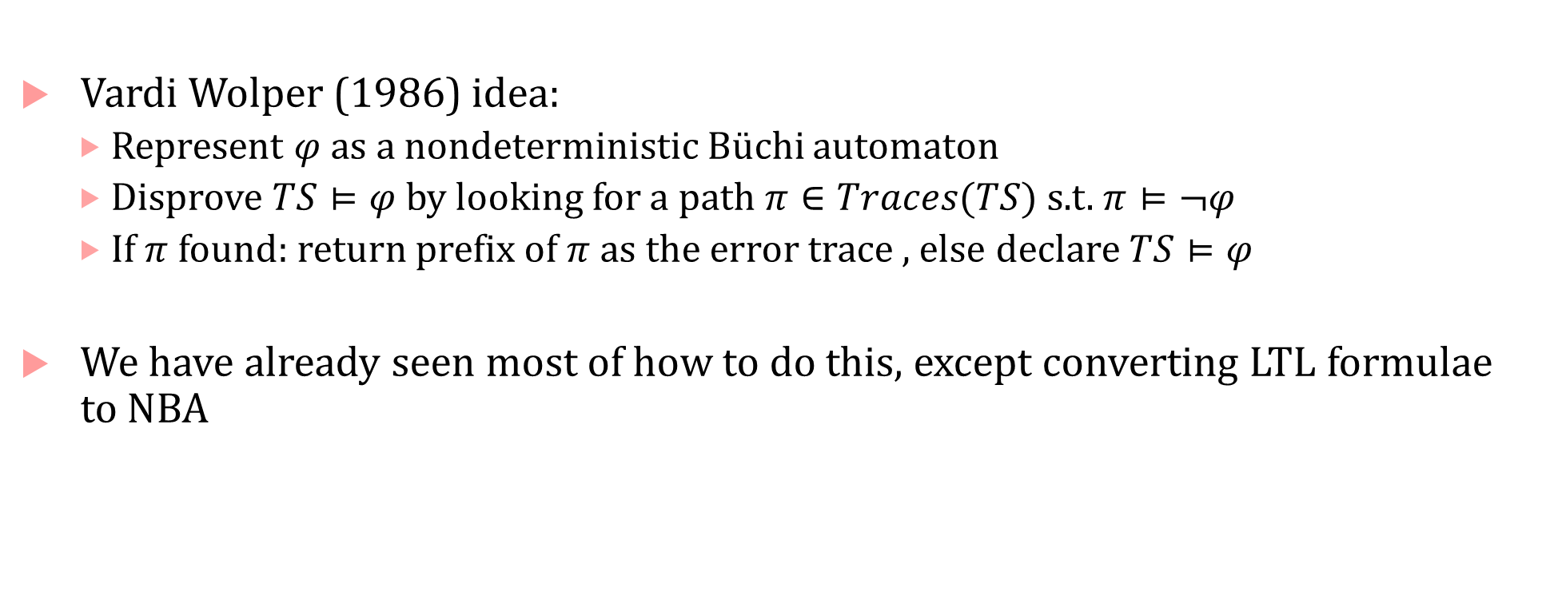
Automata-based LTL model checking
Vardi Wolper (1986) idea:
  Represent $φ$ as a nondeterministic Büchi automaton
  Disprove $TS⊨φ$ by looking for a path $π∈Traces(TS)$ s.t. $π⊨¬φ$
  If $π$ found: return prefix of $π$ as the error trace , else declare $TS⊨φ$
We have already seen most of how to do this, except converting LTL formulae to NBA

Slide 36
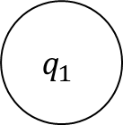


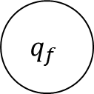
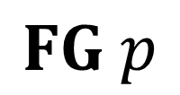


Examples of Büchi automata for LTL formulas
*
$$p$$
$$p$$
$$FG p$$
$$q_{0}$$
$$q_{f}$$
*
$$¬p$$
$$q_{1}$$

Slide 37



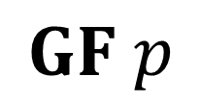

Examples of Büchi automata for LTL formulas
$$¬p$$
$$p$$
$$q_{0}$$
$$p$$
$$q_{f}$$
$$GF p$$
$$¬p$$

Slide 38
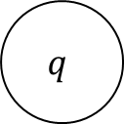
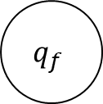

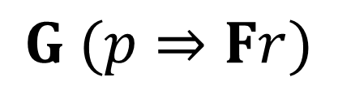


Examples of Büchi automata for LTL formulas
$$¬p$$
$$¬r$$
$$q$$
$$p$$
$$q_{f}$$
$$G (p⇒Fr)$$
$$r$$

Slide 39


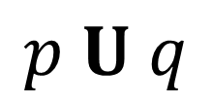


Examples of Büchi automata for LTL formulas
$$p$$
q
$$∗$$
$$q_{0}$$
$$q_{f}$$
$$p U q$$
$$¬p∧¬q$$
*
$$q_{1}$$

Slide 40

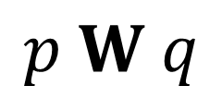
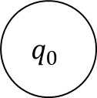
Examples of Büchi automata for LTL formulas
$$p$$
q
$$∗$$
$$q_{0}$$
$$q_{0}$$
$$q_{f}$$
$$p W q$$
$$¬p∧¬q$$
*
$$q_{1}$$

Slide 41
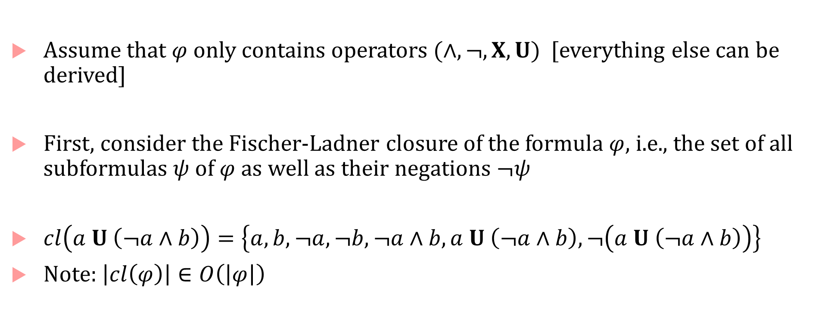
Easier to construct GNBA instead of NBA from LTL formulae
Assume that $φ$ only contains operators $(∧, ¬, X, U)$ [everything else can be derived]
First, consider the Fischer-Ladner closure of the formula $φ$, i.e., the set of all subformulas $ψ$ of $φ$ as well as their negations $¬ψ$
$cl\left(a U \left(¬a∧b\right)\right)=\left\{a,b,¬a,¬b,¬a∧b,a U \left(¬a∧b\right),¬\left(a U \left(¬a∧b\right)\right)\right\}$
Note: $\left|cl\left(φ\right)\right|∈O\left(\left|φ\right|\right)$

Slide 42
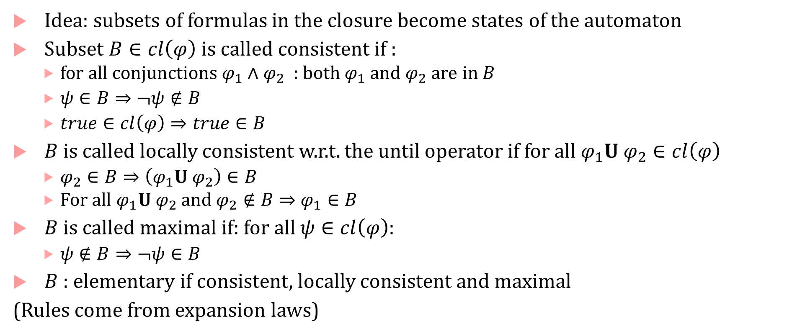
Elementary sets of formulae
Idea: subsets of formulas in the closure become states of the automaton
Subset $B∈cl\left(φ\right)$ is called consistent if :
  for all conjunctions $φ_{1}∧φ_{2}$ : both $φ_{1}$ and $φ_{2}$ are in $B$
  $ψ∈B⇒¬ψ∉B$
  $true∈cl\left(φ\right)⇒true∈B$
$B$ is called locally consistent w.r.t. the until operator if for all $φ_{1}U φ_{2}∈cl\left(φ\right)$
  $φ_{2}∈B⇒\left(φ_{1}U φ_{2}\right)∈B$
  For all $φ_{1}U φ_{2}$ and $φ_{2}∉B⇒$ $φ_{1}∈B$
$B$ is called maximal if: for all $ψ∈cl\left(φ\right)$:
  $ψ∉B⇒¬ψ∈B$
$B$ : elementary if consistent, locally consistent and maximal
(Rules come from expansion laws)

Slide 43

Example
$cl\left(a U \left(¬a∧b\right)\right)=\left\{a,b,¬a,¬b,¬a∧b,a U \left(¬a∧b\right),¬\left(a U \left(¬a∧b\right)\right)\right\}$
$B⊆cl\left(a U \left(¬a∧b\right)\right)=\left\{a,b,a U \left(¬a∧b\right)\right\}$ :
  consistent
  locally consistent
  not maximal $\left(¬a∧b \right)∈cl\left(φ\right)$ but $¬\left(¬a∧b \right)∉B$

Slide 44

Elementary sets of $cl\left(φ\right)$
$cl\left(a U \left(¬a∧b\right)\right)=\left\{a,b,¬a,¬b,¬a∧b,a U \left(¬a∧b\right),¬\left(a U \left(¬a∧b\right)\right)\right\}$
$B_{1}=\left\{a, b, ¬\left(¬a∧b\right), a U \left(¬a∧b\right)\right\}$
$B_{2}=\left\{a, b, ¬\left(¬a∧b\right), ¬\left(a U \left(¬a∧b\right)\right)\right\}$
$B_{3}=\left\{a, ¬b, ¬\left(¬a∧b\right), a U \left(¬a∧b\right)\right\}$
$B_{4}=\left\{a, ¬b, ¬\left(¬a∧b\right), ¬\left(a U \left(¬a∧b\right)\right)\right\}$
$B_{5}=\left\{¬a, ¬b, ¬\left(¬a∧b\right), ¬(a U \left(¬a∧b\right))\right\}$
$B_{6}=\left\{¬a, ¬b, ¬\left(¬a∧b\right),a U \left(¬a∧b\right)\right\}$

Slide 45


Elementary sets to GNBA $A$
$Q$ : set of elementary formulas $B⊆cl\left(φ\right)$
$Q_{0}=\{B∈Q∣φ∈B \}$
$ℱ=\left\{F_{φ_{1}Uφ_{2}} ∣ φ_{1}Uφ_{2}∈cl\left(φ\right)\right\}$
  where $F_{φ_{1}Uφ_{2}}=\left\{B∈Q ∣ φ_{1} U φ_{2}∉B or φ_{2}∈B\right\}$
$δ:Q×2^{AP}→2^{Q}$
  If $A≠B∩AP$: then $δ\left(B,A\right)=∅$
  If $A=B∩AP$: then $δ\left(B,A\right)=\{B^{′}\}$ where:
    For every $Xψ∈cl\left(φ\right)$: $Xψ∈B^{′}⇔ψ∈B′$
    For every $φ_{1} U φ_{2}∈cl\left(φ\right)$:$φ_{1} U φ_{2}∈B$ $⇔\left(φ_{2}∈B∨(φ_{1}∈B∧\left(φ_{1}Uφ_{2}∈B′\right)\right)$
Theorem: $ℒ_{ω}\left(A\right)=ℒ_{ω}\left(φ\right)$

Slide 46


GNBA for $Xa$
$cl\left(Xa\right)=\left\{a,¬a,Xa,¬Xa\right\}$
$B_{1}=\left\{a, Xa\right\}$
$B_{2}=\left\{a, ¬Xa\right\}$
$B_{3}=\left\{¬a, Xa\right\}$
$B_{4}=\left\{¬a, ¬Xa\right\}$
Set $ℱ$ is empty, i.e. every infinite run in $A$ is accepting

Slide 47

NBA from LTL Formula
Recall that for any GNBA we can construct an NBA
Theorem: For any LTL formula $φ$ there exists an NBA $A_{φ}$ s.t. $ℒ_{ω}\left(φ\right)=ℒ_{ω}\left(A\right)$ which can be constructed in time and space $2^{O\left(\left|φ\right|\right)}$
There is a family of LTL formulae $φ_{n}$ with $\left|φ_{n}\right|=O\left(poly\left(n\right)\right)$ such that every NBA for $φ_{n}$ has at least $2^{n}$ states. (Here $X^{i}$ is $XX.. i$ times)
  $$φ_{n}= \bigwedge_{a∈AP}{\bigwedge_{0≤i<n}{\left(X^{i}a≡X^{i+1}a\right)}}$$

Slide 48

LTL vs First-Order Logic
Kamp’s theorem [1968]: LTL with past + future is as expressive as FOLLO (FOL of linear order)
  FOL: first order logic
  FOL over the natural numbers with less-than relation
$(x,t⊨Fp)≡∃t^{′}\left(t<t^{′}∧𝔹_{p}\left(t^{′}\right)\right)$
  $𝔹_{p}$: unary predicate over times $t$ where $p$ is true

Slide 49
Complexity of LTL model checking

